Slide 1
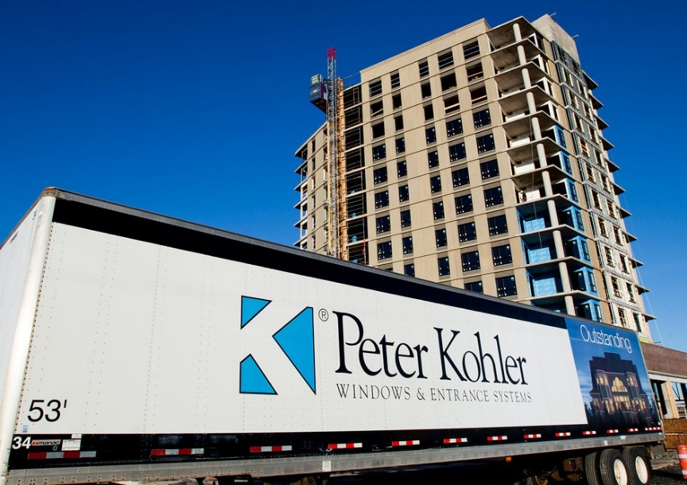
COMMERCIAL SOLUTIONS

Slide 2
Agenda
Commercial Solutions
Commercial Support
Cost
Energy Efficiency
Sustainability
Performance
Colour Options
Glazing Options
Sound Abatement
Available Configurations
Reference Projects

Slide 3
Commercial Support
Commercial Solutions
Architectural/Developer plan review
Assistance to write specifications
Window performance review
Custom engineered solutions
Full range of custom glass options
Extensive structural capabilities

Slide 4
Commercial Support
Commercial Solutions
In-house CAD technicians
Extensive R&D and testing expertise
Quick sample turnaround times
Installation review and training
Logistical and planning support

Slide 5
Typical Product Costs
Commercial Solutions
uPVC Windows
  Fixed White ($13 – $18 psf)
  Fixed Colour ($20 – $25 psf)
  Operating White ($16 – $20 psf)
  Operating Colour ($25 – $29 psf)
uPVC tends to be less expensive than the alternatives

Slide 6
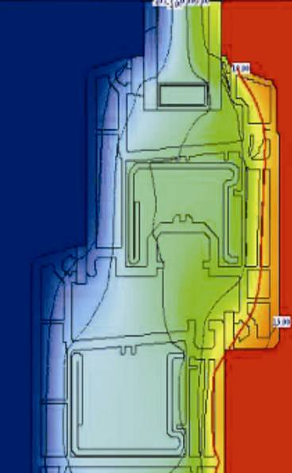
Energy Efficiency
Commercial Solutions
U Values Double Glazed (7036 LoE w Argon)
U Values Triple Glazed (7036 LoE w Argon x 2)
Type | uPVC | Aluminum
Fixed | 1.48 W/m²C | 1.85 W/m²C
Casement | 1.48 W/m²C | 2.56 W/m²C
Type | uPVC | Aluminum
Fixed | 0.85 W/m²C | 1.14 W/m²C
Casement | 0.97 W/m²C | 2.10 W/m²C

Slide 7
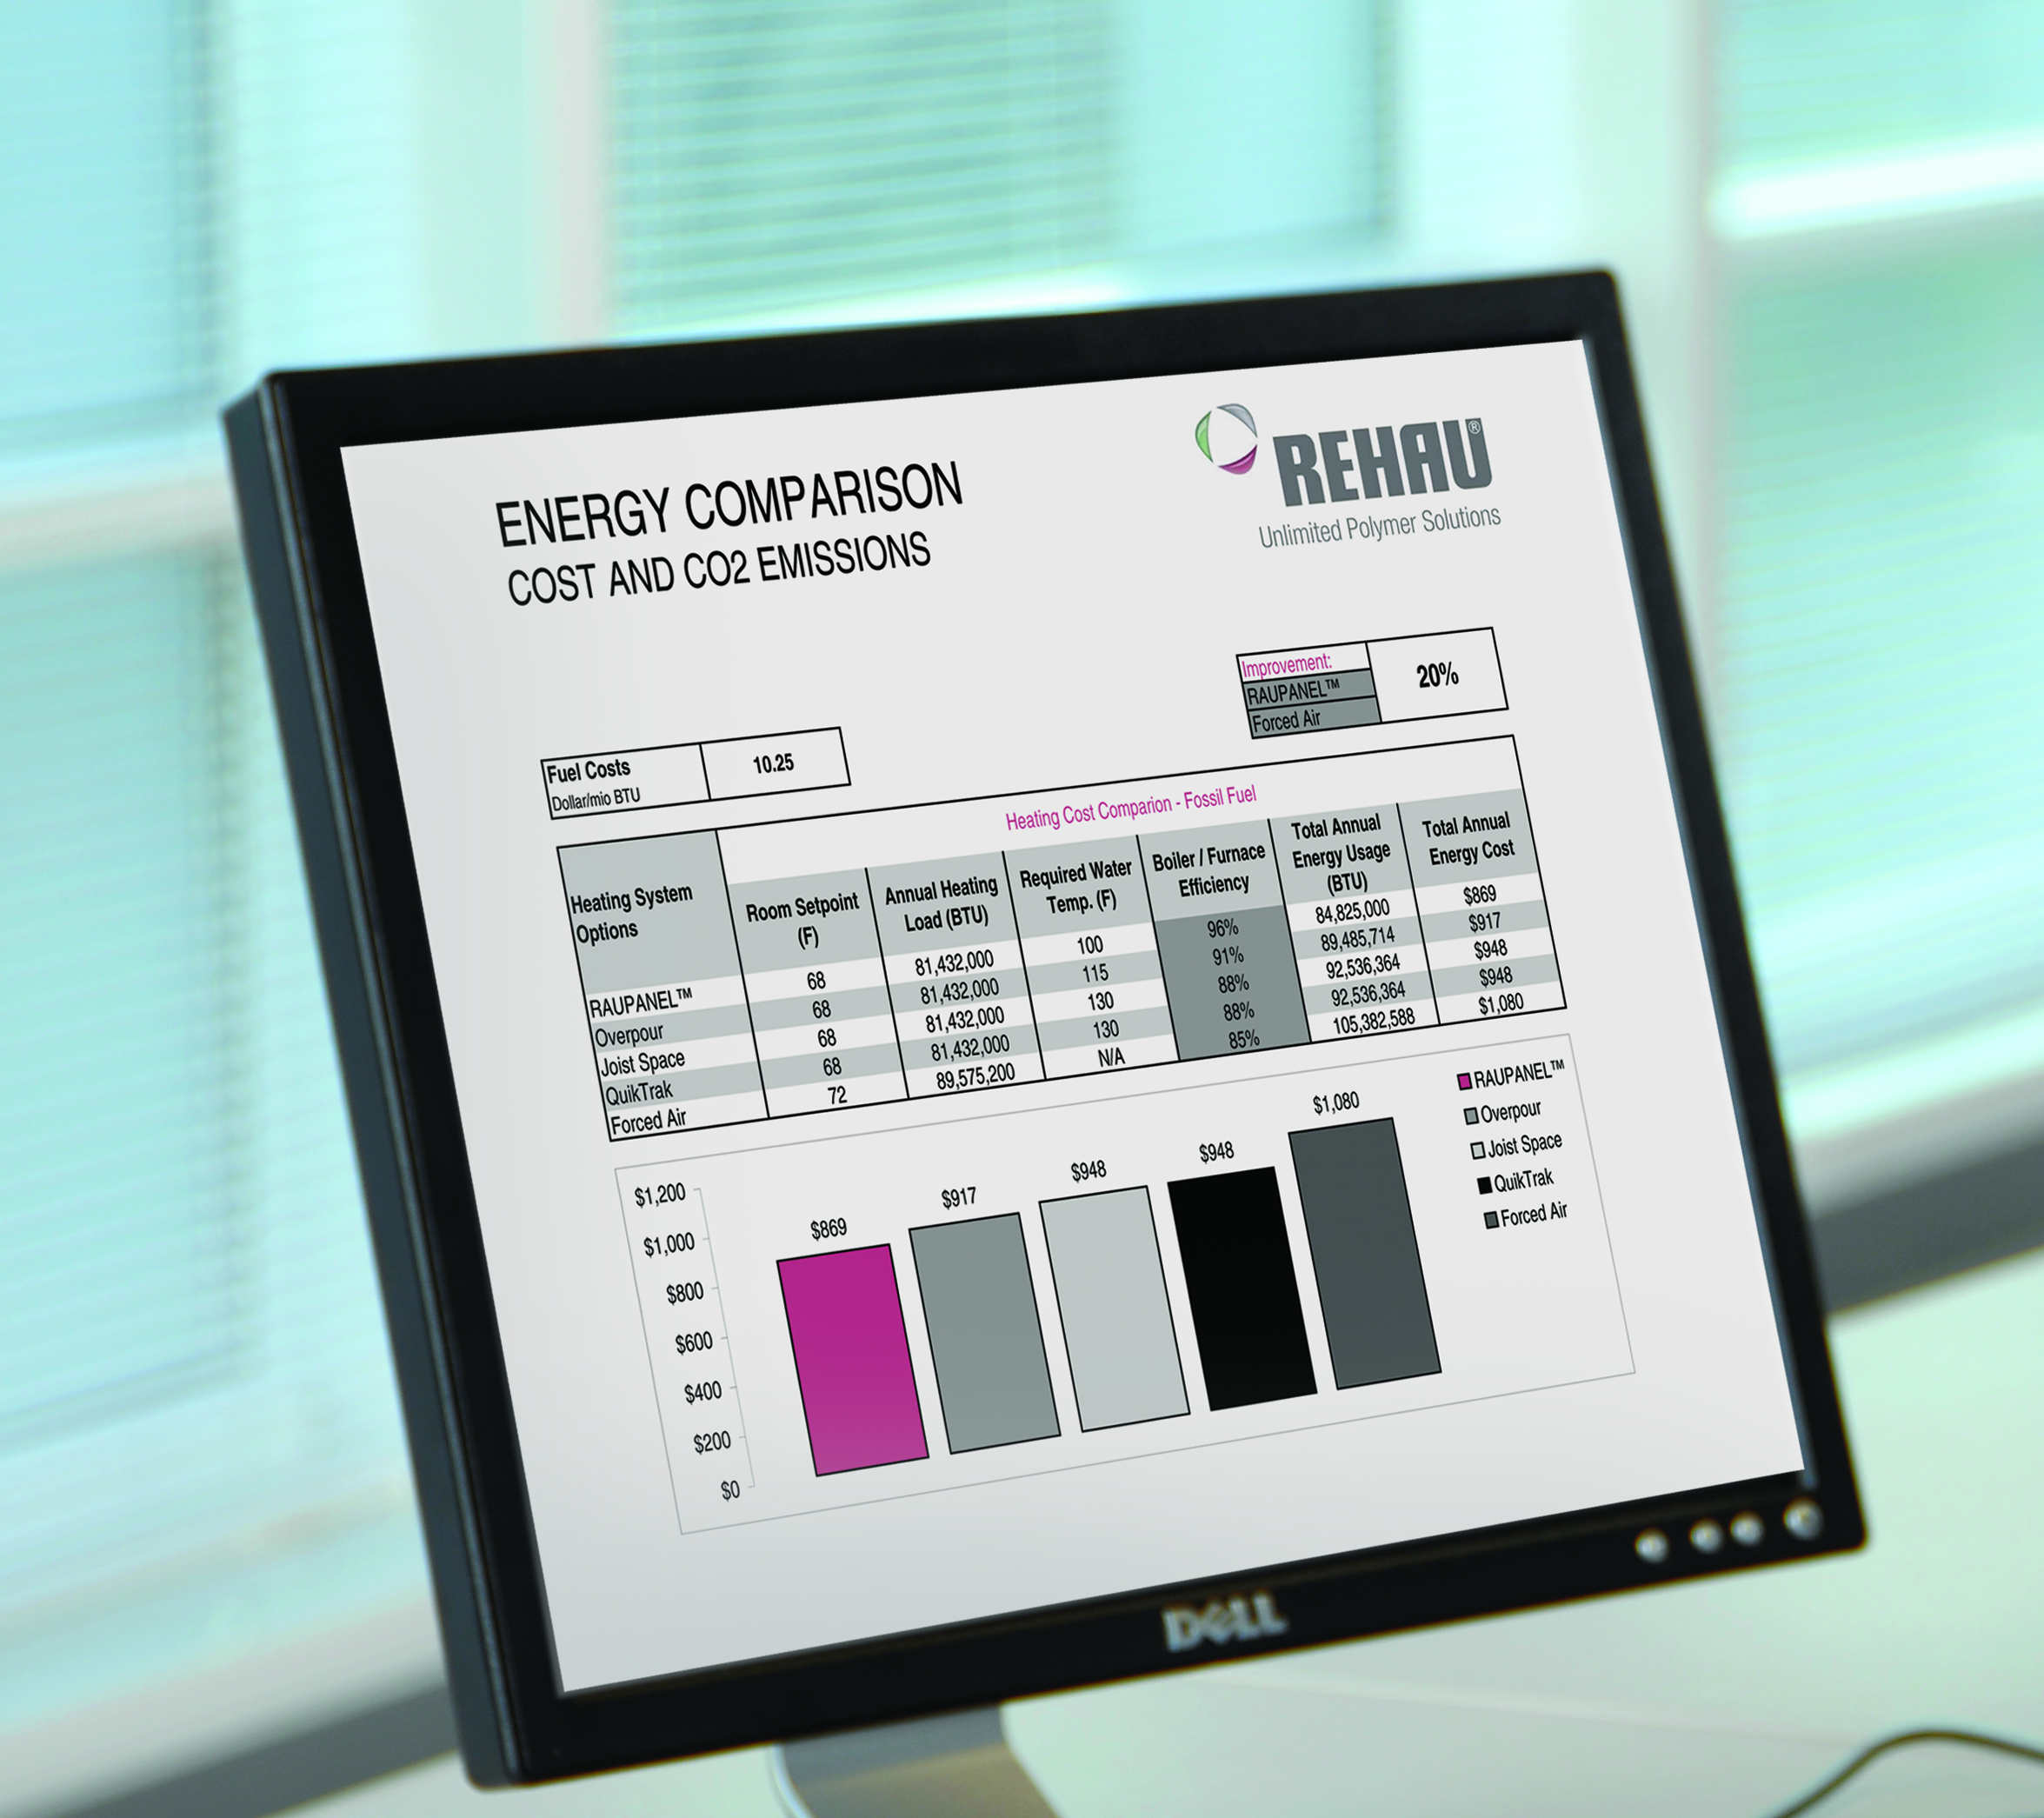
Energy Cost Differences
Commercial Solutions
Fixed Windows
  $0.36 per square foot annually
Casement Windows
  $1.05 per square foot annually
Assumptions:
4367 heating degree days in Halifax
Energy cost of 10 cents per kWh

Slide 8
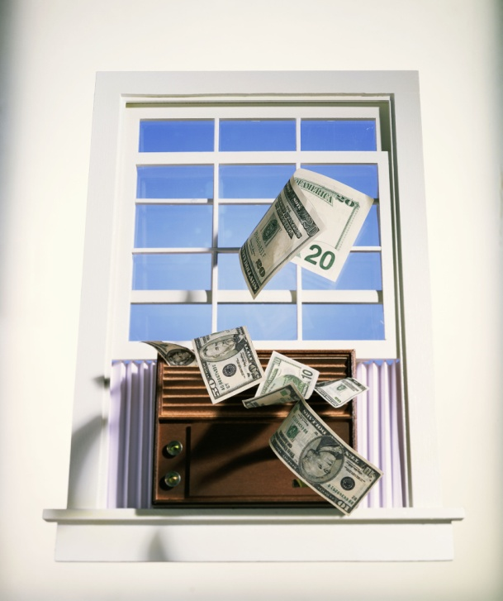
Free Windows
Commercial Solutions
In this climate uPVC windows can pay for themselves on energy savings alone:
  36 year payback on fixed windows
  15 year payback on operating windows

Slide 9
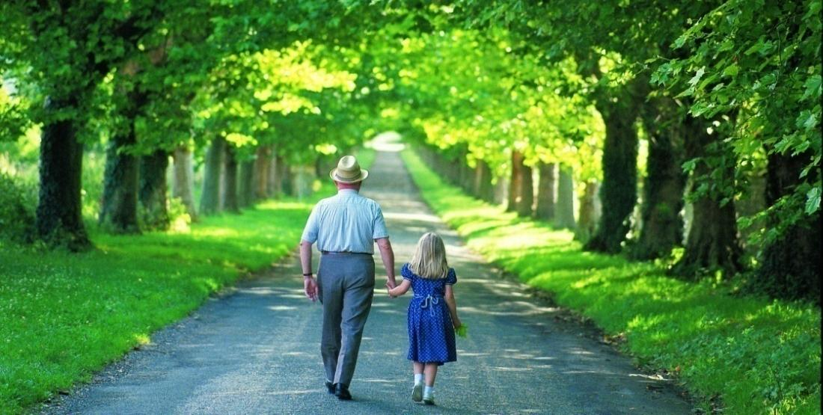
Environmental Savings
Commercial Solutions
Coal generated electricity creates roughly 1kg of CO₂ per kWh
So an operating uPVC window reduces roughly 11 kg of CO₂ emissions per year per square foot

Slide 10
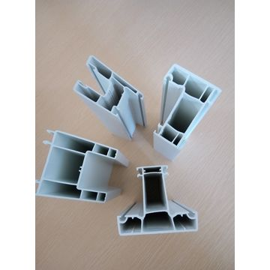
Sustainability
Commercial Solutions
What is uPVC?
“u” means “unplasticized” – no plasticizers added
PVC is a plastic material produced by combining salt and oil derivatives
Ethylene is a natural by-product of natural gas production and produced by “cracking” natural gas (distilling with heat)
Chlorine is combined with Ethylene to produce Ethylene Dichloride
Ethylene Dichloride is then turned into Vinyl Chloride Monomer (Gas)
This gas is converted into a polymer (chains of molecules)
Result: unplasticized Polyvinyl Chloride Resin, a fine white powder
uPVC powder mixed with other ingredients, stabilizers, etc. to form a compound
Compound is melted, then processed through extruders to make uPVC profiles

Slide 11
Sustainability
Commercial Solutions
Green Credentials of PVC
Oil consumed per litre produced
  PVC – 2 kg’s
  Steel – up to 5 kg’s
  Aluminum – up to 15 kg’s
Made of plentiful natural resources (salt and ethylene) → Low stress on environment and energy sources
Un-plasticized (uPVC) → minimum harmful gas emissions → environmentally safe
Very long product life cycle →less waste → low stress on environment

Slide 12
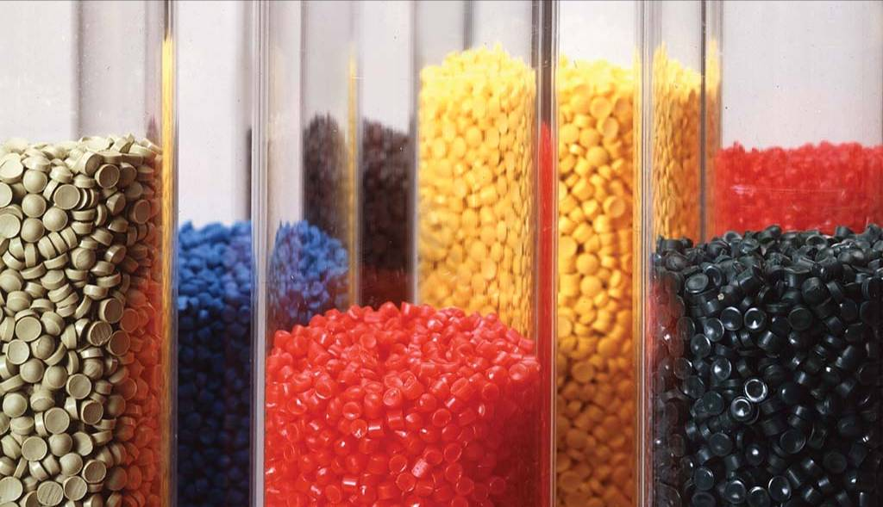
Sustainability
Commercial Solutions
Green Credentials of PVC
uPVC is difficult to ignite and self extinguishing
Proven resistance to UV degradation → maintains structural integrity → extended service life → less waste → low stress on environment
Does not corrode and is mould and mildew resistant → maintains structural integrity over long periods of time→ extended service life → less waste → low stress on environment
uPVC is recyclable

Slide 13
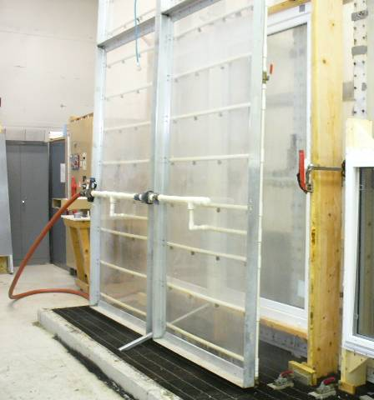
Performance
Commercial Solutions
uPVC windows have certified ratings available up to CW-PG100 for operating windows
The ability to use different mullion reinforcements → scale performance
Are typically factory assembled and glazed with full time permanent trained employees → Quality
Fusion welded corners instead of mechanical joints

Slide 14
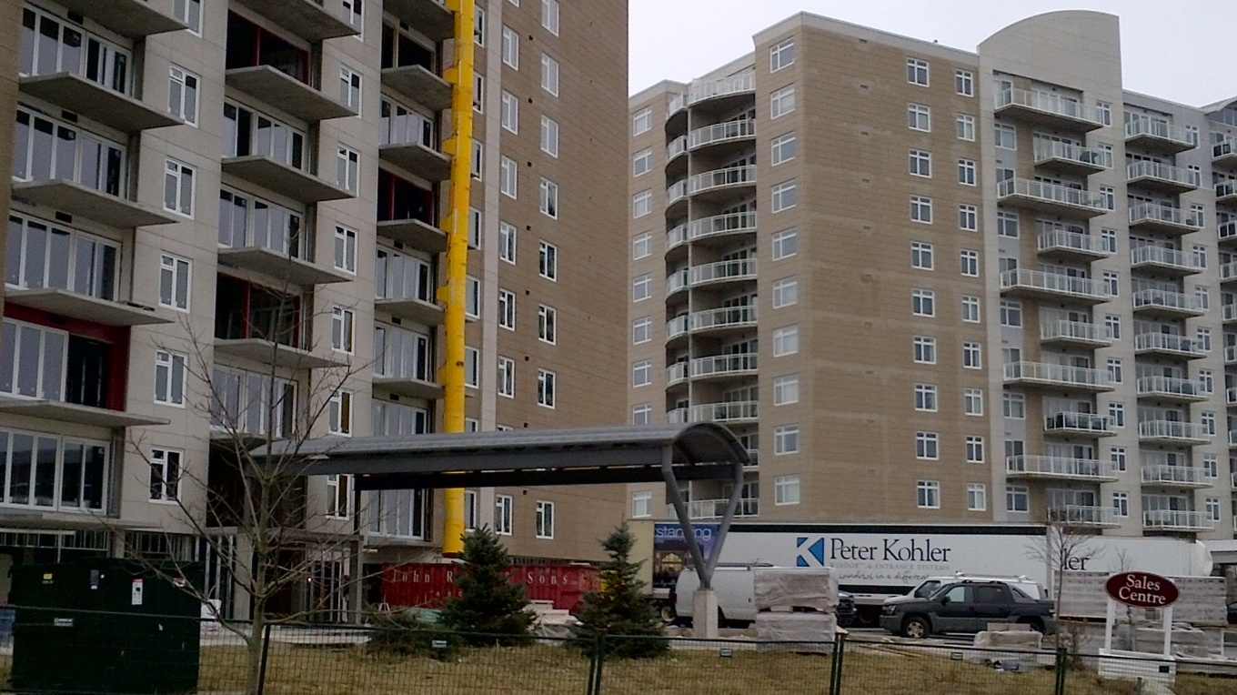
Reference Projects
Commercial Solutions
Waterton 1 & 2
Products:
Select Awning/Fixed
Select Patio Doors
Project Location:
Halifax, Nova Scotia
Unique Solutions Provided:
Structurally Reinforced for 12 stories of exposure

Slide 15
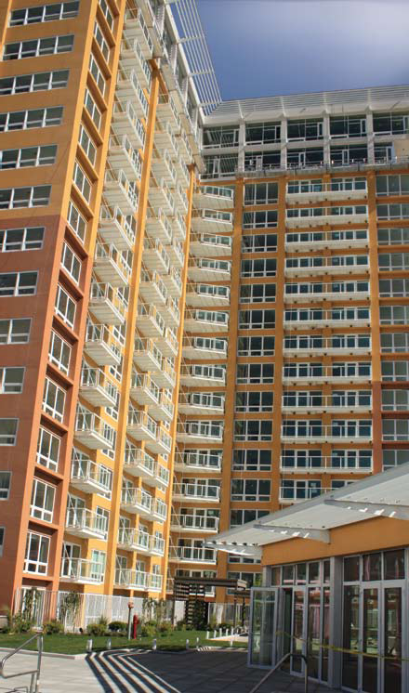
Reference Projects
Commercial Solutions
The Montage
Products:
4500 Series Hoppers
4500 Series Fixed
Project Location:
Reno, Nevada
Unique Solutions Provided:
Renovation - Hotel-Casino Conversion to Condo’s

Slide 16
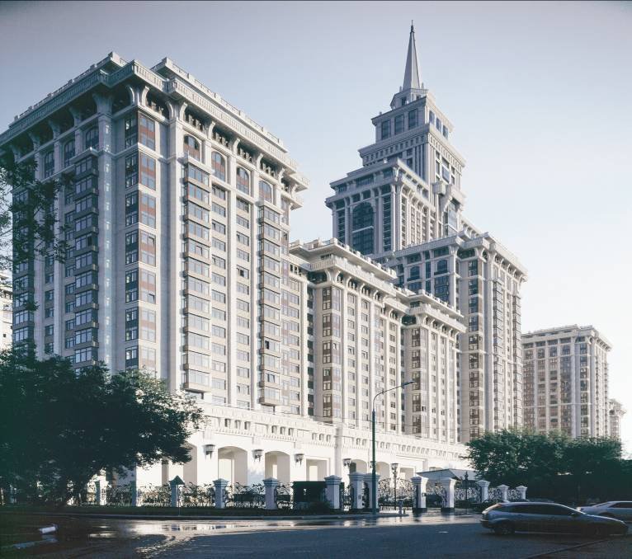
Reference Projects
Commercial Solutions
Triumph Palace
Products:
4500 Series Tilt/Turn
Project Location:
Moscow
Unique Solutions Provided:
57 Storey Performance

Slide 17
Colour Options
Commercial Solutions
Historically uPVC windows were available mainly in white or tan extrusions
The advent of waterborne polyurethane coating processes for uPVC windows have created a rapid growth in demand for colour
The coating chemically bonds to the PVC providing superior adhesion and durability
Heat reflective properties allow a full range of standard colours including greens and blacks
Custom colour matching is available

Slide 18
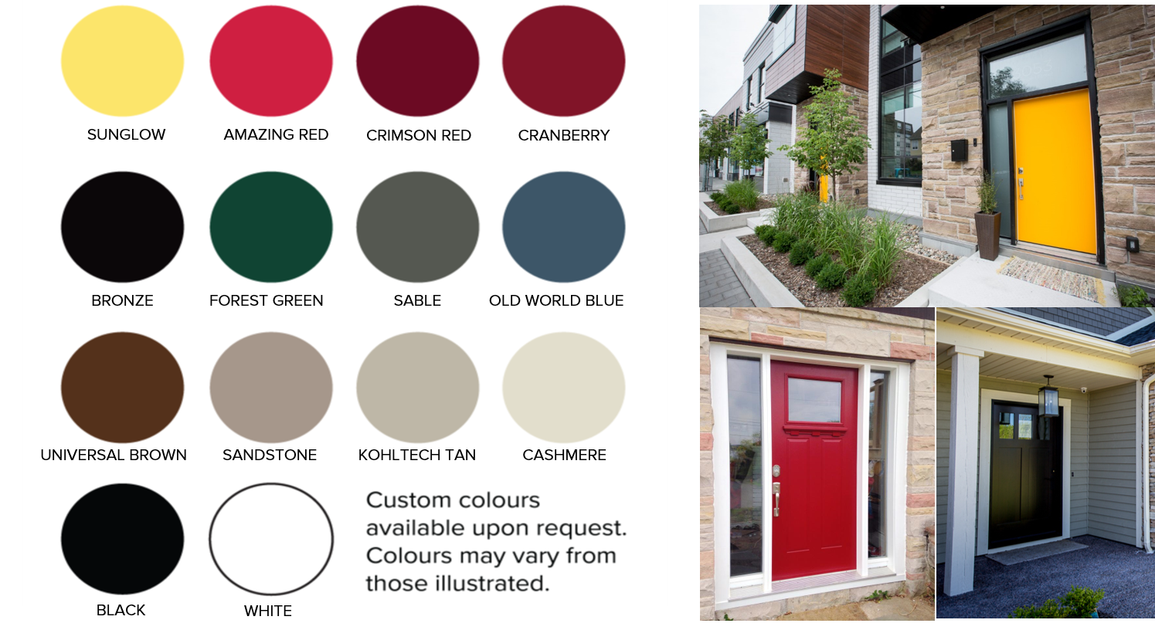
Colour Options
Commercial Solutions

Slide 19
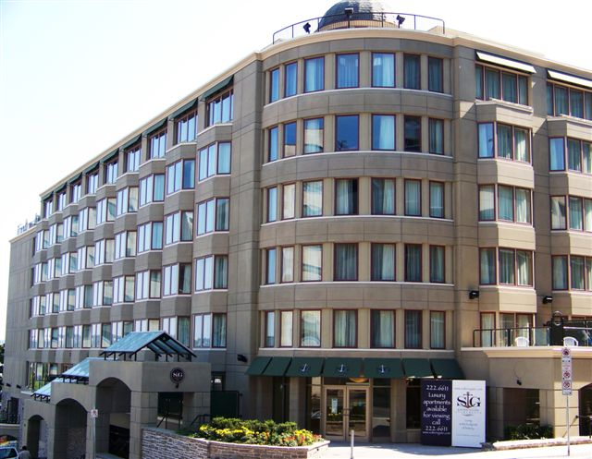
Reference Projects
Commercial Solutions
Courtyard Marriot
Products
Supreme Casement
Project Location:
Halifax, Nova Scotia
Unique solutions provided:
Custom Color Matched Marriot Red
Bay Windows with Custom
Anchor Brackets
Cost Effective

Slide 20
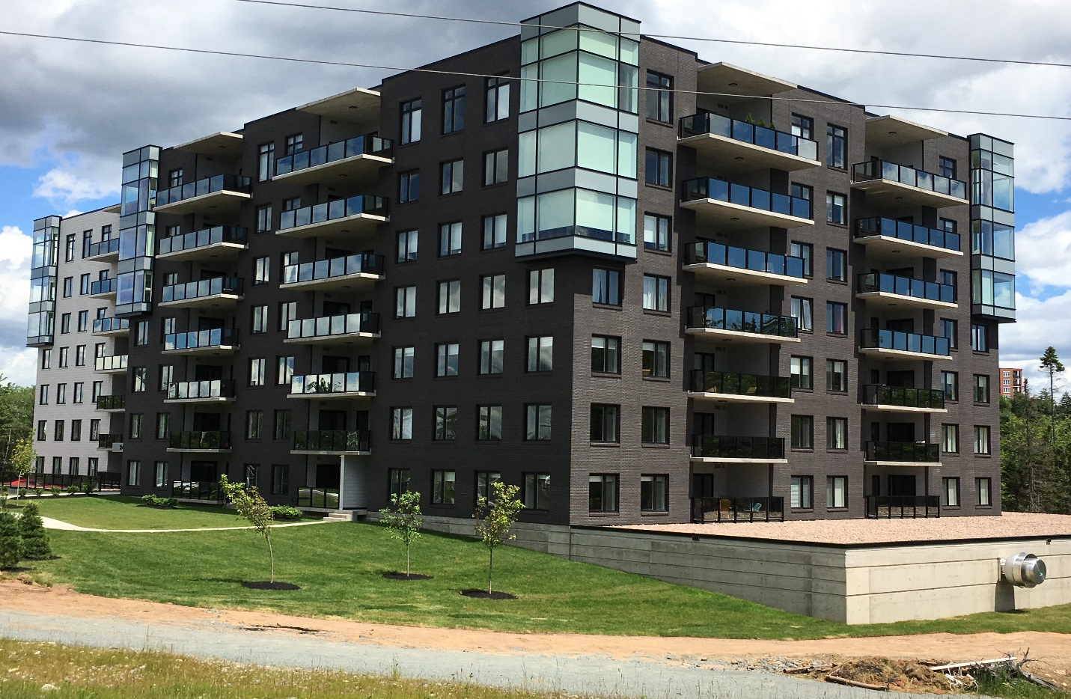
Reference Projects
Commercial Solutions
Luxor West
Products:
Supreme Awnings
Project Location:
Halifax, NS
Unique Solutions Provided:
Black Exterior

Slide 21
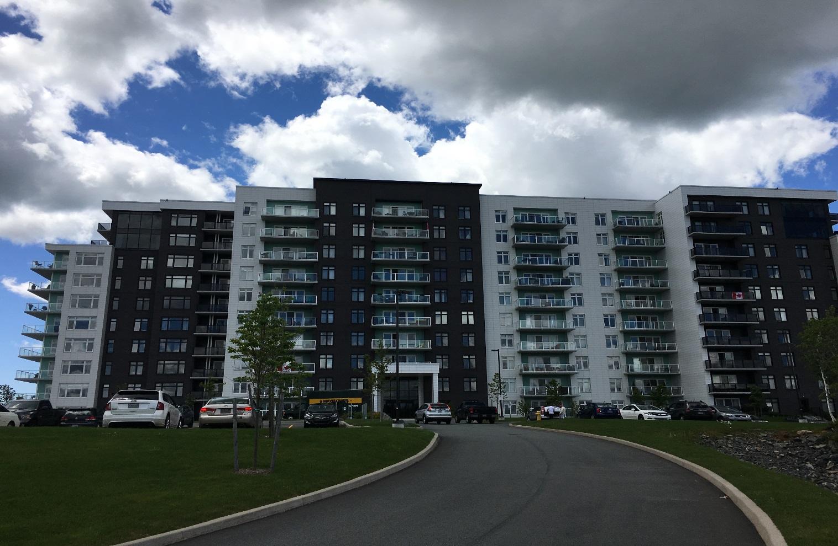
Reference Projects
Commercial Solutions
Friesian Court
Products:
Supreme Awnings
Patio Doors
Project Location:
Halifax, NS
Unique Solutions
Provided:
Mix of Colours

Slide 22
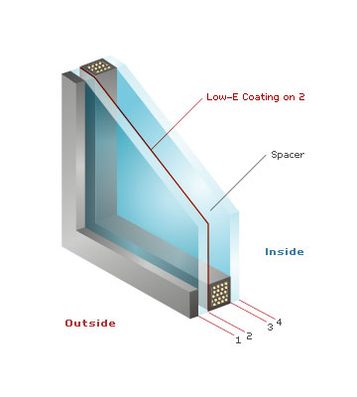
Glazing Options
Commercial Solutions
PVC windows offer a lot of flexibility when it comes to glazing including multiple air spaces, glass thicknesses, and double and triple glazing

Slide 23
Glazing Options
Commercial Solutions
Obscure, Satin Deco
Tempered for strength and safety
Laminated for safety and sound abatement
Tinted (grey, bronze, green, blue, etc.)

Slide 24
Glazing Options
Commercial Solutions
There has been a growing trend towards triple glazing in commercial developments lately.
  1 3/8” deep insulated glass units with 2 LoE surfaces and both cavities argon filled can double the R value for the glazed portion of a window or door.
In some cases the upfront savings on HVAC systems are greater than the cost of the triple glazing upgrade.
  The annual energy savings and sound abatement benefits are just a bonus

Slide 25
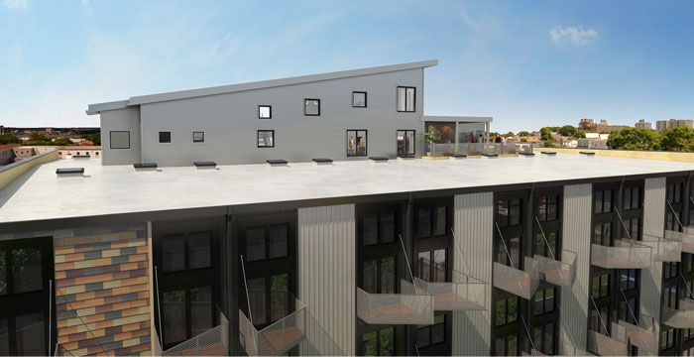
Reference Projects
Commercial Solutions
Q-Lofts
Products:
Supreme Tilt & Turn
Supreme Awnings
Project Location:
Halifax, Nova Scotia
Unique Solutions Provided:
Energy Efficient triple glazed
Custom Hardware and Screens

Slide 26
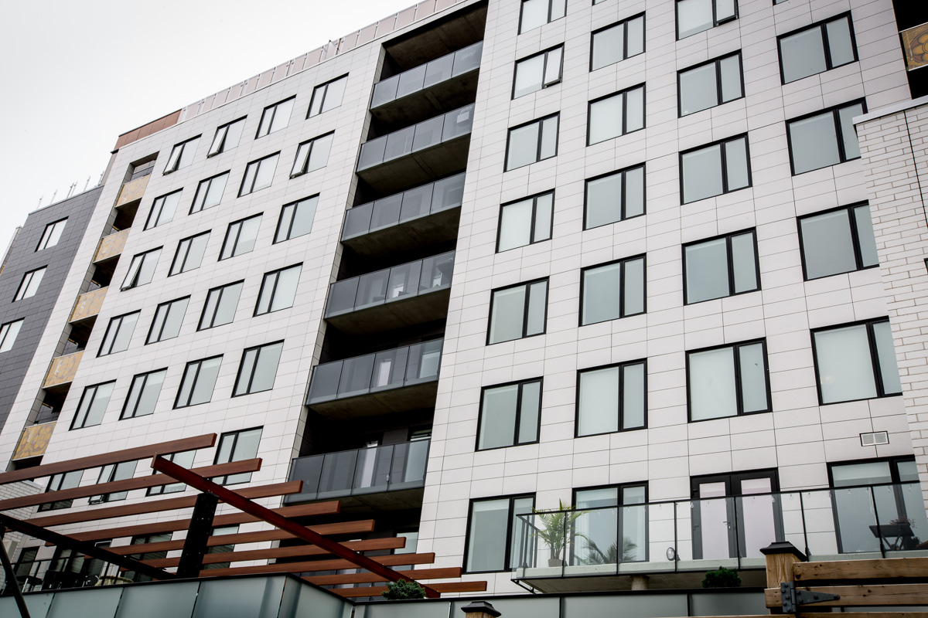
Reference Projects
Commercial Solutions
St. Joseph’s Square
Products:
Supreme Tilt & Turn
Supreme Awnings
Project Location:
Halifax, Nova Scotia
Unique Solutions Provided:
Energy Efficient triple glazed

Slide 27
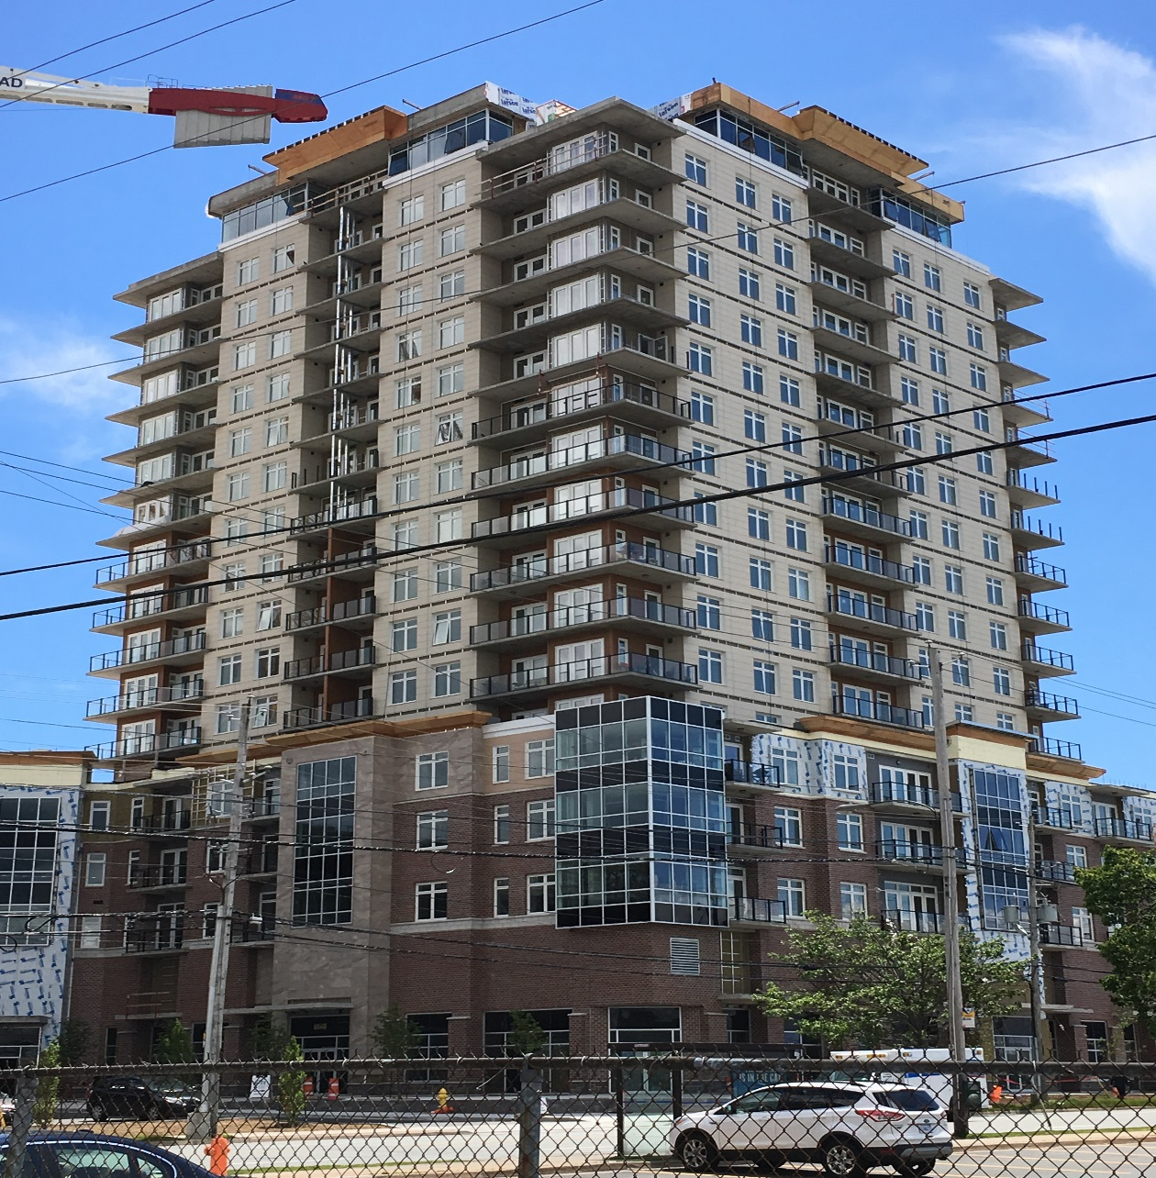
Reference
Projects
Commercial Solutions
Monaghan Square
Products:
Supreme Tilt & Turn
Supreme Awnings
Project Location:
Halifax, Nova Scotia
Unique Solutions Provided:
Energy Efficient triple glazed

Slide 28
Sound Abatement
Commercial Solutions
Air, rail, and highway traffic and associated noise is on the rise
It is important to match the performance of windows and doors with that of the wall since sound transmission finds the weakest path
STC ratings have been widely used to define requirements, but OITC is being considered to replace it in the long term
High performance uPVC windows and doors are available to deliver high levels of sound abatement

Slide 29
STC – Sound Transmission Class
Commercial Solutions
Calculated in accordance with ASTM E413
Created to provide a single number rating for interior building partitions that are subjected to noises from speech, television, radio, and office equipment
Calculated over the frequency range of 125 to 4,000 Hz by comparing the measured sound transmission loss relative to a reference contour curve
The higher the number, the higher the sound transmission reduction (abatement)

Slide 30
OITC – Outdoor Indoor Transmission Class
Commercial Solutions
Calculated in accordance with ASTM E1332
Created to provide a single number rating for facades (exterior walls) and façade elements (windows and doors) which are subjected to transportation noises
The higher the number the higher the outdoor-indoor transmission loss (abatement)
Calculated over the frequency range of 80 to 4,000 Hz

Slide 31
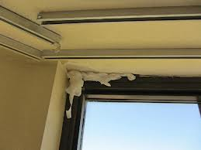
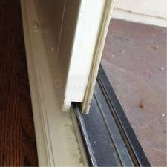
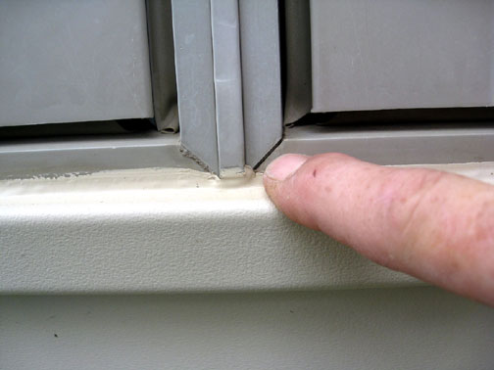
Fenestration Solutions for Sound Abatement
Commercial Solutions
Problem Areas
  Cracks (poor design or construction)
  Air infiltration (leakage)
  Lightweight materials (low mass)
  Poor gaskets and sealing

Slide 32
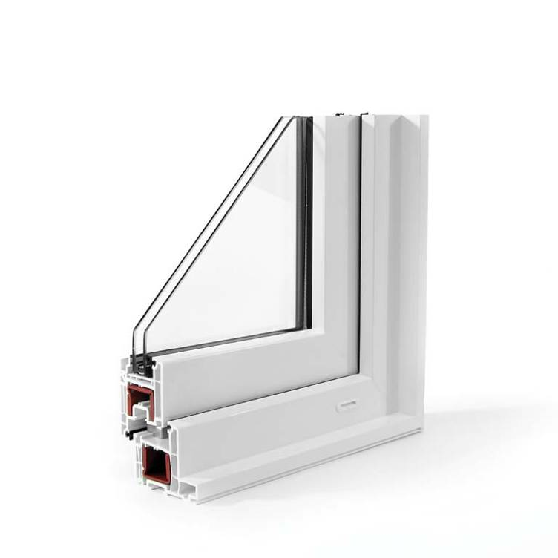
Fenestration Solutions for Sound Abatement
Commercial Solutions
Heavier materials have higher sound transmission loss
Larger air spaces improve sound abatement
Multi-chambered profiles common in uPVC designs reduce and block air movement, greatly reducing sound transmission

Slide 33
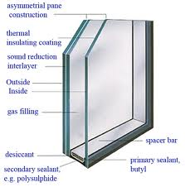
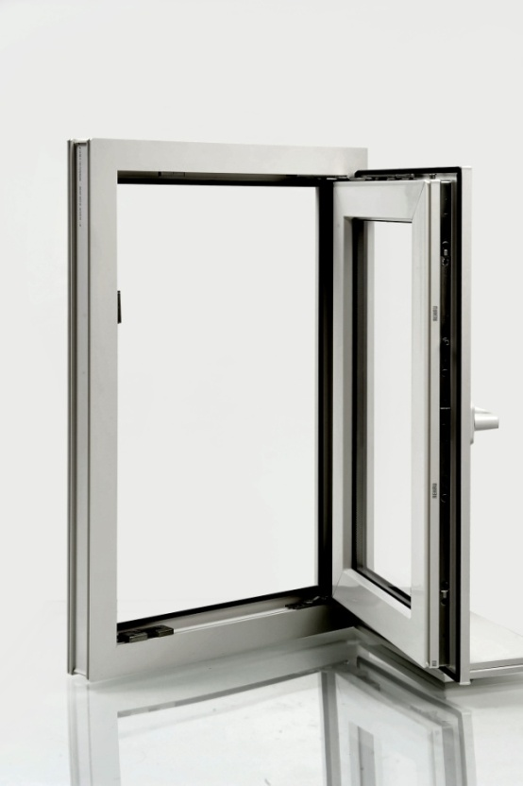
Fenestration Solutions for Sound Abatement
Commercial Solutions
Window Design Options
  Apply same materials in varying thicknesses
  Use compression seal technology

Slide 34
Typical Results for Windows and Doors
Commercial Solutions
Window Type | Glass | STC | OITC
Fixed Window | 1/8 + 1/4” L | 33-35 | 27-28
Hung/Slider | 1/8 + 1/4” L | 33-35 | 27-29
Casement | 1/8 + 1/4” L | 35 | 28
 | 1/4 + 1/4” L | 40 | 32
Tilt/Turn Window | 1/4 + 1/4” L | 43 | 34
Door Type | Glass | STC | OITC
Hinged Door | 1/8 + 1/4” L | 34 | 28
Sliding Patio Door | 1/8 + 1/4” L | 32 | 28
Tilt/Slide Door | 5/16 + 1/4” L | 40 | 31

Slide 35
Reference Projects
Commercial Solutions
Collingswood Manor
Products:
Supreme Double Hung
Project Location:
Collingswood, New Jersey
Unique solutions provided:
Sound Abatement (STC 37)

Slide 36
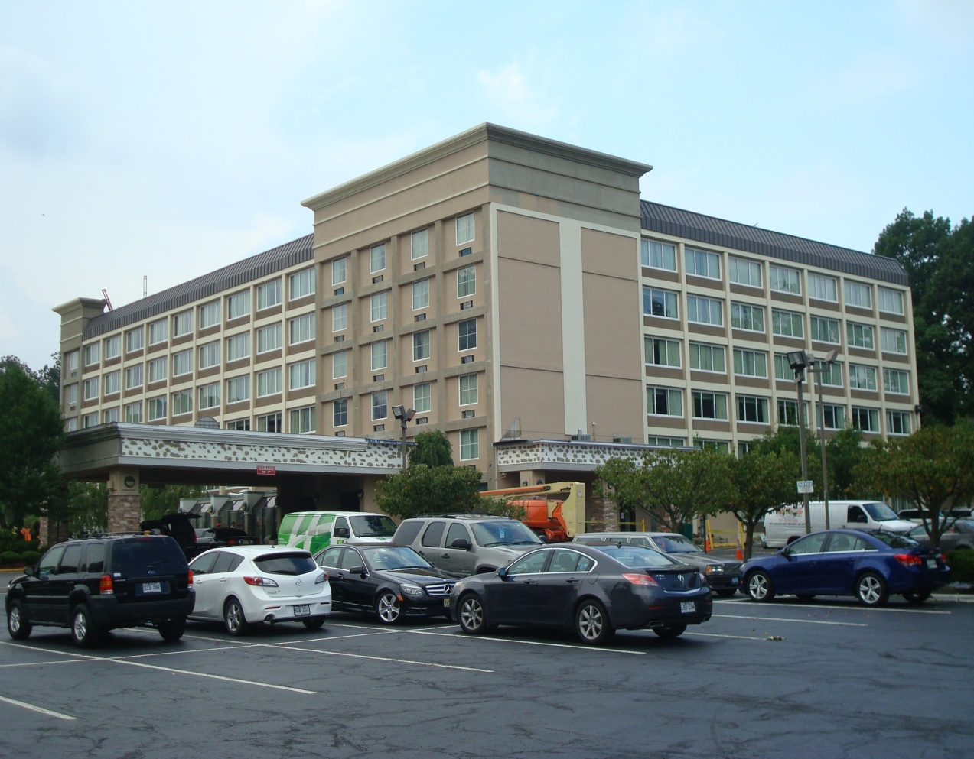
Reference Projects
Commercial Solutions
Holiday Inn GW Bridge
Products:
4500 Series Fixed
Project Location:
Fort Lee, New Jersey
Unique solutions provided:
Sound Abatement
Energy Efficiency

Slide 37
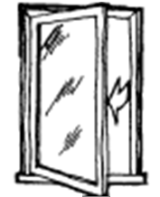
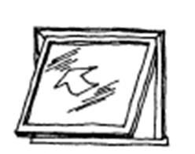
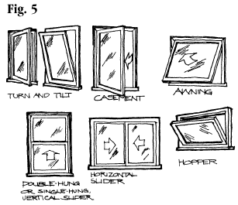
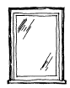
Available Configurations
Commercial Solutions
Windows:
Casement
Awning
Tilt Turn
Hopper
Fixed

Slide 38
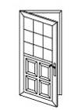
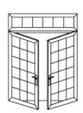
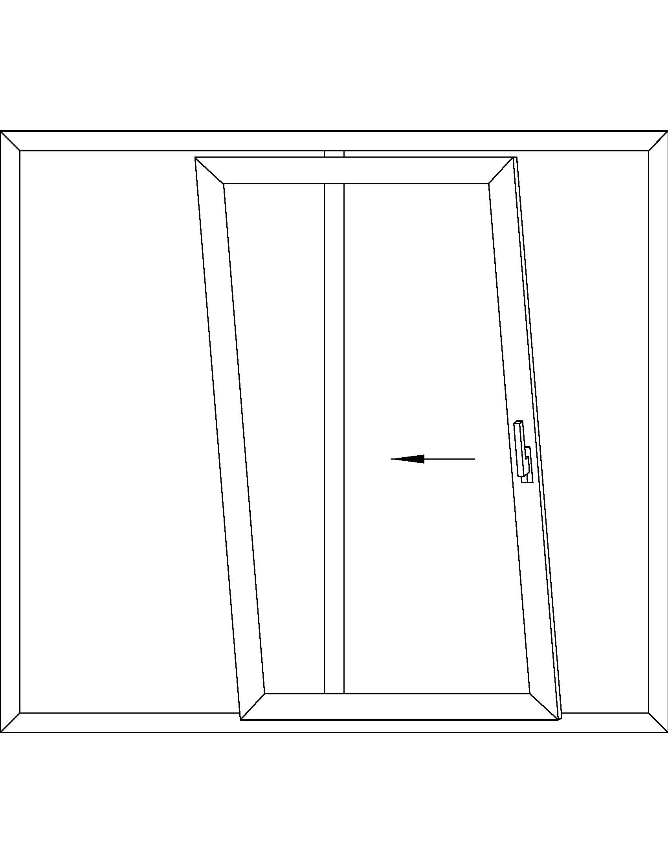
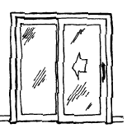
Available Configurations
Commercial Solutions
Doors:
Swing Doors
Outswing French Doors
Sliding Patio Assemblies
Tilt/Slide Doors

Slide 39
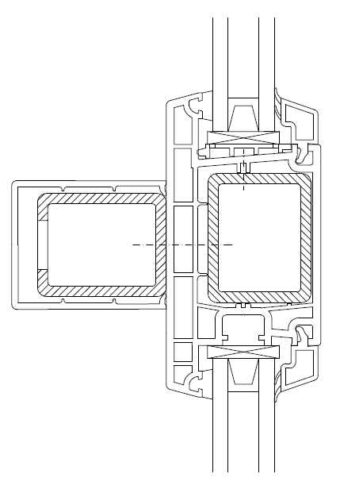
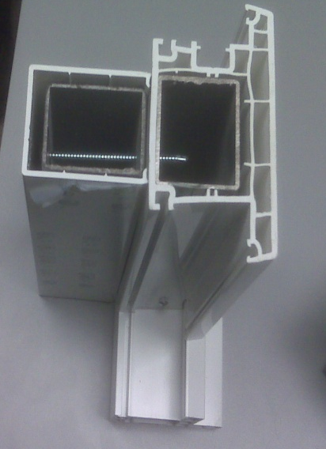
uPVC Commercial Offerings
Commercial Solutions
Code Compliance
Certification
Engineered Systems
On-site Consultation

Slide 40
Reference Projects
Commercial Solutions
Other Applications
Institutional
Hotels/Resorts
Heritage Renovations
Business/Mixed Use
Assisted Living Facilities

Slide 41
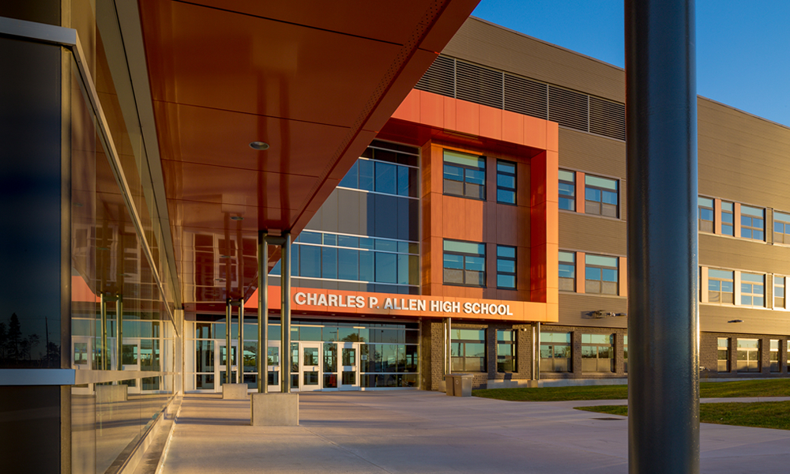
Institutional
Commercial Solutions
CP Allen High
School
Products:
Supreme Single Hung
Project Location:
Bedford, Nova Scotia
Unique solutions provided:
Painted Exterior
Custom Transom Glass
Restricted Sashes
Heavy Duty Hardware and Structural
Reinforcing

Slide 42
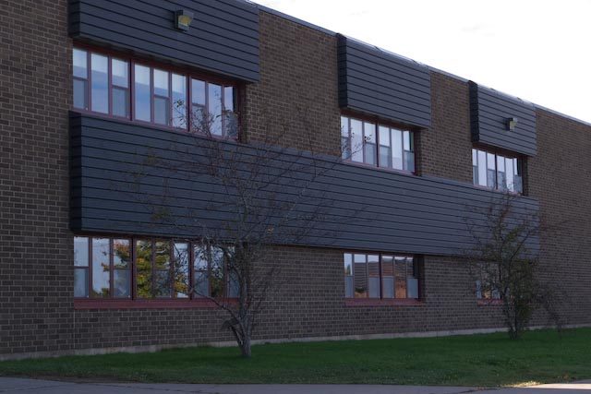
Institutional
Commercial Solutions
Coldbrook Elementary School
Products:
Supreme Single Hung
Project Location:
Coldbrook, Nova Scotia
Unique solutions provided:
Custom colored paint
Aluminum screen cloth
Restricted Sashes

Slide 43
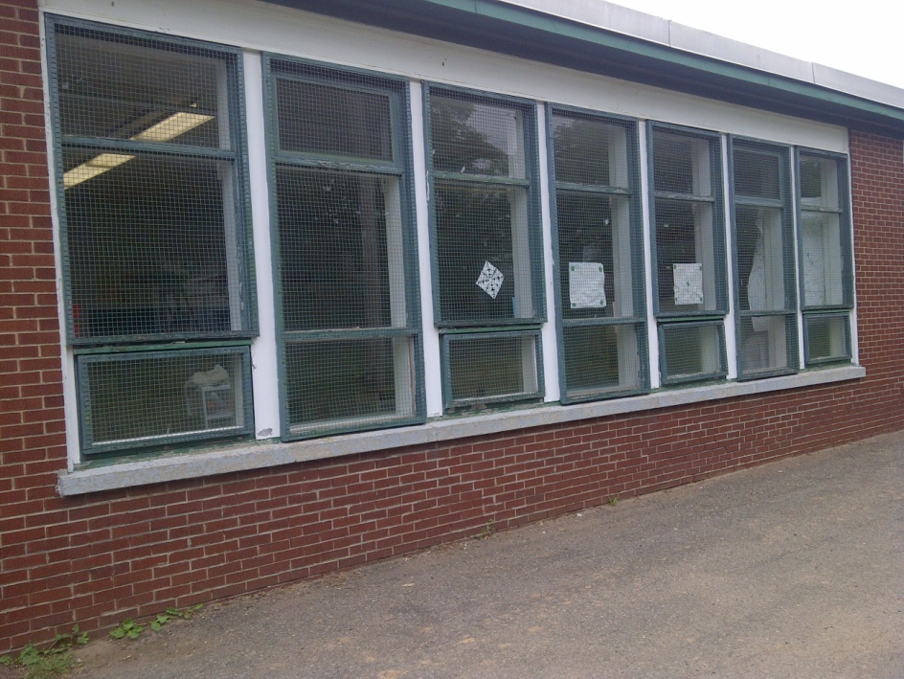
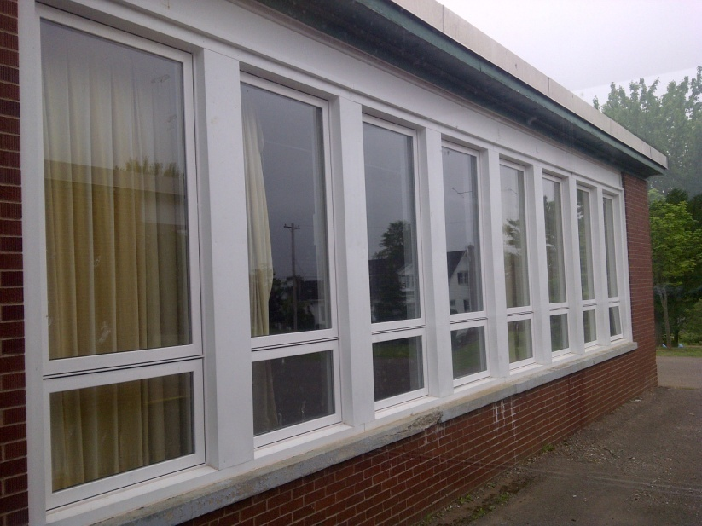
Institutional
Commercial Solutions
Douglas Street School
Products:
Select Picture/Awning
Project Location:
Truro, Nova Scotia
Unique solutions provided:
Energy Efficiency
Improved aesthetics
Fresh Air Ventilation

Slide 44
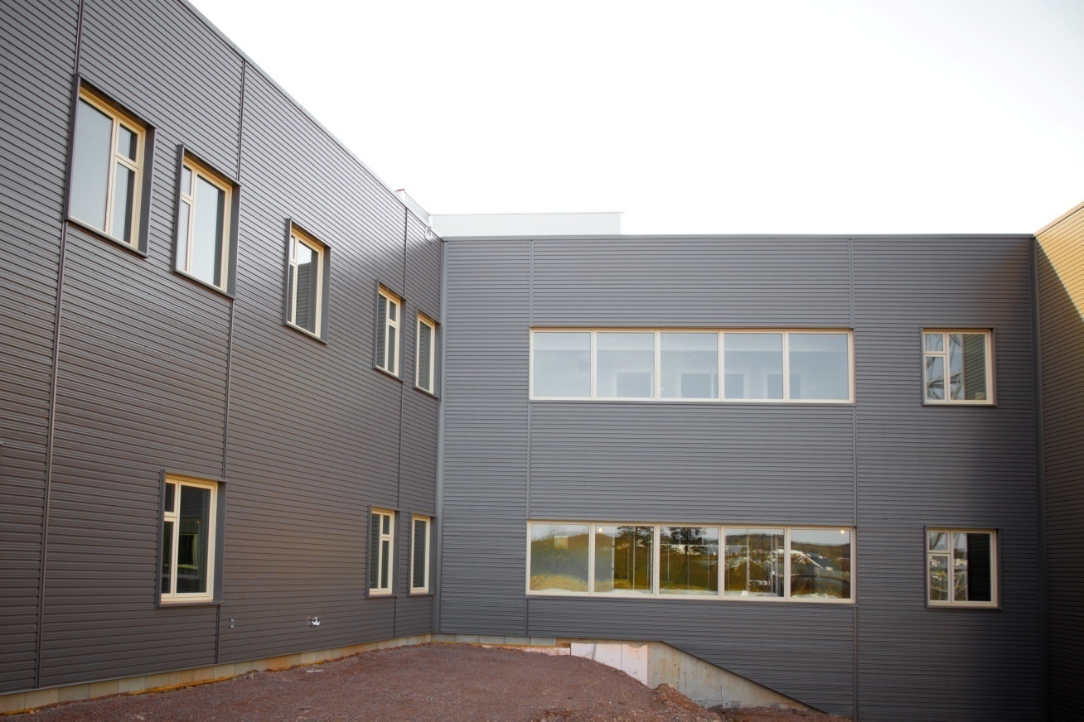
Institutional
Commercial Solutions
Colchester East Hants Health
Centre
Products:
Tilt and Turn Fixed
Casement
Project Location:
Truro, Nova Scotia
Unique solutions provided:
Spallshield glass

Slide 45
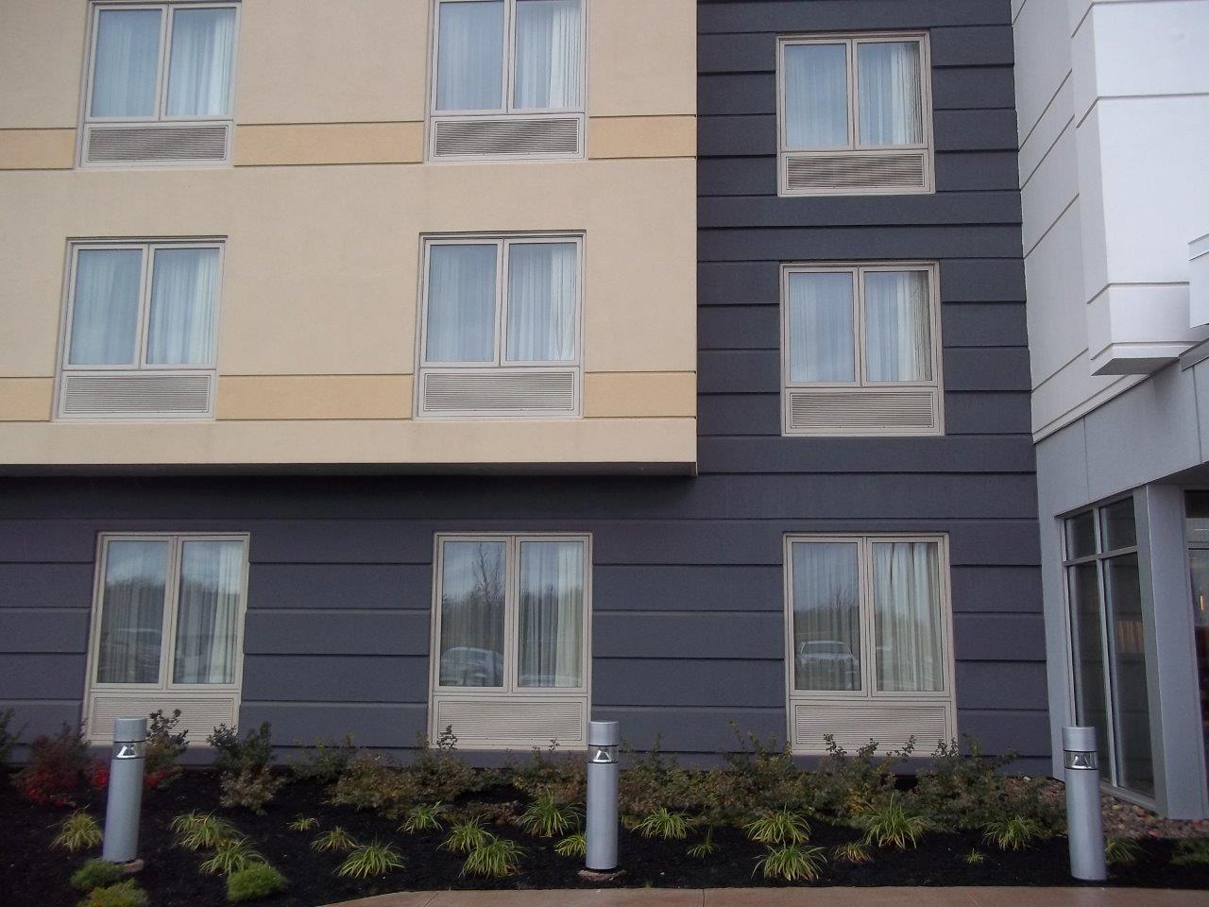
Hotel/Resort
Commercial Solutions
Fairfield Marriott
Products:
Supreme Casement
Project Location
Moncton, New Brunswick
Unique solutions provided:
Integrated PTAC Louvers
Tan Extrusion
Sash Restriction

Slide 46
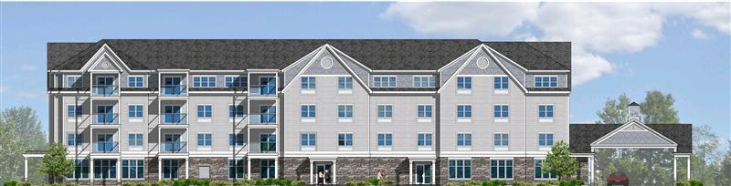
Hotel/Resort
Commercial Solutions
Hampton Inn Bar Harbor
Products:
Supreme Single Hung
Project Location
Bar Harbor, Maine
Unique solutions provided:
Integrated PTAC Louvers
Forest Green Exterior
Sash Restriction

Slide 47
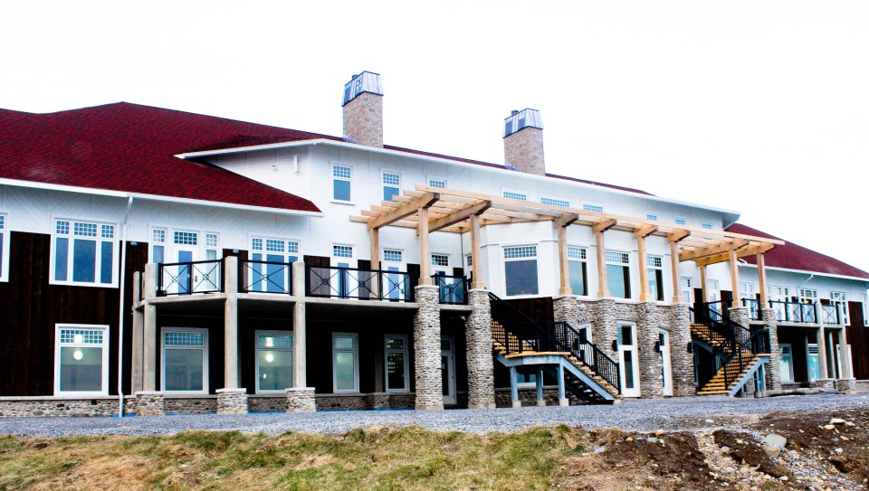
Hotel/Resort
Commercial Solutions
White Point Beach Resort
Products:
Supreme Casement
7’ Fiberglass Doors
Project Location
White Point, Nova Scotia
Unique solutions provided:
Custom grill configuration
Quick lead-time
Custom door transoms

Slide 48
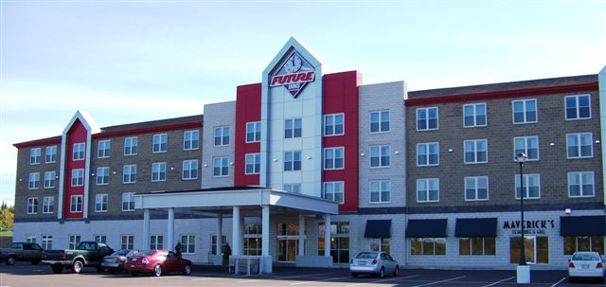
Hotel/Resort
Commercial Solutions
Future Inns Moncton
Product:
Supreme Double Hung
Project Location:
Moncton, New Brunswick
Unique solutions provided:
High Performance
Short Lead-Time
Low Maintenance

Slide 49
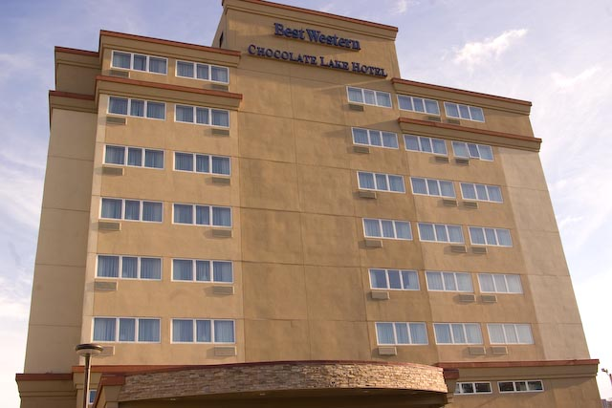
Hotel/Resort
Commercial Solutions
Best Western Chocolate Lake Hotel
Products:
Supreme Awnings and Fixed
Project Location:
Halifax, Nova Scotia
Unique solutions provided:
Cost effective vs Aluminum
Ease of maintenance
Retrofit

Slide 50
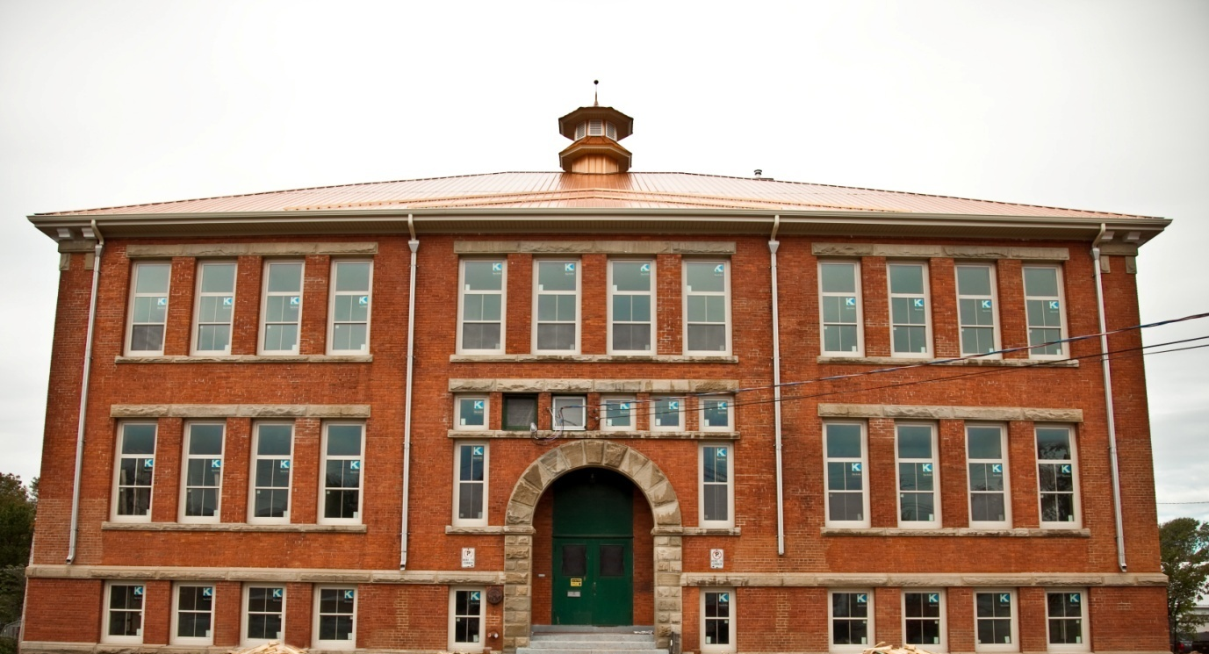
Heritage Renovation
Commercial Solutions
Willow Street School
Products:
Select Single Hung
Project Location:
Truro, Nova Scotia
Unique solutions provided:
Tan Extrusion
Custom configuration

Slide 51
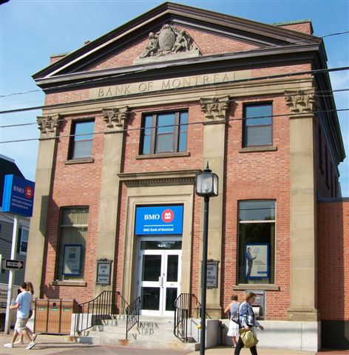
Heritage Renovation
Commercial Solutions
BMO Building
Products:
Select Single Hung
Project Location:
Wolfville, Nova Scotia
Unique solutions provided:
Painted Exterior
Energy Efficiency

Slide 52
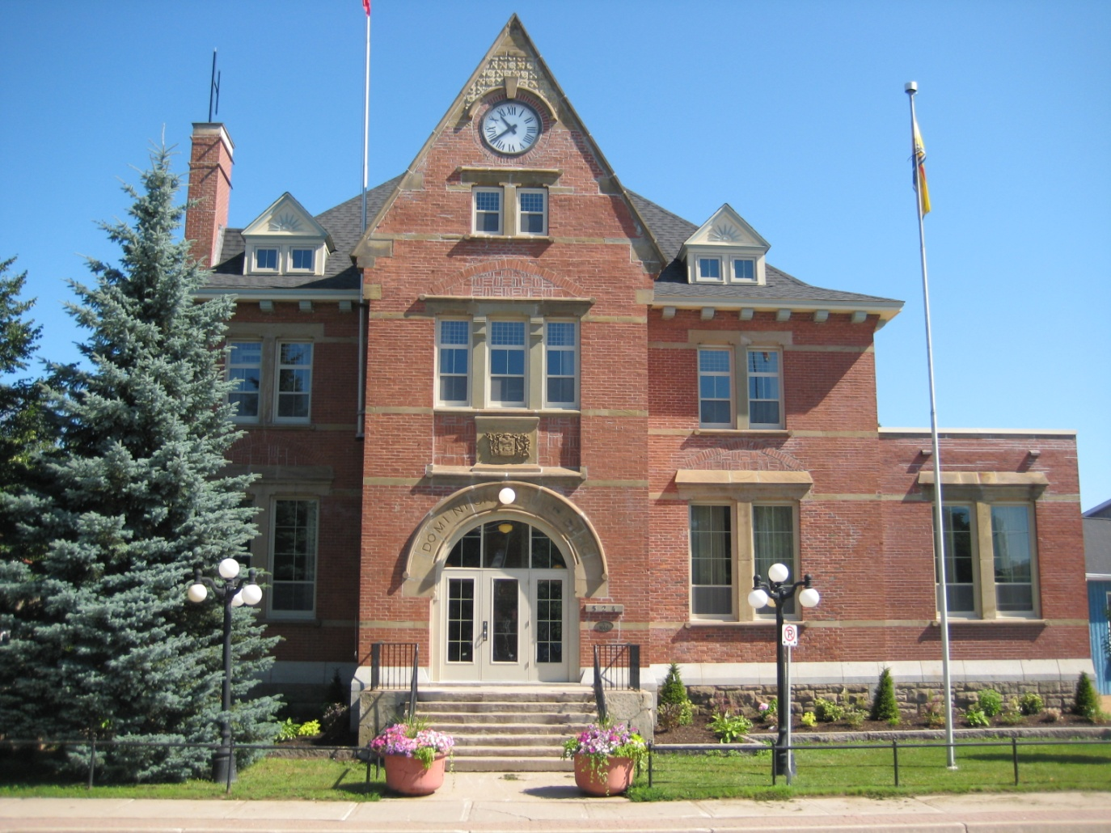
Heritage Renovation
Commercial Solutions
Sussex Town Hall
Products:
Supreme Single Hung
Project Location:
Sussex, New Brunswick
Unique solutions provided:
Tan Extrusion
Natural Ventilation

Slide 53
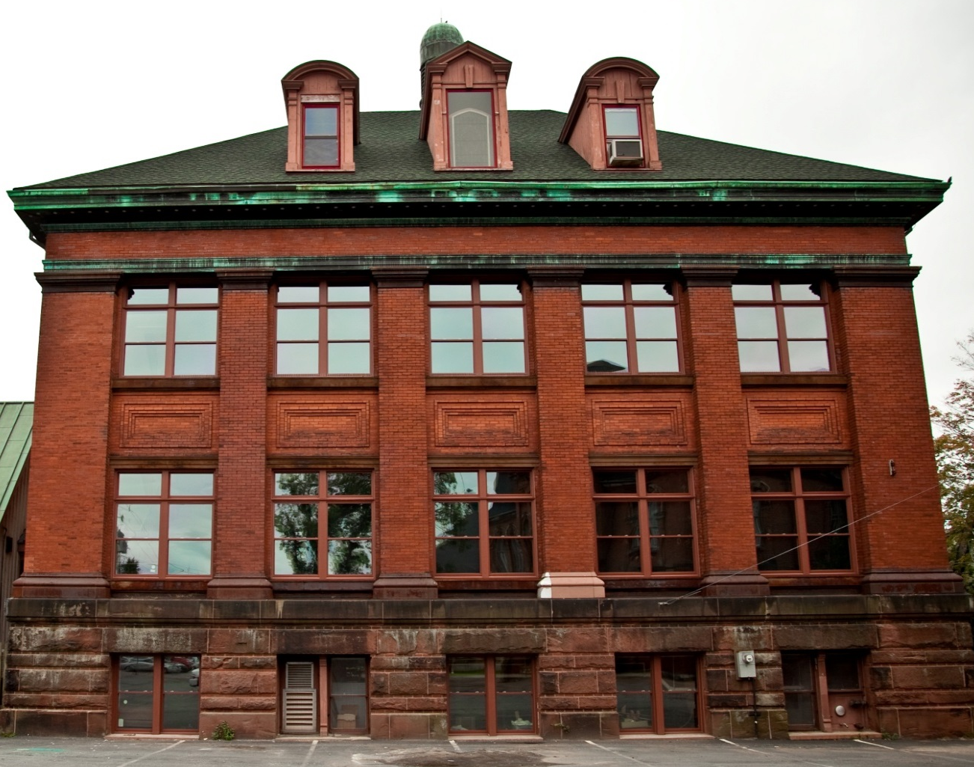
Heritage Renovation
Commercial Solutions
Colchester Historeum
Products:
Supreme Single Hung
Supreme Double Hung
Project Location:
Truro, Nova Scotia
Unique solutions provided:
Custom Color Exterior
Energy Efficiency
Exterior Install

Slide 54

Heritage Renovation
Commercial Solutions
Colchester East Hants
Library
Products:
Supreme Single Hung Shapes
Project Location:
Truro, Nova Scotia
Unique solutions provided:
Black Exterior
Custom Shapes

Slide 55

Business/Mixed Use
Commercial Solutions
Dartmouth Crossing
Products:
Select Casement
Project Location:
Dartmouth, Nova Scotia
Unique solutions provided:
Cost effective vs Aluminum
Short Lead Time
Ease of maintenance
Aesthetics

Slide 56

Business/Mixed Use
Commercial Solutions
Notting Village
Products:
Select Single Hung
Oriels with Low Solar glass
Project Location:
Dartmouth, Nova Scotia
Unique solutions provided:
Cost effective vs Aluminum
Tan profile
Aesthetics

Slide 57

Business/Mixed Use
Commercial Solutions
Aylesford Church
Products:
Select Single Hung
Supreme Picture Window
Project Location:
Aylesford, Nova Scotia
Unique solutions provided:
Stainless Steel Tilt up Brackets
Heavy Duty Reinforcement
Site Glazing

Slide 58

Business/Mixed Use
Commercial Solutions
Vimica Ridge Medical Center
Products:
Tan Supreme Picture windows
with solar cooled bronze glass
Project Location:
Lower Sackville, Nova Scotia
Unique solutions provided:
Fiberglass Entrance System
Energy efficiency
Ease of maintenance
Aesthetics

Slide 59

Business/Mixed Use
Commercial Solutions
Garden Stone
Place

Slide 60

Assisted Living Facilities
Commercial Solutions
Shannex Riverview
Products:
Supreme Single Hung
Tilt and Turn Picture
Project Location:
Riverview, New Brunswick
Unique solutions provided:
Energy efficiency
Ease of maintenance
Restricted Opening
Custom glass at second floor interface

Slide 61

Assisted Living Facilities
Commercial Solutions
Wickwire Seniors Complex
Products:
Supreme Casement
Project Location:
Wolfville, Nova Scotia
Unique solutions provided:
Energy efficiency
Fixed over operators
Ease of maintenance
Aesthetics

Slide 62

Assisted Living Facilities
Commercial Solutions
Sagewood Continuing Care
Products:
Supreme Single Hung
Project Location:
Lower Sackville, Nova Scotia
Unique solutions provided:
Custom Install Brackets
Tilt up Construction
Low Maintenance

Slide 63
Summary
Commercial Solutions
Benefits of uPVC Commercial Products:
Cost
Energy Efficiency
Sustainability
Performance
Colour Options
Varied Glazing Options
Sound Abatement
Available Configurations

Slide 64

Thank You
Commercial Solutions

