Slide 1

Marketing Support

Slide 2
Table of Contents
Marketing Support
Co-op Promotional & Advertising Allowance
Dealer/Community Support
Merchandising Support
Dealer Training – Kohltech U
What’s New?
Trade Shows
Dealer Communication
Notes:
Welcome
Introductions

Slide 3
Co-op Promotional & Advertising
Allowance
Allowance is calculated on your previous year’s sales (to a maximum of $6000 for advertising and promotional items)
Kohltech will pay up to 50%. For maximum credit, Kohltech must be only product advertised and proper logo must be used.
Current logos and ad mats to be used (when in doubt, contact Jeff Barsalou or territory manager to discuss)
Be sure to include all info when submitting a claim (copy of invoice paid, radio scripts, copy of ad, etc.)
Notes:
Kohltech began with 4 employees in 1977 when Peter Kohler began manufacturning insulation. 1982, he saw an opportunity in a new product – vinyl windows. He became the first manufacturer of vinyl windows in Atlantic Canada. He started the company with 4 very loyal employees, two of whom are still active within the company.
Peter Kohler helped change the window industry in Atlantic Canada by producing a high quality product and by providing excellent service. Kohltech windows became the largest window manufacturer in Atlantic Canada.
In 2007, KP, CB and KW entered into an ownership position in the company. They continue to provide leadership and vision today.
In 2008, Kohltech purchased a small family owned window company in Edmonton Alberta called Equibuilt Windows. Equibuilt had been manufacturing and retailing vinyl windows for 30 years in the western market.
Peter remained active within the company until his retirement in 2010.

Slide 4
Dealer/Community Support
Contractor Events – ie: BBQ, Breakfasts, Training, etc.
Sponsorship Events – ie: Golf, Hockey, Baseball, Events, etc.
Truckload Sales, Yard Sales, Grand Re-Openings
Local Charities
Homebuilders associations

Slide 5


Merchandising Support
Promo merchandise (ie: wearables, gadgets, etc) – can work with you on pricing (Kohltech sometimes has cost advantage)
Dealer showrooms, displays, pillars, roller stands, options displays, corner sections, brickmould trees, stain boards, glass samples, etc.
Signage, banners, decals, ad mats, radio ads

Slide 6


Dealer Training
Onsite training, topics include: windows, doors, glass, installation demo, marketing support, energy performance & ratings, Paradigm training, new products, plant tours, warranty information, etc.

Slide 7



What’s New?
New Website – launched November 2017
Warranty Book
Window & door brochure (Recent update)
Novatech Door Brochure/Patio & Deck Door Brochure
Masonite Quick Ship Brochure & Glass Options Brochure
Promotions (i.e. Winter Booking)

Slide 8
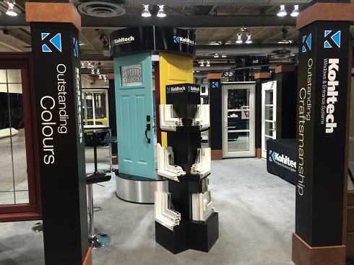
Trade Shows
ABSDA
Home Hardware Spring & Fall
Market
Timbermart National Buying Show
LBM Boston Expo
WRLA Prairie Showcase
Habitation Show, Tough As Nails,
Real Home Show, Ideal Home
Show
Consumer Trade Shows
Contractor Shows
Other trade shows

Slide 9
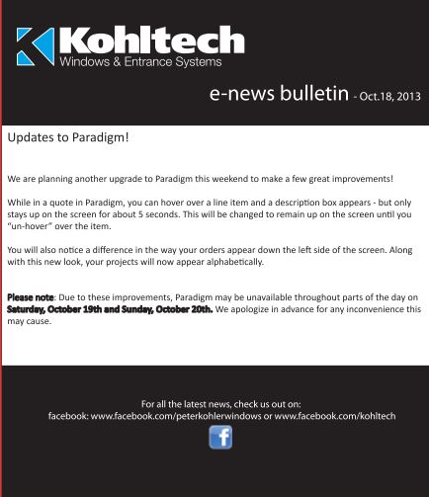



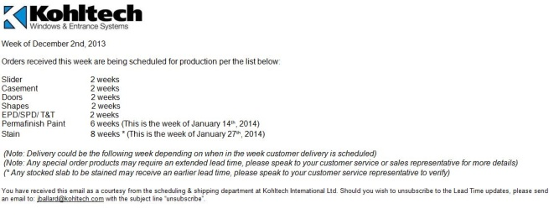
Dealer Communication
E-news Bulletins
Facebook
Twitter
Instagram
Lead Time Report
Road Notes

Slide 10
Dealer Onboarding Package
Kohltech Brand Files
Brand Guidelines
Ad material (newspaper ad templates)
PR Release & Announcement
Radio Ads
Digital copies of brochures
Inclusion on our Dealer map at www.kohltech.com/dealer-finder/

Slide 11
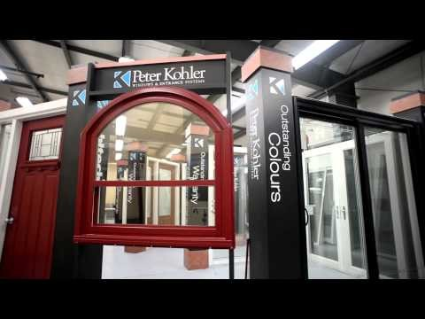
Promotional Video
Available on our website
30 Sec version available for showroom/store TV’s

Slide 12
Questions???

