Slide 1
Who We Are

Slide 2
Table of Contents
Who We Are
Company History
Our Brand
Our Vision
Our Core Values
Our Creed
Our Supplier Partners
Our Commitment to Safety
Our Clearly Green Commitment
Our Commitment to our Community
Notes:
Welcome
Introductions

Slide 3
History of Kohltech
Peter Kohler, P.Eng. began the company manufacturing insulation.
Kevin Pelley and Carl Ballard entered into ownership position.
Peter Kohler retired.
Today, over 400 highly skilled employees produce Kohltech Windows.
Purchased McLeod Windows & Doors in
Edmonton, AB
Purchased Equibuilt Windows in Edmonton, AB
Began producing Vinyl Windows
1977
1982
2007
2008
2010
2014
Notes:
Kohltech began with 4 employees in 1977 when Peter Kohler began manufacturning insulation. 1982, he saw an opportunity in a new product – vinyl windows. He became the first manufacturer of vinyl windows in Atlantic Canada. He started the company with 4 very loyal employees, two of whom are still active within the company.
Peter Kohler helped change the window industry in Atlantic Canada by producing a high quality product and by providing excellent service. Kohltech windows became the largest window manufacturer in Atlantic Canada.
In 2007, KP, CB and KW entered into an ownership position in the company. They continue to provide leadership and vision today.
In 2008, Kohltech purchased a small family owned window company in Edmonton Alberta called Equibuilt Windows. Equibuilt had been manufacturing and retailing vinyl windows for 30 years in the western market.
Peter remained active within the company until his retirement in 2010.

Slide 4
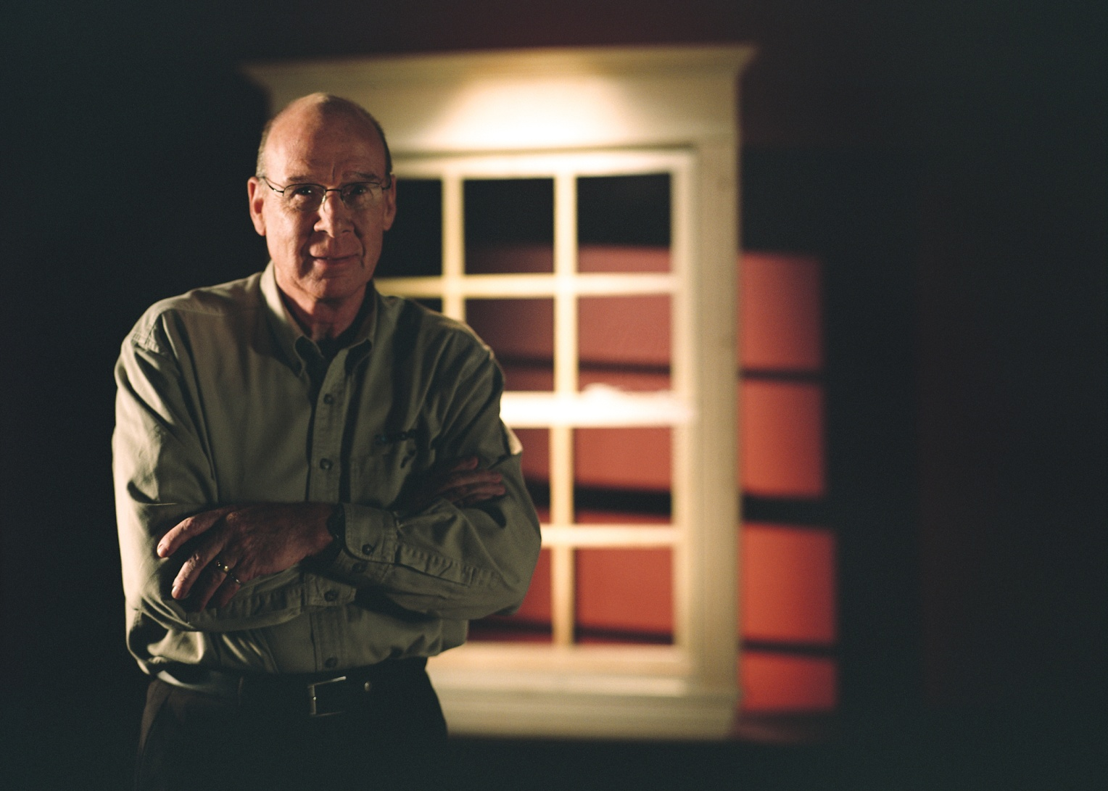
Peter Kohler - Founder

Slide 5
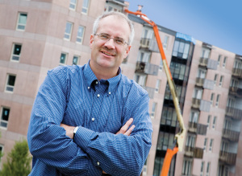
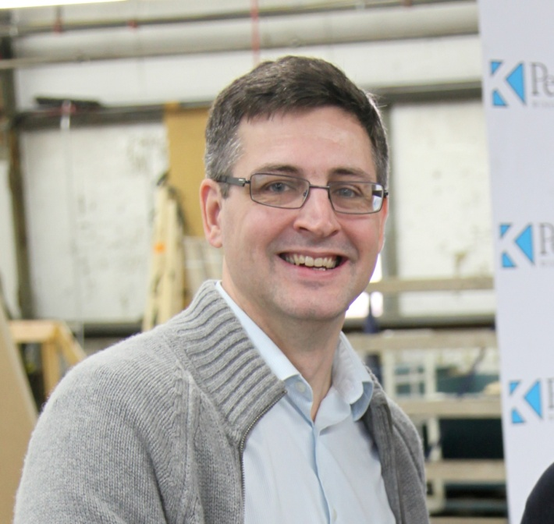
Owner/President Owner/VP Manufacturing and Engineering

Slide 6
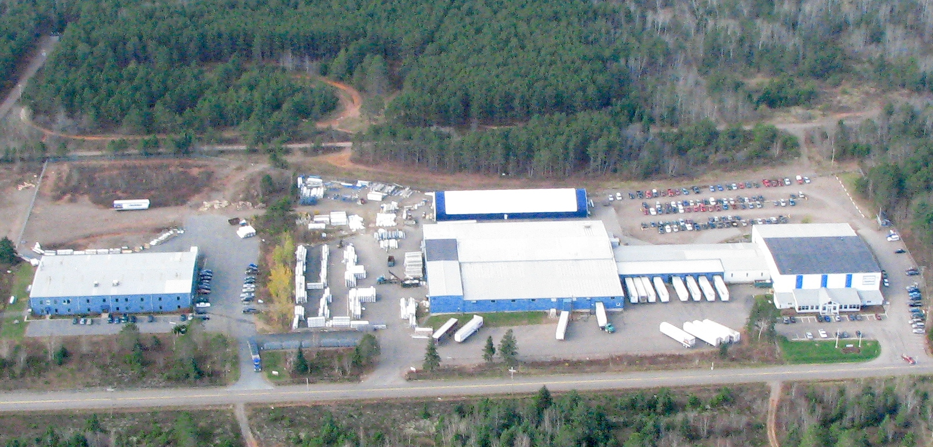
K1 & K2, Debert, Nova Scotia

Slide 7
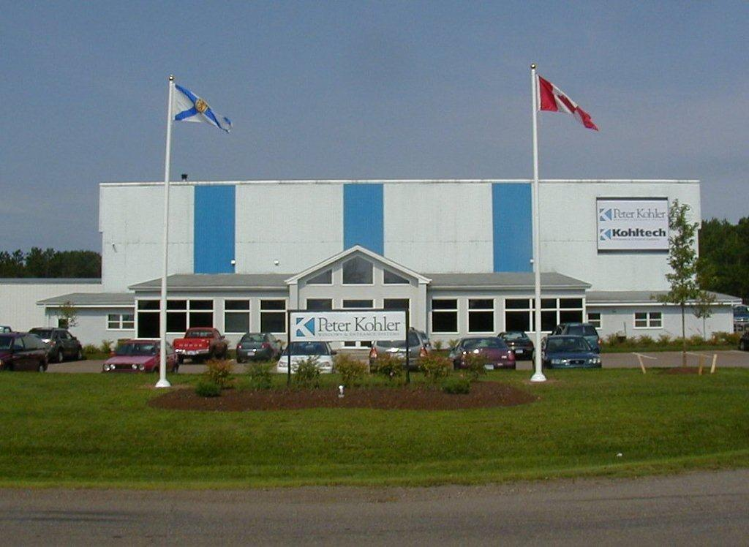
K1 (Customer Service, Glass Plant, Shipping, Window Manufacturing)

Slide 8
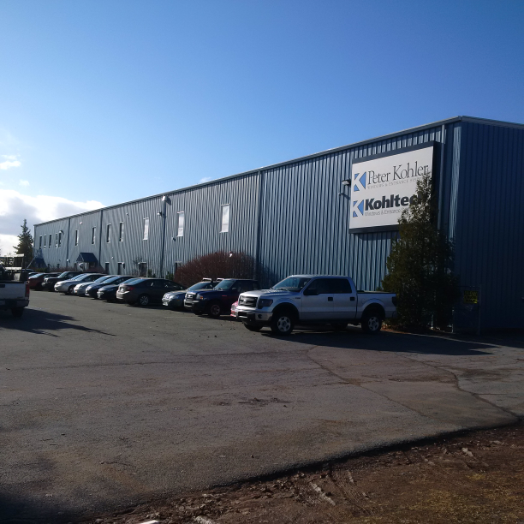
K2 (Door Manufacturing, Paint and Staining, Training Facility)

Slide 9
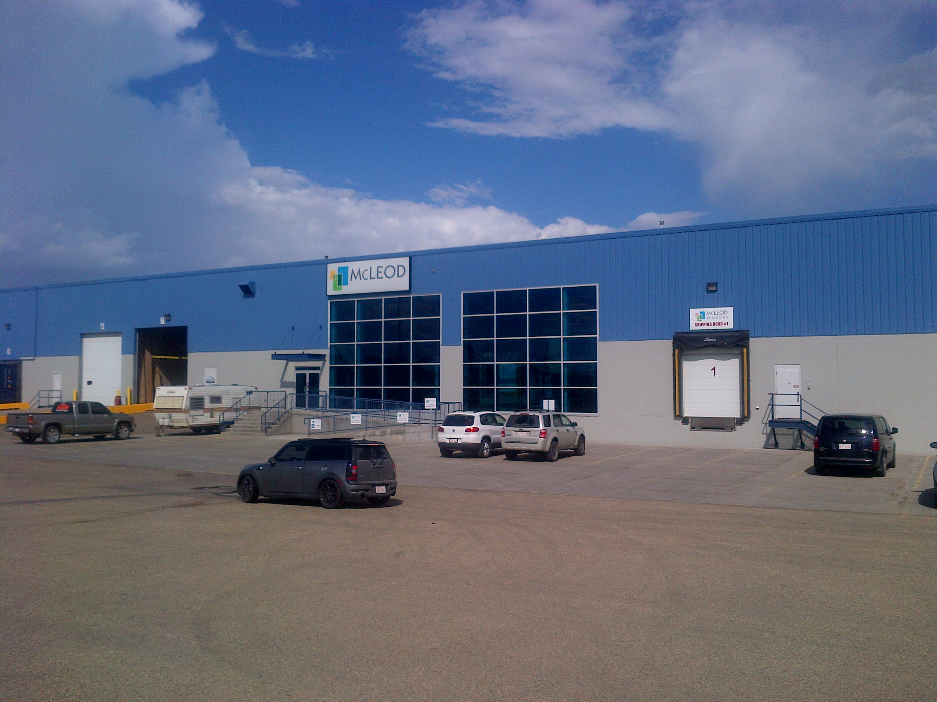
K West – Edmonton, AB

Slide 10
Company History (cont.)
Company History
Today, we operate under one trade name: Kohltech Windows & Entrance Systems. Our comprehensive line of products includes:
  Vinyl and wood/vinyl windows
  Wood, vinyl, wood/vinyl, steel and fibre glass entrance systems
  Patio and terrace door systems
  Commercial window and door systems
  We are proud to strive for continual improvement and growth in serving our customers.
Notes:
Today, Kohltech has over 300 employees, produces in two state of the art facilities (175000 ft2 of manuf. Space. We operate under two tradenames: PK in Atl Canada and Kohltech in all other markets.

Slide 11
Our Brand
Our Brand
Our name on a product promises engineering excellence, beautiful craftsmanship and unparalleled performance.
Kohltech is a brand employees want to work for, dealers want to represent and consumers want in their home.
Notes:
Today we have a brand people recognize . We accomplished this building windows the way Peter Kohler began – high quality and excellent service.
We are proudly a local employer of choice. We take pride in our employees and the workmanship reflects that.
***real estate advertisements will promote a home as having new Kohltech Windows.

Slide 12
The Kohltech Vision
The Vision
The Kohltech Vision is to be North America’s most respected window and door company.
Notes:
The most respected window and door company may not be the largest, but we will be socially responsible, environmentally responsible, treat our employees and customers with respect and deliver our promise consistently.

Slide 13
Our Core Values
Our Core Values
These core values define what Kohltech is all about. The most important thing is the way these values are delivered and brought to life. They are timeless and speak to Kohltech’s essence.
    Service
    Quality
    Innovation

Slide 14
Service
Our Core Values
We believe in providing outstanding service, treating our dealers and homeowners as we would like to be treated.
We stand behind our products. We believe that our reputation is built on the long-term satisfaction of our customers and believe that a warranty is only as good as the company that stands behind it.
Notes:
Service includes customer service, fill rates, invoicing accuracy. We strive to provide service on all parts of our business.

Slide 15
Quality
Our Core Values
Kohltech has set the standard of excellence in window performance. There is an inherent sense of commitment to quality in all that we do, thereby guaranteeing comfort and reliability with every window and door we make.
We are ISO 9001:2008 certified with monthly and yearly audits.
We inspect our products throughout the manufacturing process including 100% final inspection before they leave our facility. Continuous and weekly group audits to ensure we meet or exceed our quality system.
Our glass units are IGMA certified and window and door products are CSA and NFRC certified.
Notes:
At Kohltech, we take quality very seriously. We are ISO9001-2008 certified and we meet in all 20 criteria specified by the International Standards Organization. Conduct monthly internal audits to identify and correct or improve processes and systems.
Continuous product audits, weekly group audits including water testing, weld performance and argon fill testing.
We careful control our production processes to produce excellence everytime the first time. We try to find our opportunities and learn from them before the customer sees them.

Slide 16
Innovation
Our Core Values
Continuous improvement and leadership in product innovation is in our lifeblood in order to deliver products and value customers have not yet imagined.
We invest heavily in R&D to maintain a constant stream of product options and to stay on the leading edge of manufacturing processes.
Notes:
In 2013, we completed 650 system changes and over 200 manufacturing changes.
Launched several new products and over 75 product improvements.

Slide 17
Our Creed
Our Core Values
Our creed was developed by our Management Team to articulate the spirit of our business. We are convinced the integrity of our brand will be maintained through these beliefs.
The corporate culture at Kohltech revolves around a deeply instilled ethic of personal pride and commitment that sets us apart from other manufacturers of windows and doors.
Our creed is distributed and posted throughout all of our facilities.

Slide 18








Our Supplier Partners
Our Supplier Partners
Rehau
PPG
Novatech
Vision
Masonite
Guardian
Roto
Truth

Slide 19
Our Commitment to Safety
Our Commitment to Safety
As an employer, Kohltech is responsible for the health and safety of our employees.
Kohltech makes every effort to provide a healthy and safe work environment.
We are dedicated to the objective of eliminating the possibility of injury and illness.
In 2015 we were awarded the Mainstay Safety Transformation Award

Slide 20

Our Clearly Green Commitment
Clearly Green
We all share one Earth, so it’s in everyone’s best interest to find ways to protect it.
That not only means producing energy-efficient windows and doors, it means producing them in responsible ways that reduce waste, conserve resources and minimize our impact on the environment.
Clearly Green is our commitment as a company to do everything we can to operate in a responsible and sustainable manner.
Notes:
Since we started the Green Team in 2008, we have reduced our waste by over 75% and received the RRFB Business of the Year environmental award for our efforts.

Slide 21
Our Commitment to our Community
Our Community
  Supporter of numerous organizations throughout Canada
  We believe in giving back to our community.

Slide 22
Our Commitment to our Community
Our Community
  Colchester East Hants Health Centre Foundation
  Ignite the Spirit Campaign for Civic Centre Project
  Colchester Community Workshop Foundation
  Relay for Life
  Feed Nova Scotia
  Scholarships/Bursaries
  Support for employees in need
  Support for employee extra curricular activities

Slide 23
Our Commitment to our Community
Our Community
  Major sponsor for IWK Great Big Dig plus recycling donation
  Major sponsor for NS Hearing and Speech Foundation Golf Fundraiser
  Junior Achievement of Nova Scotia
  Healing and Cancer Foundation
  Festival of Trees, Mental Health Association of Nova Scotia
  Eco-action Centre Garden Party
  Children’s Clean Air Network
  Grand Day Event for Cobequid
  Others: Heart and Stroke Foundation, Alzheimer Society, Ronald McDonald House, Big Brothers/Big Sisters, Canadian Cancer Society

Slide 24
Questions???

