Slide 1

Windows

Slide 2
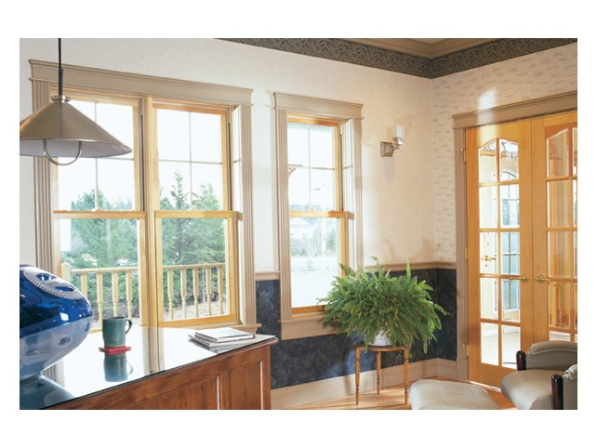
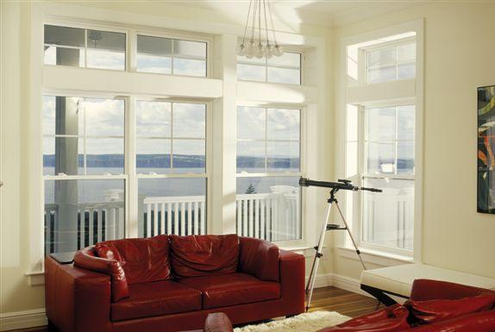
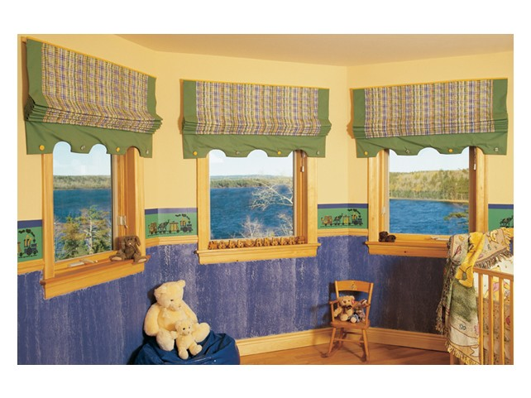
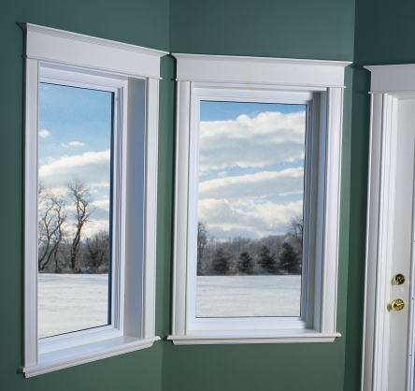
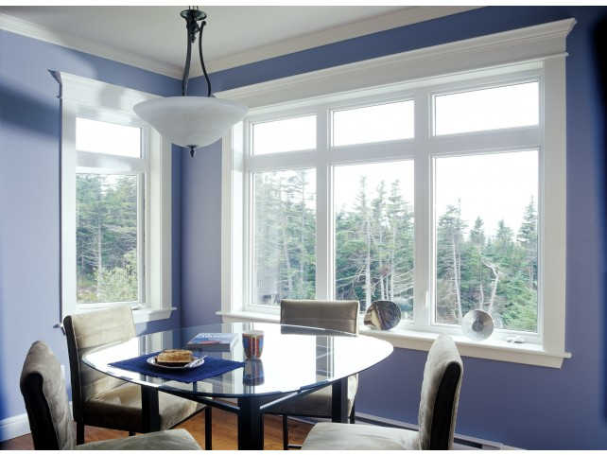
Window Families
Windows
Supreme
Heritage
Estate
Select
Tribute

Slide 3
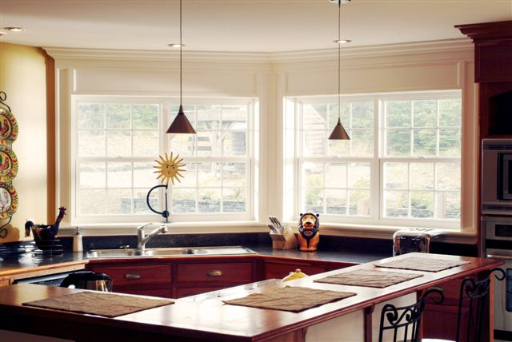
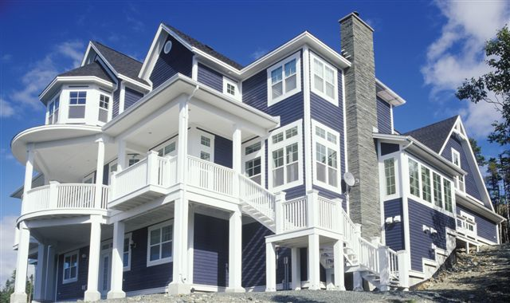
Supreme
Supreme
Kohltech’s Supreme vinyl window represents the pinnacle of design excellence and elegance.
They are virtually maintenance-free, offer superior hardware and security features, are available with Energlas® Plus - the most energy efficient glass on the market, and every window is guaranteed for life.

Slide 4
Supreme Window Types
Supreme
Supreme Casement and Awning
Supreme Single Hung and Double Hung
Supreme Single Glider and Double Glider
Supreme Shapes
Supreme Tilt and Turn

Slide 5
Supreme Windows- NAFS Ratings
Supreme
Window Style | Air | Water | Structural | Forced Entry
Tilt and Turn | A3 | DP100 | DP70 | F10
Tilt and Turn Fixed | A3 | DP100 | DP70 | -
Casement | A3 | DP100 | DP70 | F20
Casement Fixed | FIXED | DP100 | DP70 | -
Awning | A3 | DP100 | DP70 | F20
Narrow Picture Window | FIXED | DP100 | DP70 | -
Single Hung | A3 | DP60 | DP65 | F20
Double Hung | A3 | DP50 | DP65 | F20
Single Hung Picture | FIXED | DP100 | DP60 | -
Single Glider | A3 | DP55 | DP80 | F10
Double Glider | A2 | 45 | DP55 | F20

Slide 6
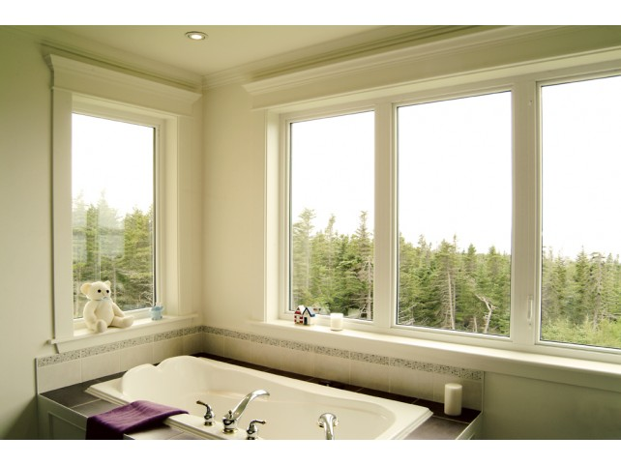
Select
Select
Select is our most popular vinyl window line, and Select windows offer the ideal blend of sophistication, practicality and value.
Standard energy efficient features include high performance perimeter weather-stripping, a concealed drain hole which cuts down on air infiltration and warm edge spacer for maximum heat retention.
Low-E, Low-E Argon and Energlas® glass units are also available on Select windows.

Slide 7
Select Windows-NAFS Ratings
Select
Window Style | Air | Water | Structural | Forced Entry
Casement | A3 | DP100 | DP70 | F20
Casement Fixed | FIXED | DP100 | DP70 | -
Awning | A3 | DP100 | DP65 | F20
Casement Picture Window | FIXED | DP100 | DP70 | -
Single Hung | A3 | DP50 | DP70 | F10
Single Hung Picture Window | FIXED | DP100 | DP55 | -
Single Glider | A3 | DP50 | DP55 | F20
Double Hung | A2 | DP50 | DP50 | F10

Slide 8
Select Window Types
Select
Select Casement and Awning
Select Single Hung
Select Double Hung
Select Single Glider
Select Shapes

Slide 9
Casement Comparison
System Comparison
Supreme | Select
3-1/4” Frame depth | 3-1/4” Frame depth
Integral drywall return | Integral drywall return
1-3/8” & ¾” Glazing options | ¾” Glazing option
Stainless steel hardware standard | Stainless steel hardware optional
Contoured glazing stop | Square glazing stop
Multipoint locking system 2 thru 5 points | Multipoint locking system 2 thru 4 points
Hidden prep for installation | Visible prep for installation
Tape sash glazing with tower co-ex | Tape sash glazing with tower co-ex
0.075” Outer wall thickness | 0.071” Outer wall thickness
Stainless Steel Hinges | Coated Hinges

Slide 10
Slider Comparison
System Comparison
Supreme | Select
3-1/4” Frame depth with integral drywall return | 3-1/4” Frame depth with integral drywall return
Auto-night lock standard | No night lock available
Robust lock & keeper with auto lock optional | Slim line lock & keeper
¾” & 1” Glazing options (dual & triple with internal grills ) | ¾” Glazing option
Robust sash (heartier reinforcement & SDL option) | Slim line sash SDL not available
Stainless steel constant force balance springs | Spiral balance springs
Head closeout on frame | Open head pocket on frame
Sash restriction available | Sash restriction available
Chambered glazing up-stand | Single wall glazing up-stand
More reinforcement options for commercial applications | Standard t-mullion and mulled reinforcement options

Slide 11
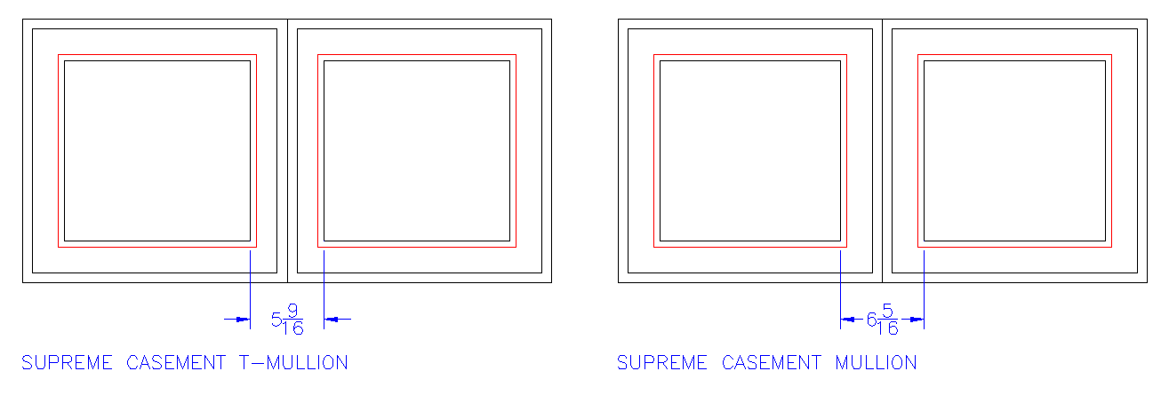
Window Frame Systems
T-mullion vs Mulled

Slide 12
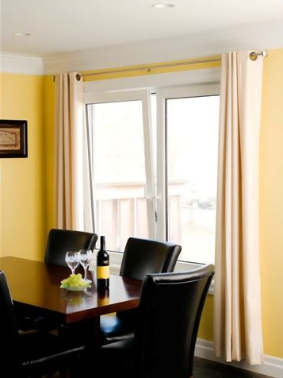
Tilt & Turn
Tilt &Turn
Options
Brickmould
Grills
Grill Patterns
Glass
Drywall Return
Jamb Extension
Paint
Hardware

Slide 13
Features and Benefits
Tilt & Turn
Top of the line product
Boasts the thickest exterior walls we offer and is available in a fully reinforced configuration for maximum structural performance
Windows can be standard tilt & turn, fixed sash, direct glaze in the frame, or hopper style.
High quality multipoint locking hardware provides versatility of operation and maximum security and egress
Available in white profile with optional painted interior/exterior

Slide 14
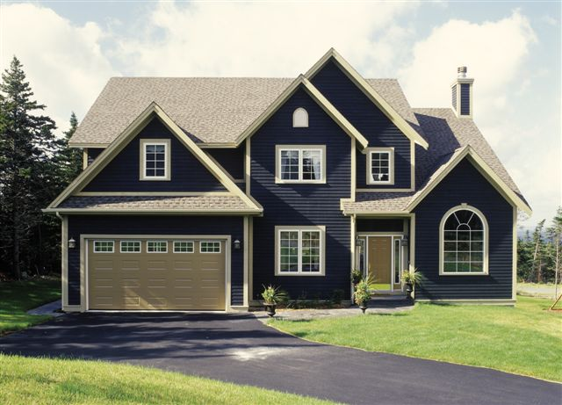
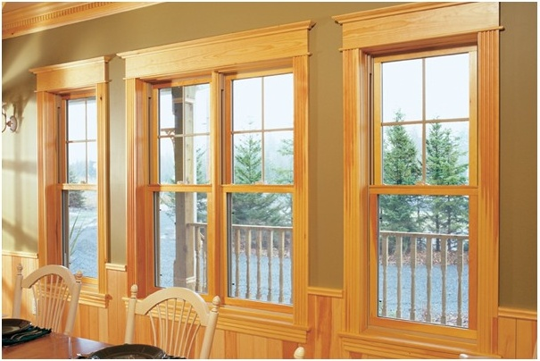
Heritage
Heritage
Kohltech’s Heritage family
  Eastern Canadian pine on the interior,
  Rugged performance and protection of solid vinyl on the exterior.
With a wide variety of styles,
  Colours and energy efficient glass options
  Sloped sill for proper drainage and
  Component warranties from 5-year to lifetime

Slide 15
Heritage Window Types
Heritage
Heritage Double Hung
Heritage Casement and Awning
Heritage Replacement
Heritage Shapes

Slide 16
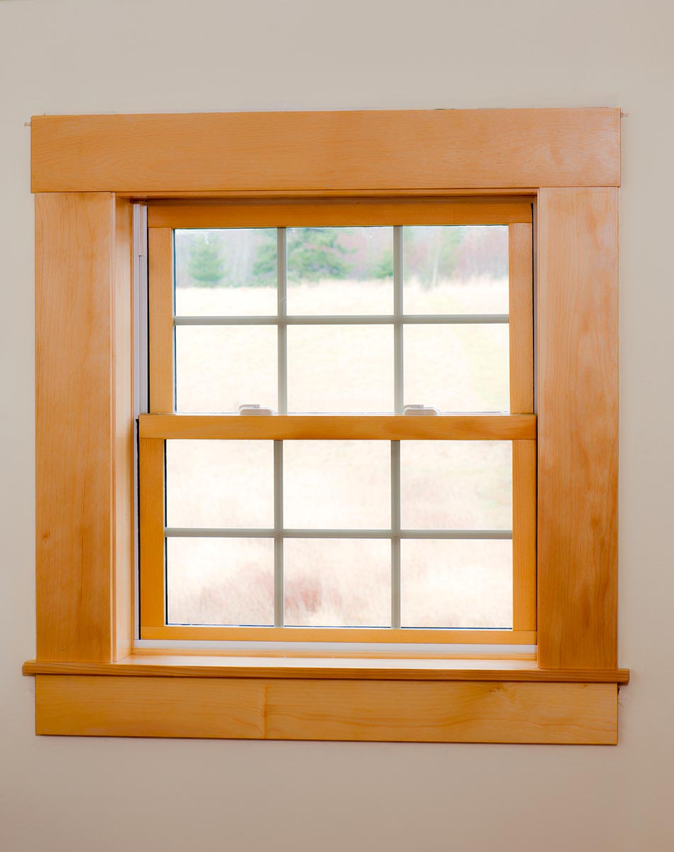
Heritage Double Hung
Heritage Double Hung
Options
Brickmould
Grills
Grill Pattern
Glass
Varied Jamb Extension Depths
Replacement Frame
Paint

Slide 17
Features and Benefits
Heritage Double Hung
Fully welded frame and sash profiles provide reliable performance
Sloped sill for added performance and classic look
Wood clad frame for classic feel
All the performance benefits of vinyl on the exterior with the beauty of pine on the interior
Equal light sashes where both sash tilts in for quick and easy cleaning
Sashes stay in place with stainless steel constant force coil balances
Patented sash construction that withstands the traditional issues of wood sashes

Slide 18
Features and Benefits (cont.)
Heritage Double Hung
Optional safety features such as night latches and sash restrictors
Flexible glazing options with ability to use ¾” or 7/8” insulated glass units
4-5/8” & 6-5/8” standard frame depths are great for new construction and renovation projects
Stainless steel pivot bars
Screen pull tabs are integrated into the corners for increased strength and durability

Slide 19
Features and Benefits (cont.)
Heritage Double Hung
Supreme cam locks for security
No exterior lines in the frame profile
Thick double walled glazing up-stand for improved aesthetics and performance
Steel reinforced sash
Available with full or half screen
Available in white or Tan profile with optional painted exterior and primed interior

Slide 20
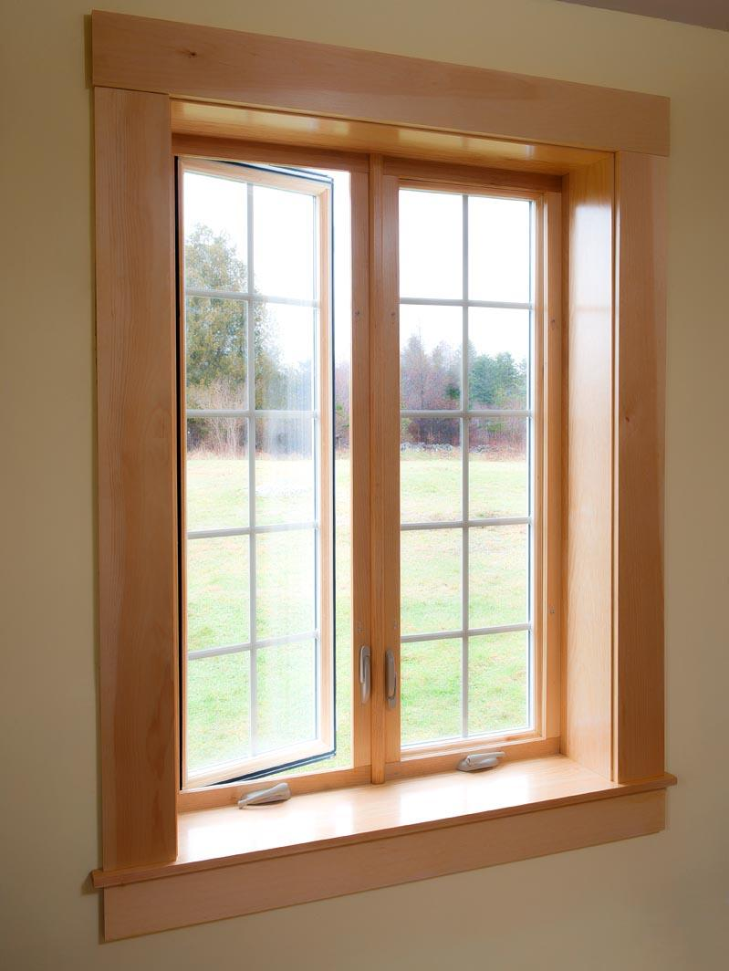
Heritage Casement
Heritage Casement
Options
Brickmould
Grills
Grill Pattern
Glass
Variety of Jamb Extension Depths
Paint
Variety of Hardware Finishes

Slide 21
Features and Benefits
Heritage Casement
All the performance benefits of vinyl on the exterior with the beauty of pine on the interior
Beautiful, clear wood interior finish
Durable vinyl construction
Same options as Supreme
Fully welded frame and sash profiles provide reliable performance
Interior screen – easy removal for cleaning
Available in white or Tan profile with optional painted exterior and primed interior

Slide 22
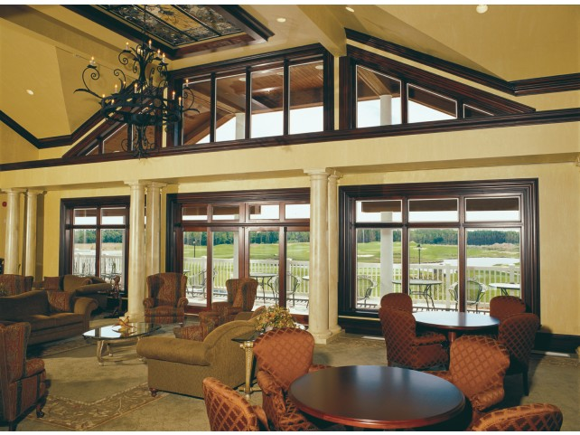
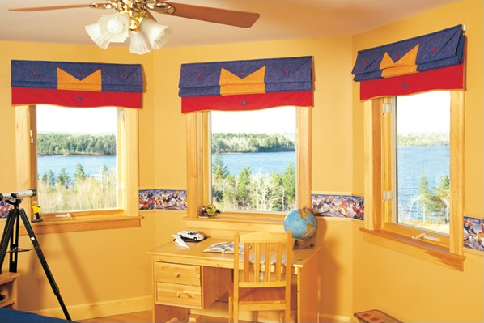
Estate
Estate
The Estate wood/vinyl window family strikes the perfect balance of design efficiency, innovation, durability and character.
  The virtually maintenance-free vinyl exterior
  Energy efficient features and reliable cam locks

Slide 23
Estate Window Types
Estate
Estate Double Hung
Estate Casement and Awning
Estate Shapes

Slide 24
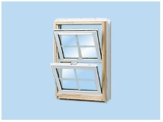
Estate Double Hung
Estate Double Hung
Options
Brickmould
Grills
Grill Pattern
Glass
Variety of Jamb Extension Depths
Paint

Slide 25
Features and Benefits
Estate Double Hung
Fully welded frame and sash profiles provide reliable performance A3/B6/C5 (PG70)
Sloped sill for added performance and classic look
Wood clad frame for classic feel
Equal light sashes where both sash tilts in for quick and easy cleaning
Sashes stay in place with stainless steel constant force coil balances
Optional safety features such as night latches and sash restrictors

Slide 26
Features and Benefits (cont.)
Estate Double Hung
Flexible glazing options with ability to use ¾” or 7/8” insulated glass units
4-5/8” & 6-5/8” standard frame depths are great for new construction and renovation projects
Stainless steel pivot bars
Screen pull tabs are integrated into the corners for increased strength and durability
Supreme cam locks for security
No exterior lines in the frame profile

Slide 27
Features and Benefits (cont.)
Estate Double Hung
Thick double walled glazing up-stand for improved aesthetics and performance
Steel reinforced sash
Available with full or half screen
Available in white or Tan profile with optional painted exterior and primed interior.

Slide 28
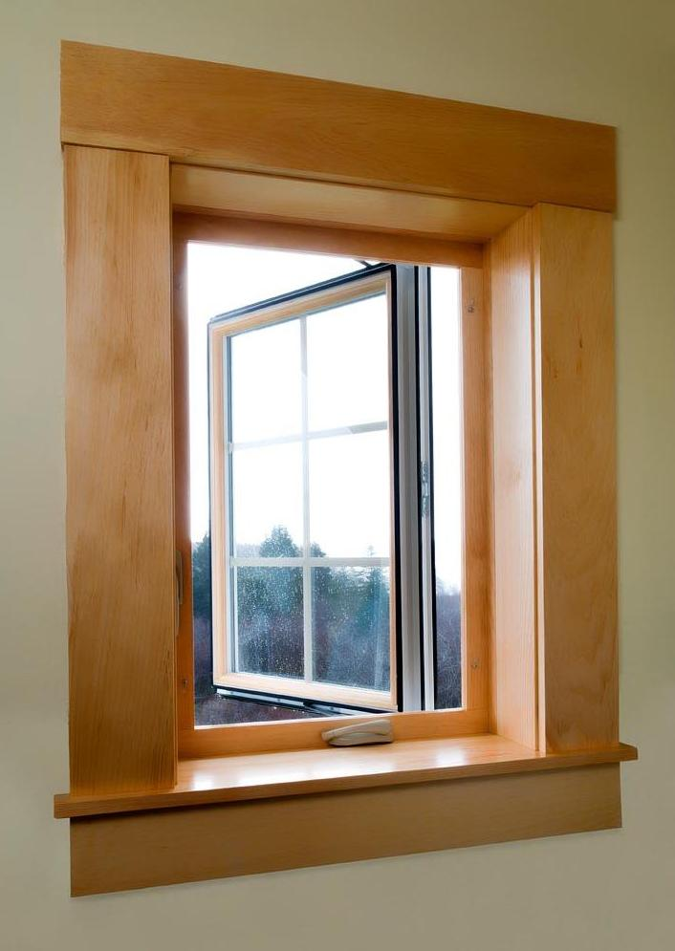
Estate Casement and Awning
Estate Casement and Awning
Options
Brickmould
Grills
Grill Pattern
Glass
Variety of Jamb Extension
Paint
Variety of Hardware Finishes

Slide 29
Features and Benefits
Estate Casement and Awning
Beautiful, paint-grade wood interior finish
Wood clad frame for classic feel
Durable vinyl construction
Same options as Supreme
Fully welded frame and sash profiles provide reliable performance
Interior screen – easy removal for cleaning
Available in white or Tan profile with optional painted exterior and primed interior

Slide 30
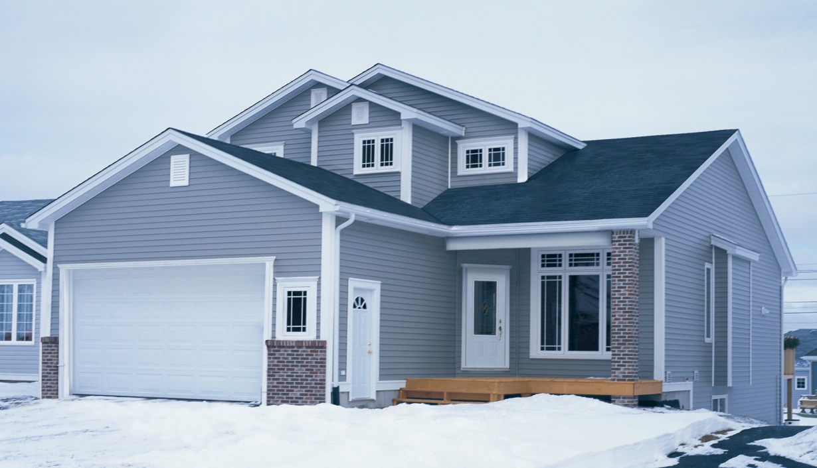
Tribute
Tribute
The Tribute family of windows offers good performance at a low price.

Slide 31
Tribute Window Types
Tribute
Tribute Casement and Awning
Tribute Single Hung

Slide 32
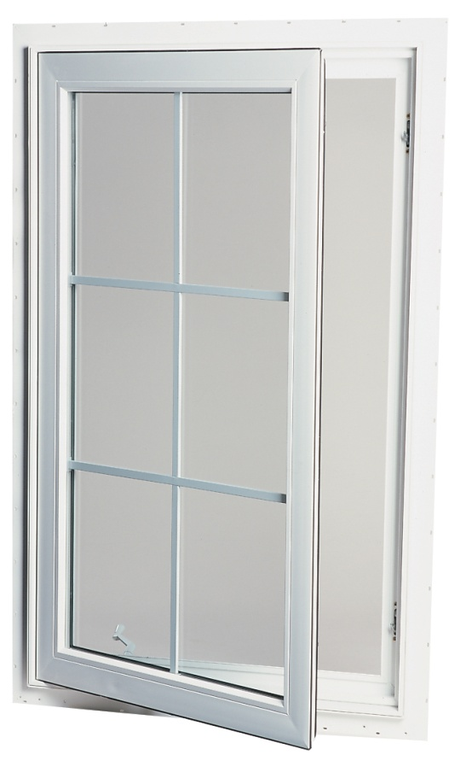
Tribute Casement and Awning
Tribute Casement and Awning
Options
Integral BM only
Integral Drywall Return
T-mullion
Paint

Slide 33
Features and Benefits
Tribute Casement and Awning
Basic options
Good performance
Low price
31/4” frame depth

Slide 34
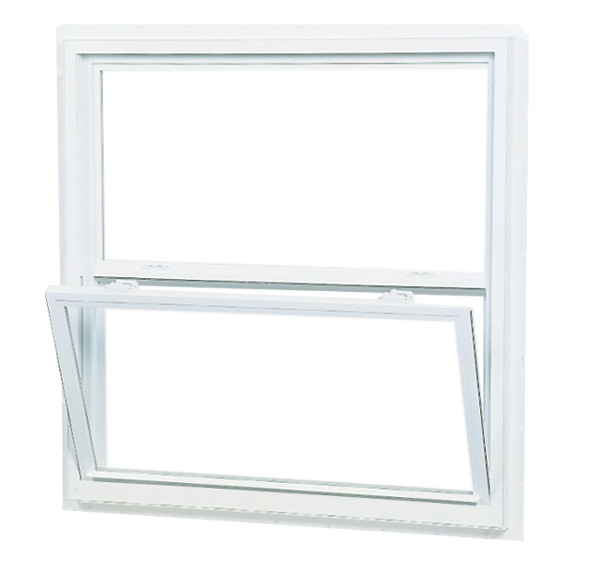
Tribute Single Hung
Tribute Single Hung
Options
Nailing Fin or J-clip
Add on Drywall Return

Slide 35
Tribute Single Hung- Features and Benefits
Tribute Single Hung
Single sash tilts in for quick and easy cleaning
Sash stays in place with spiral balances
2 5/8” frame depth
Available with integrated nail fin or with siding J
Externally Glazed Operating Sash with Integral Lift Rail

Slide 36
Tribute Single Hung- Features and Benefits (cont.)
Tribute Single Hung
Over-lapped glazing stop for consistent clean finish
Fully supported pivot bar for added strength
Steel reinforced T-mullion system
Screen pull tabs are integrated into the corners for increased strength and durability
Low profile locking hardware

Slide 37
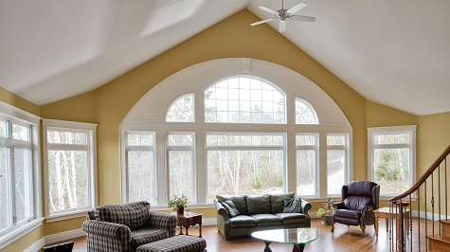
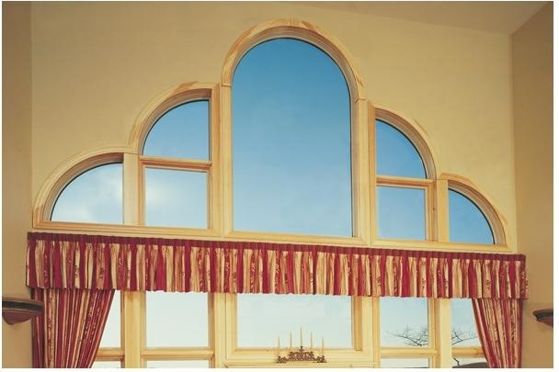
Shapes
Shapes
We offer a wide variety of shape windows, custom-made to the dimensions of your choice.
Shapes come in Supreme, Heritage, Estate or Select profile.

Slide 38
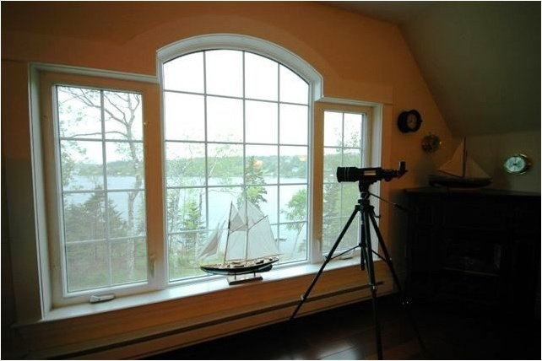
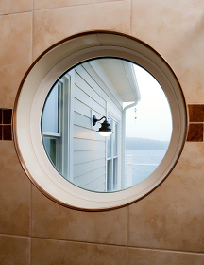
Shapes- Options
Shapes
The options for Shape windows correspond to the type of frame from which they are made.
Ex: Supreme Shapes can be:
  painted,
  have 3 ½ brickmould
  and feature Energlas® Plus glass, as can all of our Supreme windows.

Slide 39
Shape Limitations
Shapes
Bending limitations are related to the amount of vinyl in a frame, the configuration and the desired radius.
Generally speaking, the stronger the frame, the harder it is too bend.
Frames and exterior trims have different minimum bends. For example:
  Narrow picture frame minimum = 12” radius
  Main frame (SSH) = 18” radius
  Larger exterior trims such as 3-1/2” Brickmold require a 30” minimum radius.
Other exceptions depending on configuration.
All rules and minimums are built into the Paradigm Quoting Software.

Slide 40
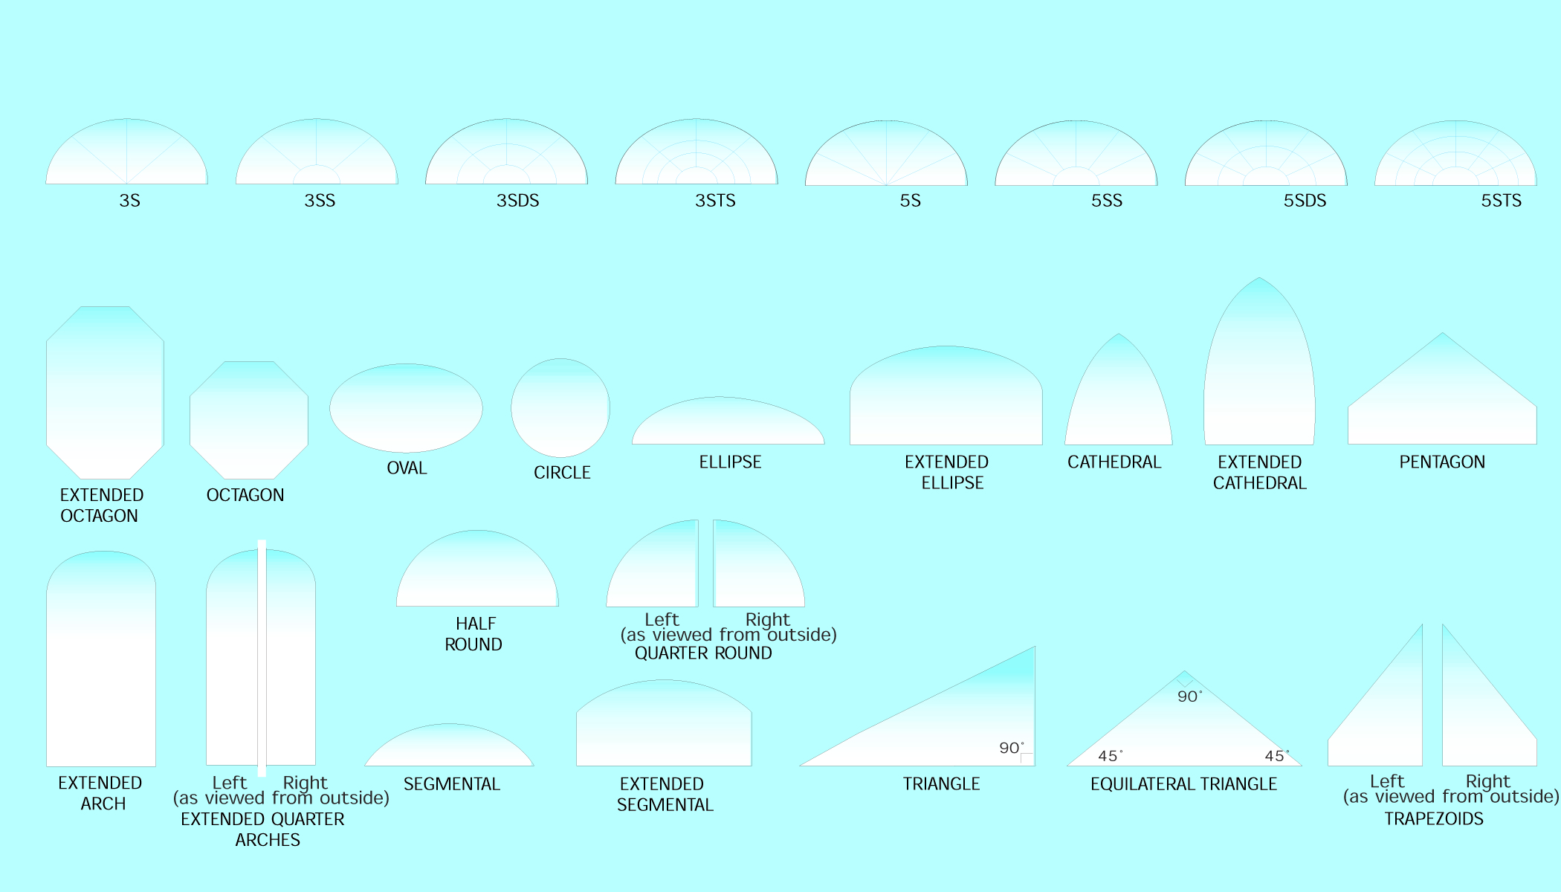
Shapes- Available Shapes
Shapes

Slide 41
Our Warranty
Our Warranty
Component | Supreme Heritage Series and Tilt and Turn | Select - Estate Series | Tribute Series | Commercial
Insulated Glass Unit | Lifetime | 30 Years | 10 Years | 10 Years
Hardware | Lifetime | 30 Years | 1 Year | 1 Year
Frame/Sash | Lifetime | 30 Years | 10 Years | 10 Years
Factory Applied Coating | 10 Years | 10 Years | 10 Years | 10 Years
Labour* | Lifetime | 30 Years | 1 Year | 1 Year
* Labour in the US is covered for 1 year for all products

