Slide 1
Window Options

Slide 2
Table of Contents
Window Options
Vinyl Colors
Exterior Trims
Interior Trims
Paint
Hardware
Grills
Glass Units

Slide 3
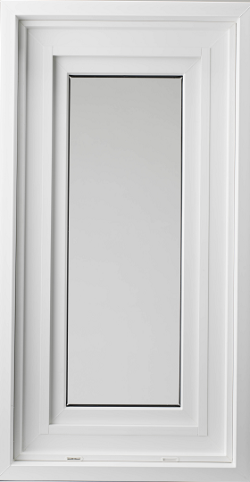
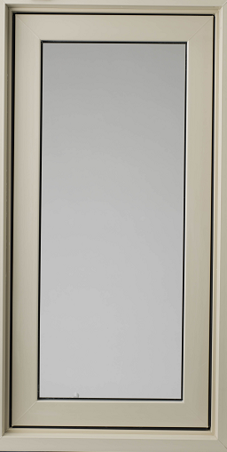
Extruded Vinyl Colours
Vinyl Colours
Many of the vinyl windows produced by Peter Kohler/Kohltech can be made using either white or tan vinyl.

Slide 4
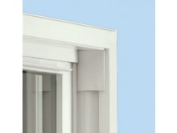
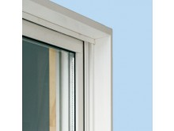
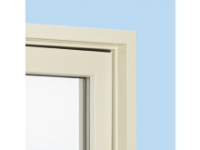
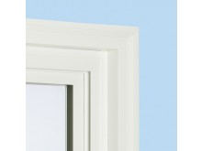
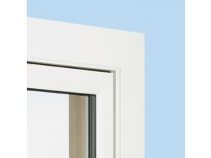
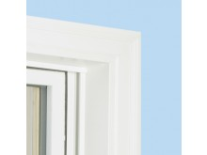
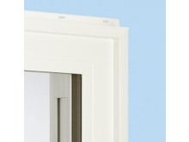
Exterior Trims
Exterior Trims
Plain Frame
7/8” Brickmould
1 ½” Brickmould (also available in extended form)
2” 180 Brickmould
3 ½” Brickmould
3 ½” 180 Brickmould
Nailing Fin
2” 2 Piece

Slide 5
Interior Trims
Interior Trims
Drywall Return
  ½” Add-on Drywall Return
  ¾” Add-on Drywall Return
Jamb Extension (3/4” thick PVC or Wood/Clad)
  1 ¾” PVC Jamb Extension, stackable
  3 ¾” PVC Jamb Extension, stackable
  ¾” x 2 5/8” Wood Jamb Extension
  ¾” x 3 5/16” Wood Jamb Extension
  ¾” x 4 5/8” Wood Jamb Extension
  ¾” x 5 ¼” Vinyl Clad Wood Jamb Extension

Slide 6
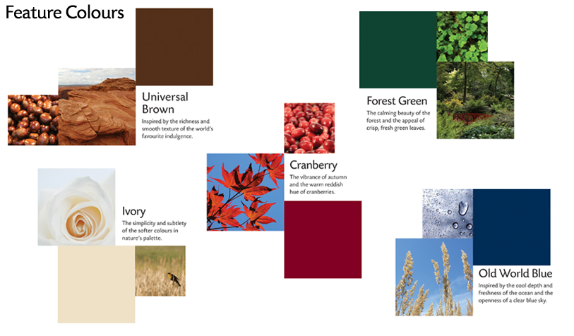
Paint
Paint

Slide 7
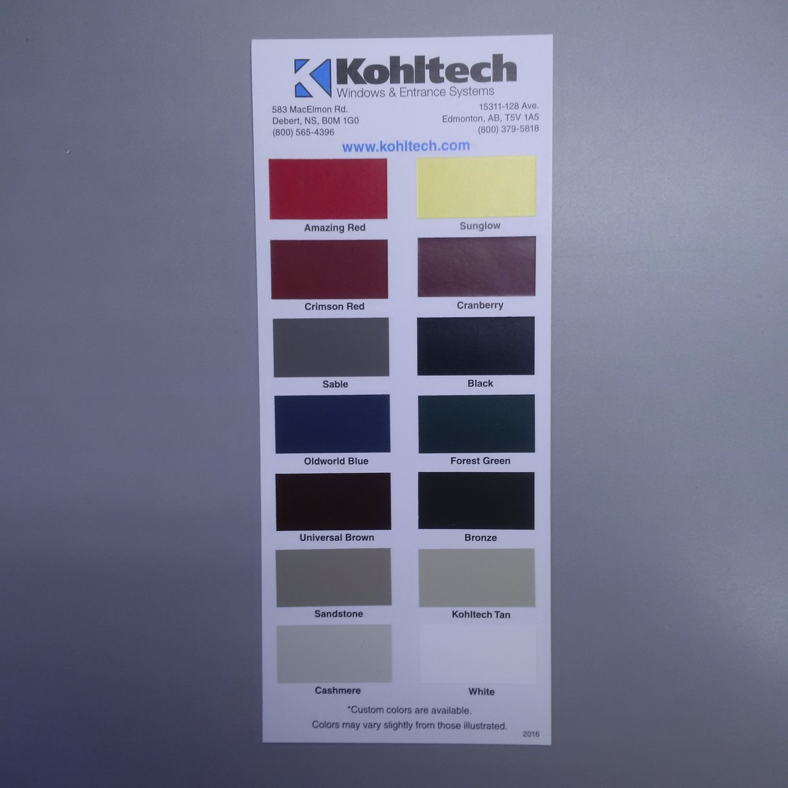
Paint (cont.)
Paint
*Custom colours available
upon request

Slide 8
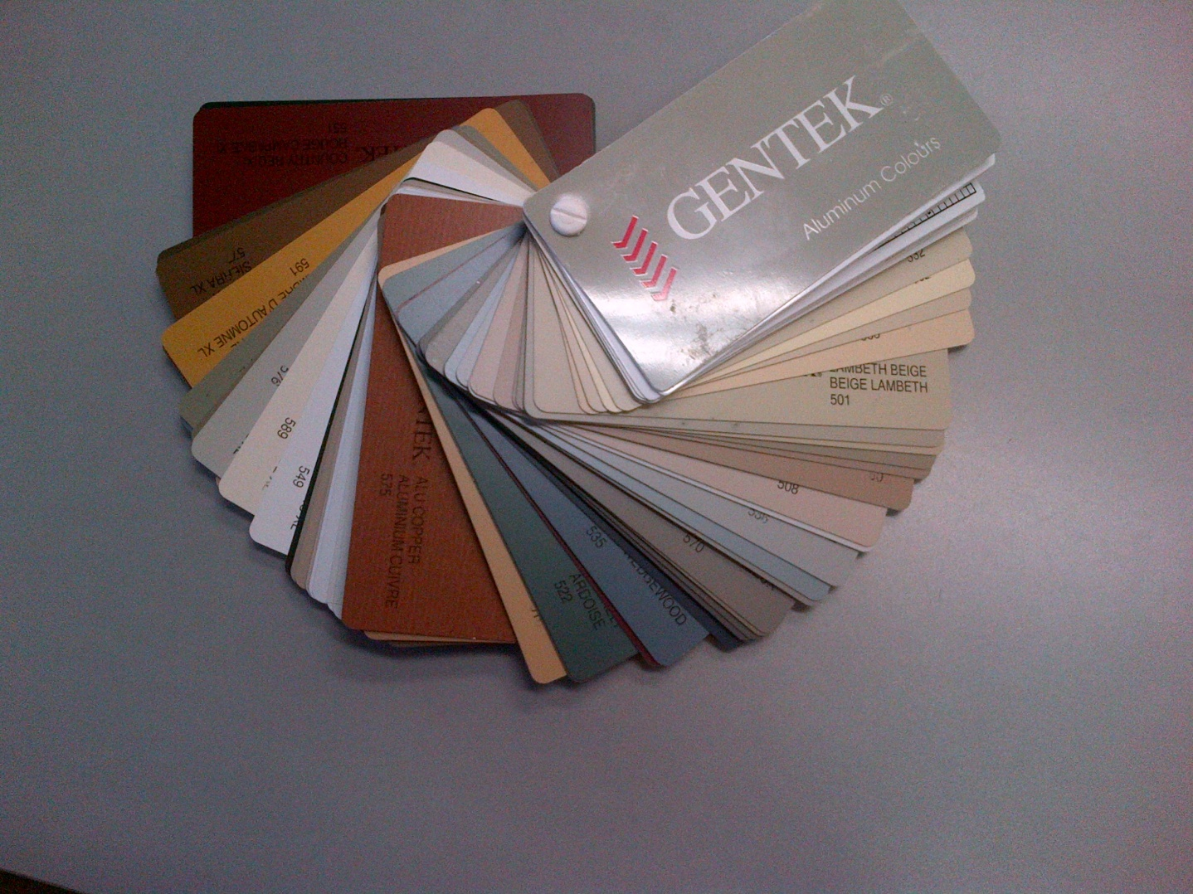
Paint (cont.)
Paint
We can also match popular colors quickly

Slide 9
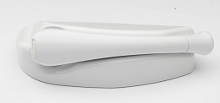
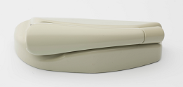
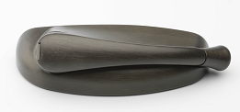
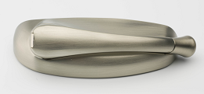
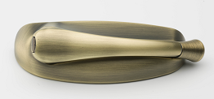
Hardware
Hardware
White
Tan
Oil Rubbed Bronze
Brushed Nickel
Antique Brass

Slide 10
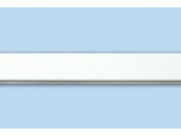
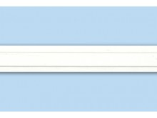
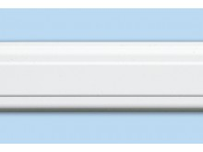
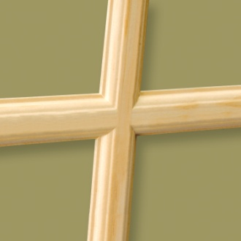
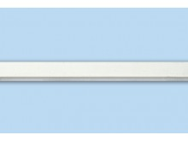
Grills and Simulated Divided Light (SDL) Bars
Grills and SDLs
Colonial (5/8”)
Georgian (3/4” or 1”)
PVC SDL
(7/8” or 1 1/4”)
Wood SDL
(0.875 “ or 1.22”)
5/16” Slimline

Slide 11
5/16” Slimline Grills
Grills and SDLs
Our slimline grills come in 6 colours:
Pewter
Chrome
Brass
Black
Tan
White

Slide 12
Other Options
Options
Sash Restrictors
Subsill
Flush nosing

Slide 13
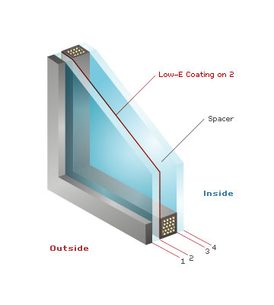
Glass
Glass
3 factors can impact glass performance
  Low-E coatings
  Gas filling
  Spacers

Slide 14
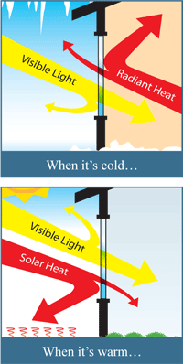
Low-E Coatings
Glass
Ultra thin metallic coating on the glass that reflects heat back to its source – which could be inside or outside
Low-E coating also reflect UV rays, reducing UV damage to furniture and flooring.
Kohltech offers two types of Low-E coating:
  High Solar Gain, Guardian 8070
  Low Solar Gain, Guardian 7138

Slide 15
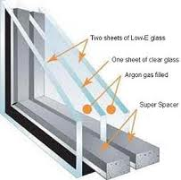
Gas Filling
Glass
The heavier the gas, the heat loss across the glass unit.
We use 3 types of gas;
Air : Natural insulator
Argon: An inert gas, heavier than air, better insulator than air
Krypton: Heavier than argon, better insulator than argon, particularly on smaller widths

Slide 16
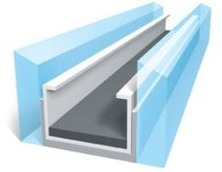
Spacers
Glass
Intercept® Tinplate, made with tin-plated steel.
  provides condensation resistance,
  reduced heat loss
  and improves the life expectancy of an IG.
Intercept® Ultra, made with stainless steel,
  offers improved energy efficiency over Intercept® Tinplate.
  Our trademarked Energlas units are produced using this spacer.

Slide 17
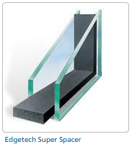
Spacers
Super Spacer® is a flexible spacer option
  That performs as well as the Ultra spacer.
  Can be bent so it is ideal for shaped windows.
  This spacer is also used for triple glazed units

Slide 18
Offered IG Units
Glass
Energlas® Plus:
  Triple glazed thermopane,
  combines 2 panes of HSG Low-E on surfaces 3 & 5
  both cavities filled with inert gas
  Superspacer
Energlas®:
  Double glazed thermopane,
  Guardian HSG Low-E 0n surface #3
  Argon gas
  Intercept Ultra spacer
Energlas® Plus LSG and Energlas® LSG:
  For year round comfort keeping a home cool in the summer.
  LSG Lo-E is on surface #2 (and #4).
  Offers the lowest U values and solar heat gain coefficients.

Slide 19
Offered IG Units
Low-E/Argon:
  Double glazed thermopane
  HSG Low-E on surface #3 with Argon gas filling.
  Tin plated steel spacer
Clear Glass:
  Our standard glazing and most economical choice.

Slide 20
Kohltech Glass Options
Option | Glazing | Surface 2 | Airspace 1 | Surface 3 | Surface 4 | Airspace 2 | Surface 5 | Unit Size | Spacer
Energlas Plus HSG | Triple Glazed, Lo-E/Argonx2 | Clear | Argon | HSG | Clear | Argon | HSG | 1-3/8" | Superspacer
Energlas Plus LSG | Triple Glazed, Lo-E/Argonx2 | LSG | Argon | Clear | LSG | Argon | Clear | 1-3/8" | Superspacer
Energlas HSG | Double Glazed, Lo-E/Argon | Clear | Argon | HSG | Clear | N/A | N/A | 3/4" | Ultra SS Intercept
Energlas LSG | Double Glazed, Lo-E/Argon | LSG | Argon | Clear | Clear | N/A | N/A | 3/4" | Ultra SS Intercept
LoE Argon HSG | Double Glazed, Lo-E/Argon | Clear | Argon | HSG | Clear | N/A | N/A | 3/4" | Tin Plate Intercept
LoE Argon LSG | Double Glazed, Lo-E/Argon | LSG | Argon | Clear | Clear | N/A | N/A | 3/4" | Tin Plate Intercept
Clear | Double Glazed | Clear | Air | Clear | Clear | N/A | N/A | 3/4" | Tin Plate Intercept
Clear | Triple Glazed | Clear | Air | Clear | Clear | Air | Clear | 1-3/8" | Superspacer
Triple LoE Argon x 1, HSG | Triple Glazed, Lo-E/Argonx1 | Clear | Air | Clear | Clear | Argon | HSG | 1-3/8" | Superspacer
Triple LoE Argon x 1, LSG | Triple Glazed, Lo-E/Argonx1 | LSG | Argon | Clear | Clear | Air | Clear | 1-3/8" | Superspacer
Note: The Supreme Slider Triple glazed has a 7/8" unit size
Other Glass Options in Paradigm:
Bronze Tint, Grey Tint, Obscure, Rain, Satin Deco, Tempered, Laminated

Slide 21
Kohltech Glass Options
Kohltech Energy Ratings
Option | Energy Rating | R- Value Centre of glass | R-Value of entire window | U-Value Metric Imperial |  | SHGC | Grills | CR
Energlas Plus LSG | 30 | 8.3 | 5.9 | 1.0 | 0.17 | 0.20 | No | 78
Energlas Plus LSG Grills | 29 | 8.3 | 5.9 | 1.0 | 0.17 | 0.18 | Yes | 78
Energlas Plus HSG | 40 | 7.1 | 5.6 | 1.0 | 0.18 | 0.39 | No | 77
Energlas Plus HSG Grills | 37 | 7.1 | 5.6 | 1.0 | 0.18 | 0.35 | Yes | 77
Triple Low E Argon x 1 LSG | 27 | 5.3 | 4.8 | 1.2 | 0.21 | 0.23 | No | 71
Triple Low E Argon x 1 LSG Grills | 26 | 5.3 | 4.8 | 1.2 | 0.21 | 0.21 | Yes | 71
Energlas LSG | 22 | 4.1 | 3.8 | 1.5 | 0.26 | 0.25 | No | 61
Energlas LSG Grills | 21 | 4.1 | 3.8 | 1.5 | 0.26 | 0.23 | Yes | 61
Energlas HSG | 32 | 3.7 | 3.7 | 1.5 | 0.27 | 0.45 | No | 59
Energlas HSG Grills | 30 | 3.7 | 3.7 | 1.5 | 0.27 | 0.41 | Yes | 59
LoE Argon LSG | 20 | 4.1 | 3.7 | 1.5 | 0.27 | 0.25 | No | 58
LoE Argon LSG Grills | 19 | 4.1 | 3.7 | 1.5 | 0.27 | 0.23 | Yes | 58
LoE Argon HSG | 31 | 3.7 | 3.6 | 1.6 | 0.28 | 0.45 | No | 57
LoE Argon HSG Grills | 28 | 3.7 | 3.6 | 1.6 | 0.28 | 0.41 | Yes | 57
Triple Clear | 29 | 3.2 | 3.4 | 1.6 | 0.29 | 0.44 | No | 62
Triple Clear Grills | 27 | 3.2 | 3.4 | 1.6 | 0.29 | 0.40 | Yes | 62
Clear | 17 | 2.1 | 2.4 | 2.3 | 0.41 | 0.49 | No | 47
Clear Grills | 14 | 2.1 | 2.4 | 2.3 | 0.41 | 0.44 | Yes | 47
Note: All data is for Supreme Casement except for Center of Glass R value which applies specifically to the glass option
Note: Energlas Products produced in Edmonton use Superspacer and not Ultra SS Intercept

Slide 22
Comparison Chart: Clear Glass vs. Low-E
Glass
 | Winter Warmth | Heat Gain | Cool in the Summer | UV Protection | Appearance/Clarity | Overall
Clear Glass | Good | Best | Good | Good | Best | Good
HSG 8070(3) | Better | Better | Better | Better | Better | Best
LSG 7138(2) | Best | Good | Best | Best | Good | Better

Slide 23




Other Glass Options
Glass
Obscure
  Rain Glass
  Satin Deco
  Pinhead
Tempered
Laminated
Tinted

