Slide 1
Window Installation

Slide 2
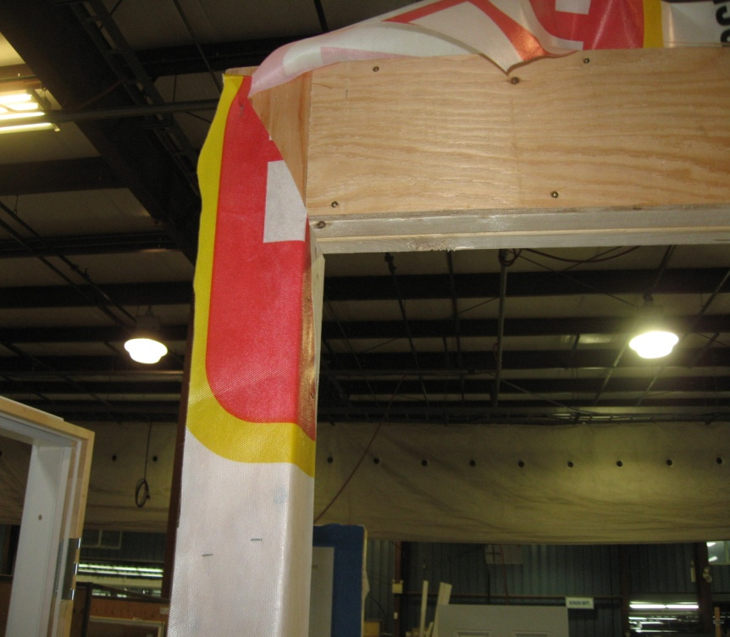
Cut the weather resistant barrier from the rough window opening;
Cut the top portion to create a 12” flap and
temporarily tape above the head.
Notes:
2

Slide 3
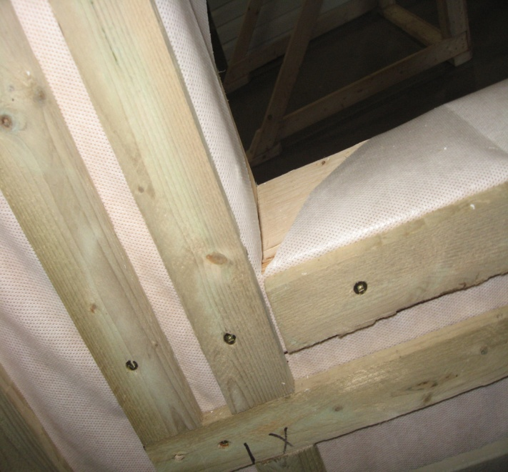
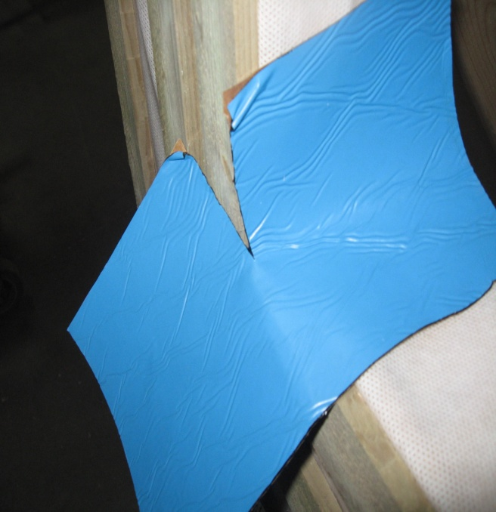
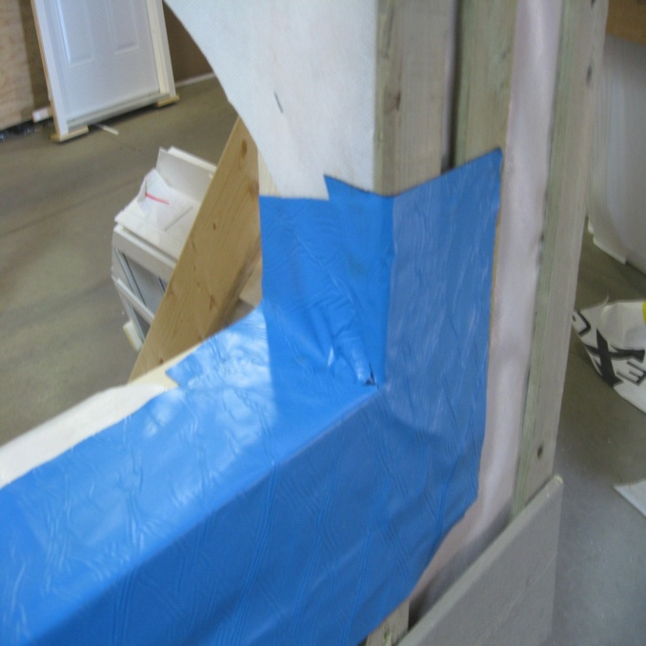
Install sill pan flashing;
Along sill
Overlap into rough opening
Up 6” to 8” of jamb
Cut out 2 pieces to overlap your corners
Notes:
3

Slide 4
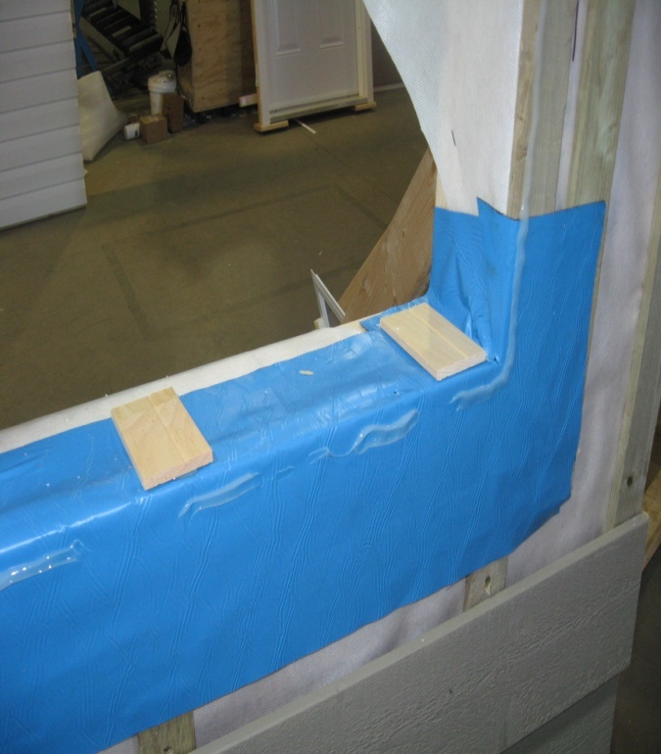
Shim the sill and jambs;
allow a minimum ¼” to ½” gap between the window and rough opening.
Note: When installing twin or triple units, shim the sill directly under the T-Mullion(s) for added support
.

Slide 5
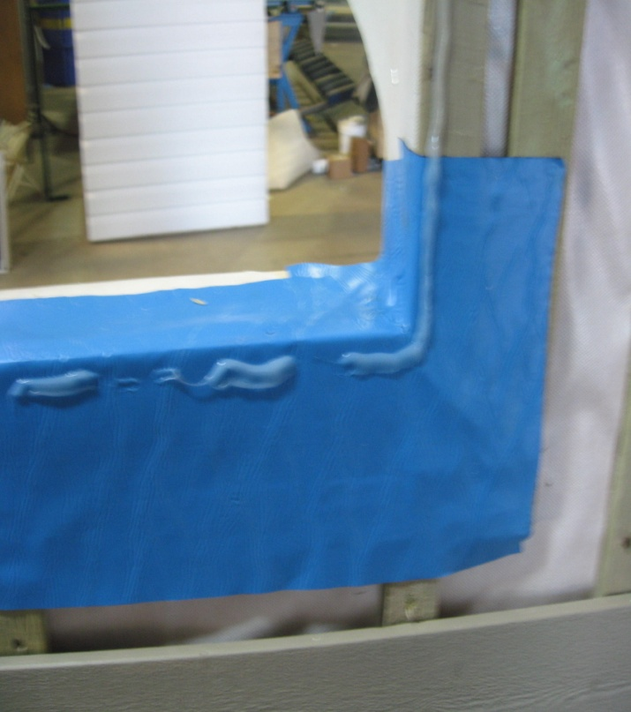
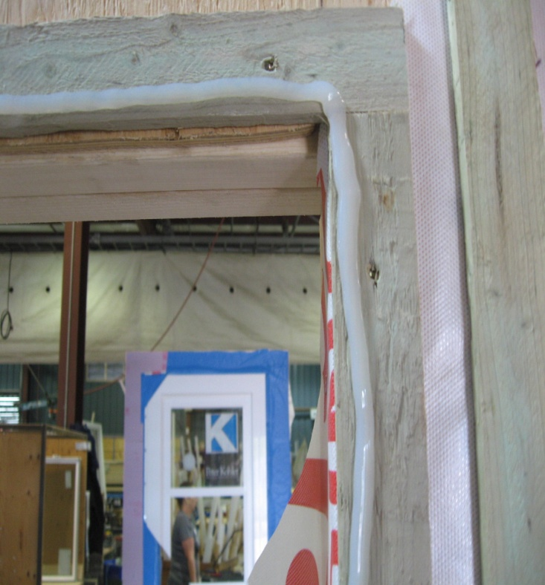
Remove packaging material, shipping blocks, etc.
The windows must be closed and locked before placing into opening.
6. Apply a continuous bead of good quality sealant along the jambs and head of the window nailing flange and along the bottom leaving gaps.

Slide 6
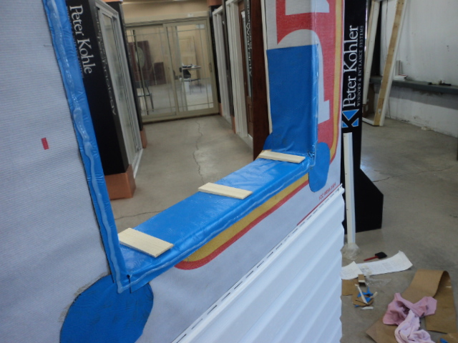
Set shims under sill and at correct locations along jambs.
Note; do not shim above the window. There should be no transfer of load onto the window frame.

Slide 7
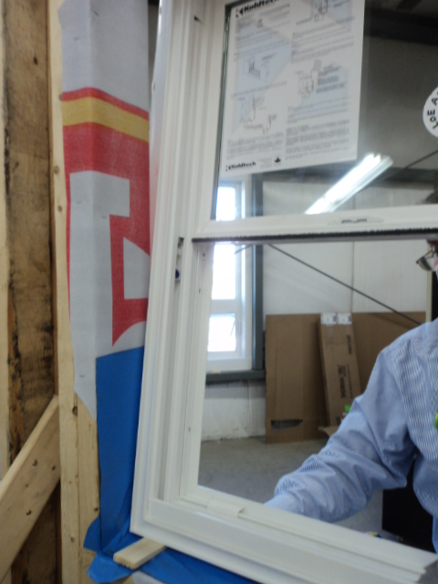
9. Place the sill of the window in the rough opening then tilt the rest of the window firmly into the opening.
Notes:
Roto Hardware VS Truth Hardware. Handle extended

Slide 8
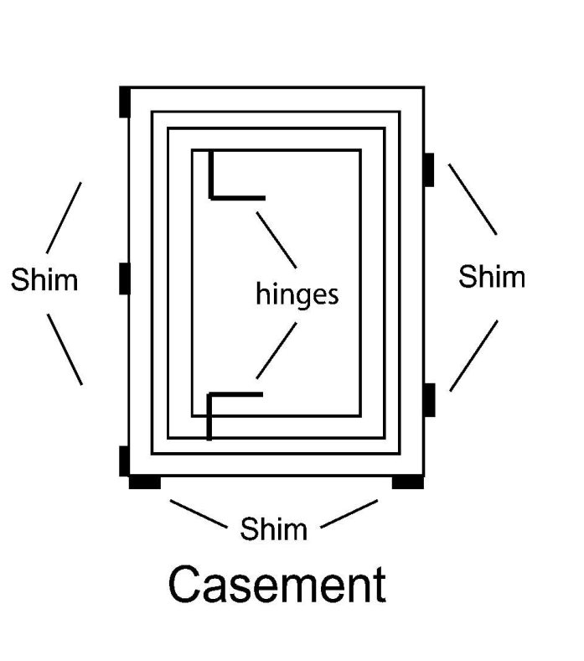
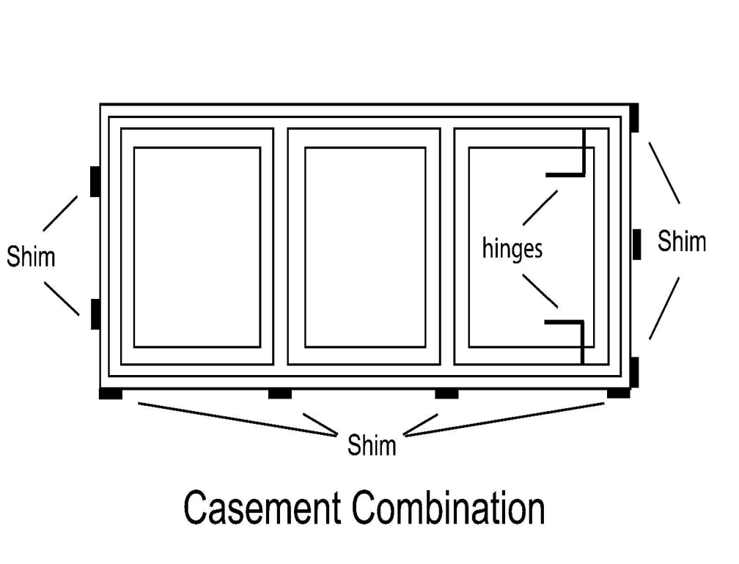
Casement Shimming

Slide 9
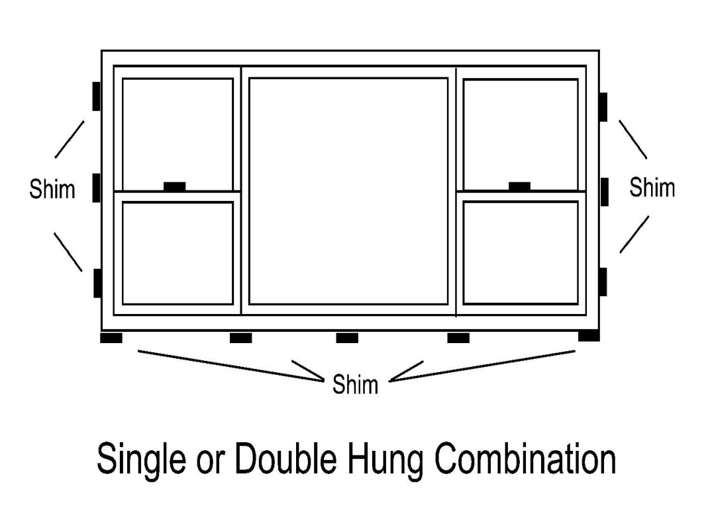
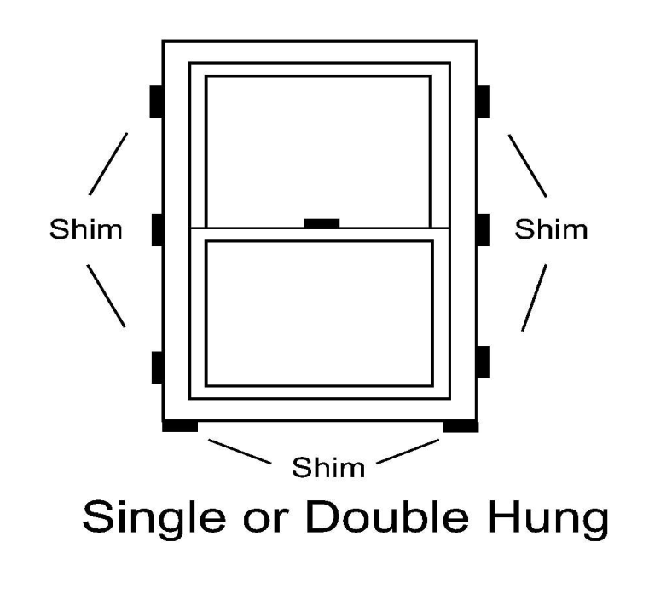
Single/Double Hung Shimming

Slide 10
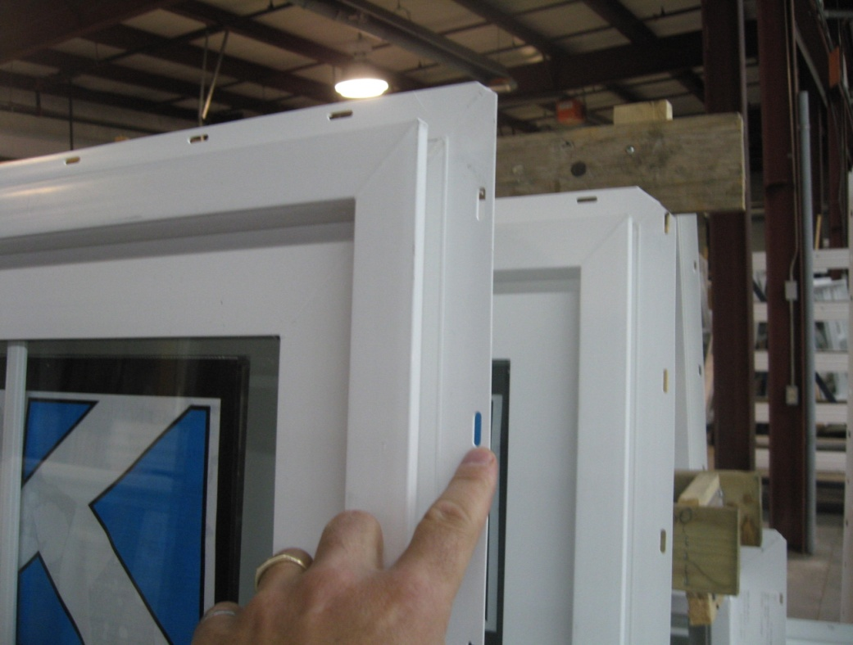
Nail one fastener 4 to 6” from the top corner along one jamb.
Do not drive all the way in.
Check for level, plumb and true. Shim as necessary.
Check that the window operates smoothly.
.
Notes:
Roto Hardware VS Truth Hardware. Handle extended

Slide 11
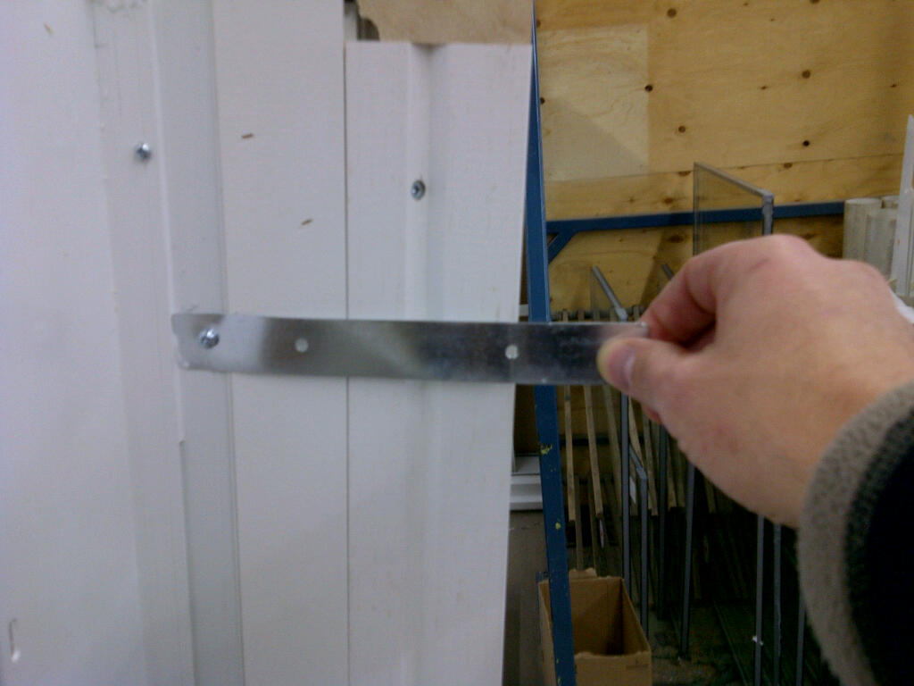
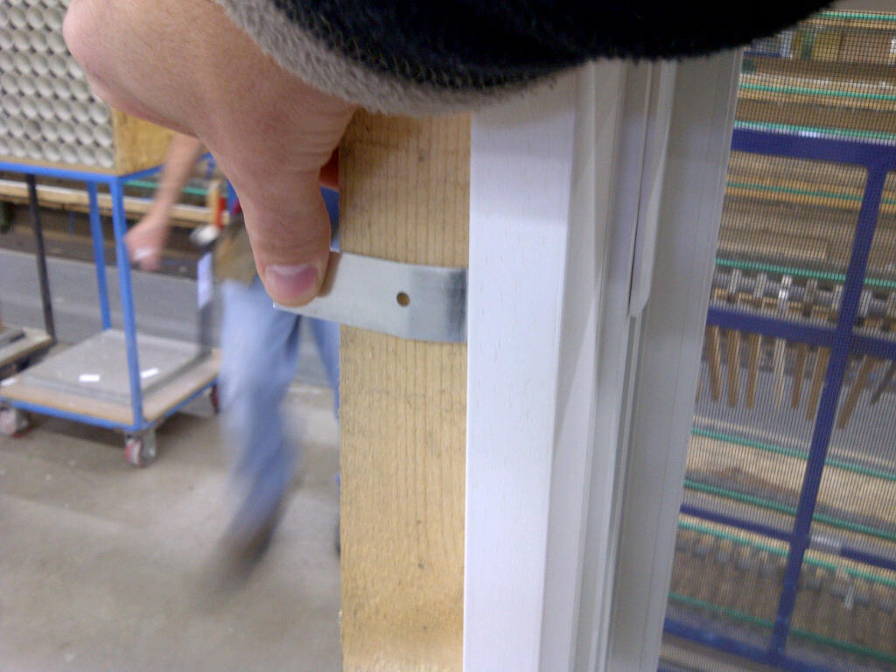
11. Continue to fasten the window in place along the nailing flange.
Note: windows with wide 3 1/2” brickmould or greater are not to be installed by the nailing flange alone.
Anchor screws are to be used in the predrilled installation holes in the jamb of the window or
Install using installation clips provided.
Notes:
Truth Vs Roto handles folded

Slide 12
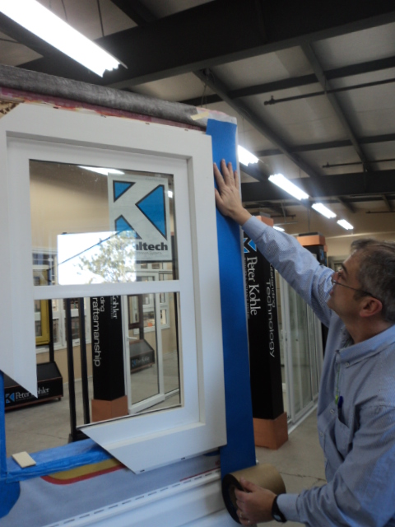
13. Install the jamb flashing over the nailing flange extending 2 to 3” above the head and overlapping the sill flashing by approximately ½”.
Note: do not apply flashing over the sill nailing fin to allow for moisture to escape.
Notes:
Upcharge for fashion colors- $62.00 list. Upcharge for stainless steel hardware- $55.00 list per operator.

Slide 13
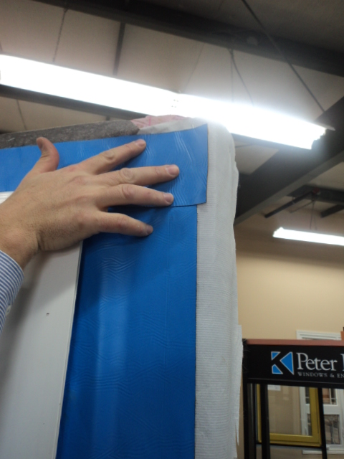
14. Install the head flashing over the nailing flange of the head extending 1” beyond the jamb flashing.

Slide 14
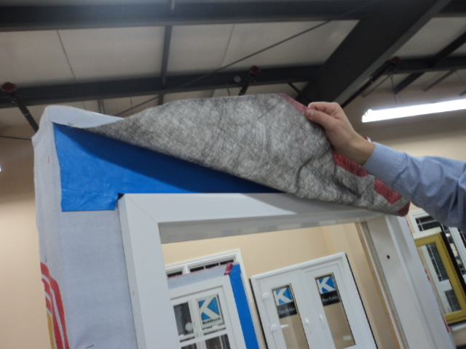
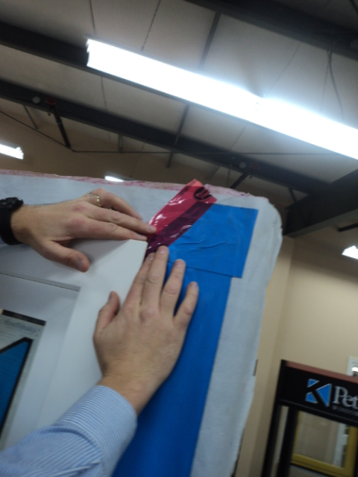
15. Flip the wall cover back over the head flashing and tape in place.

Slide 15
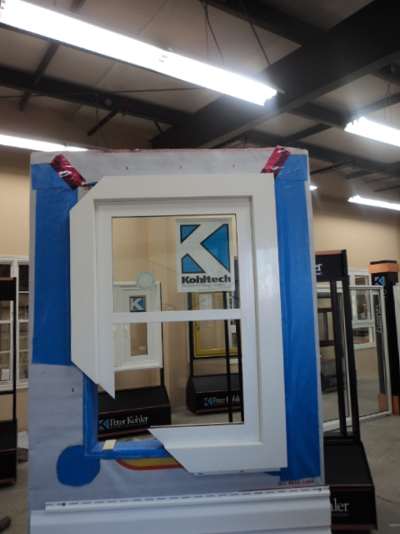

Slide 16
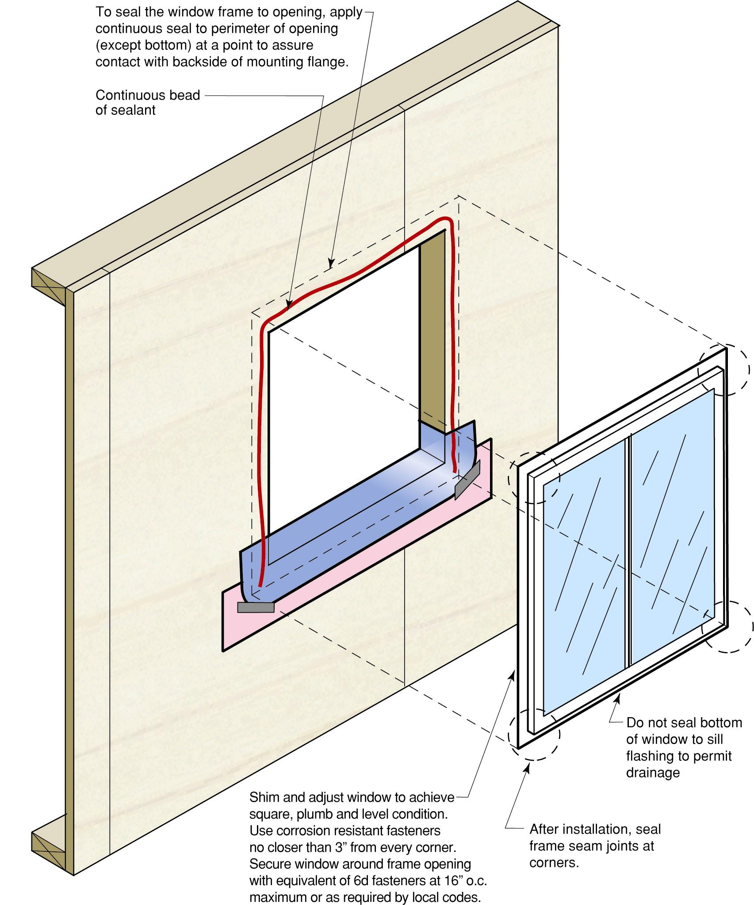

Slide 17
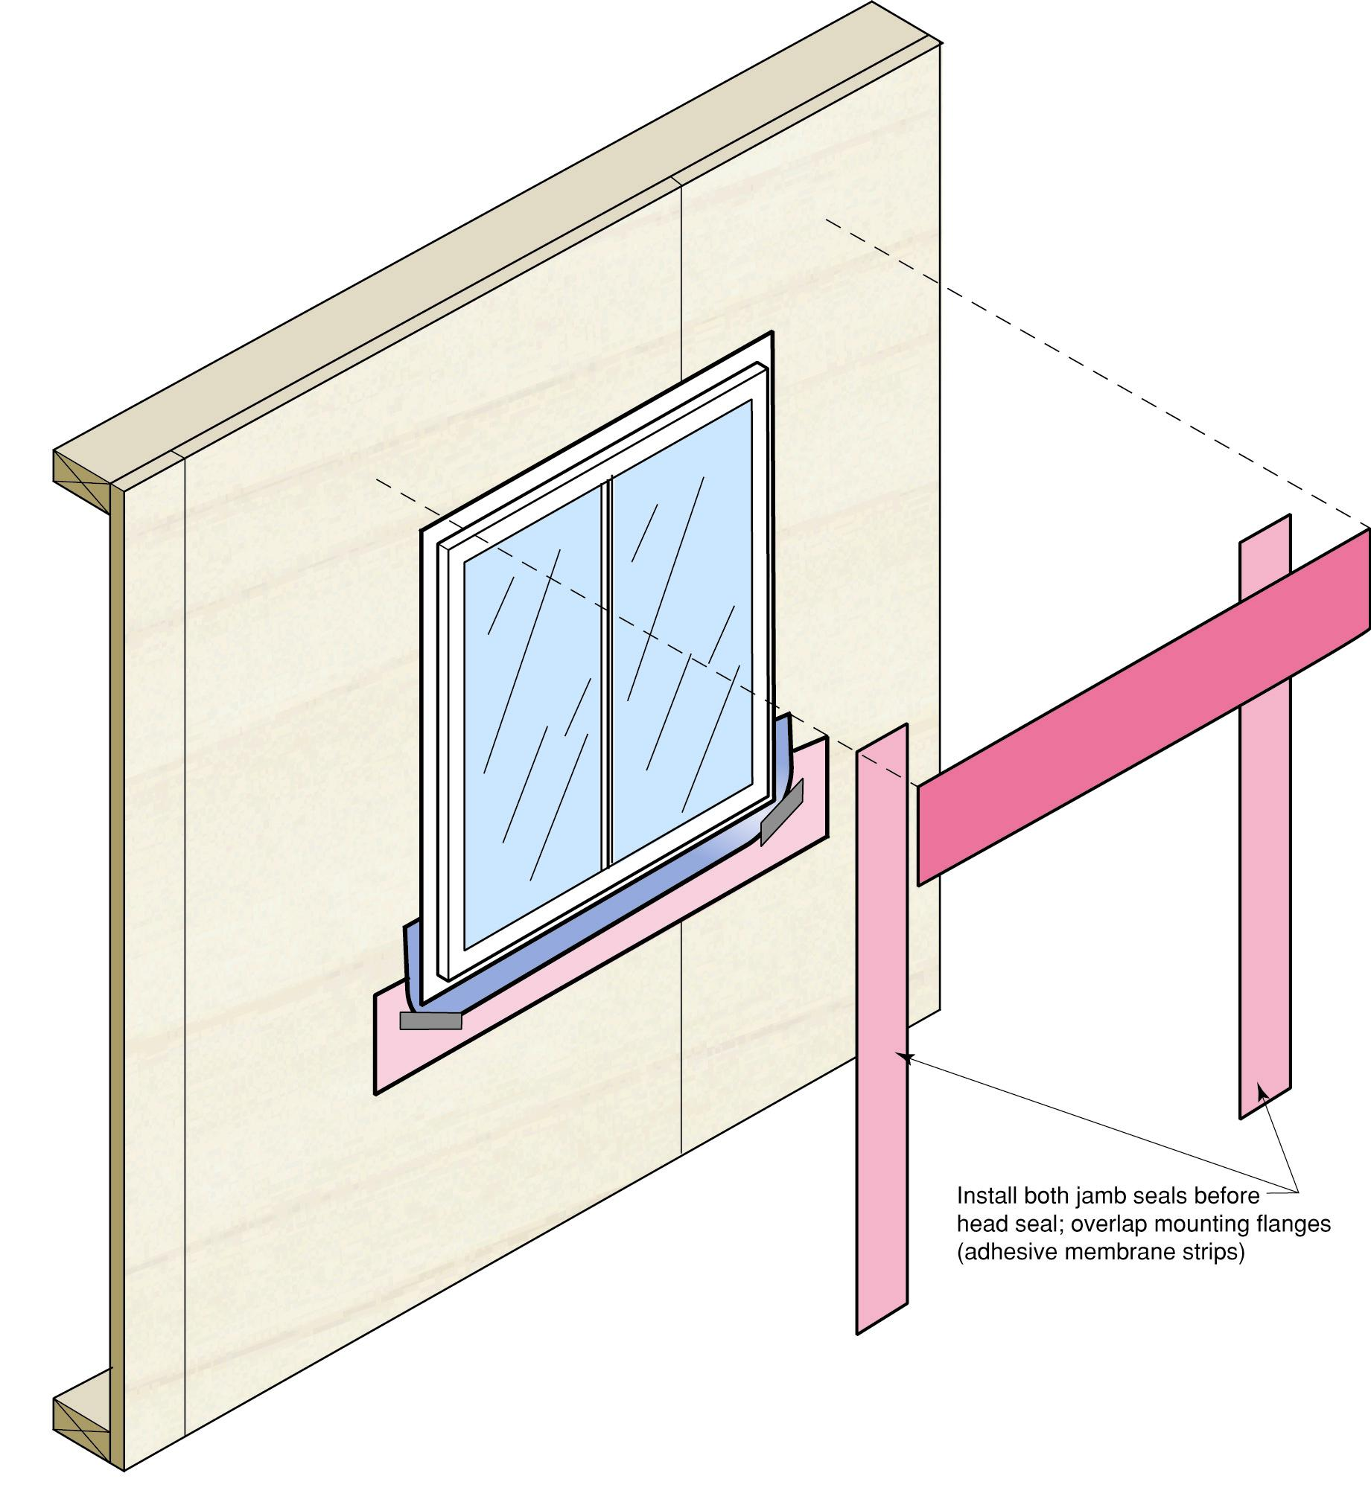

Slide 18
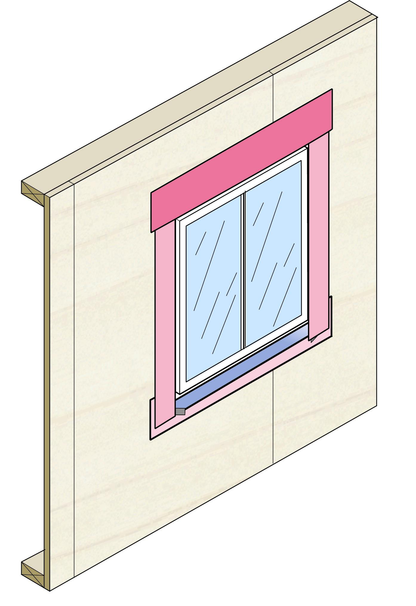

Slide 19
18. Use fiberglass insulation to fill the gap between the window and the framing. Do not overfill.
Note: if using expanding foam, use low expansion foam as this could bow the window jambs and affect the operation of the window.
Notes:
Up-charge for fashion covers- $62.00 list. Up-charge for stainless steel operator- $55.00 list.

Slide 20
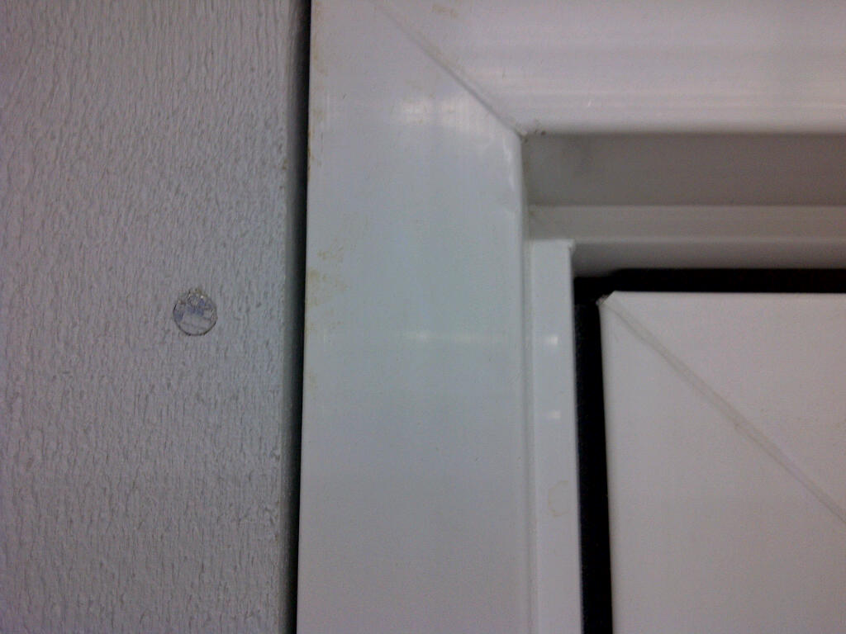
Also ensure there is room for at least a 1/8” expansion and contraction on the external wall between the wall covering and the window trim.
Note: For painted windows, there are air vents drilled into the edges of the window. Do not block these holes.

Slide 21
Retrofit Application:
For a casement window,
If there is no nailing flange, caulk behind the brick mould. Have someone assist you to hold the window firmly in place in the rough opening.
For an operating casement window, screw through the pre-drilled holes in the frame profile.
Notes:
Supreme heavier glazing stop, higher up-stand.

Slide 22
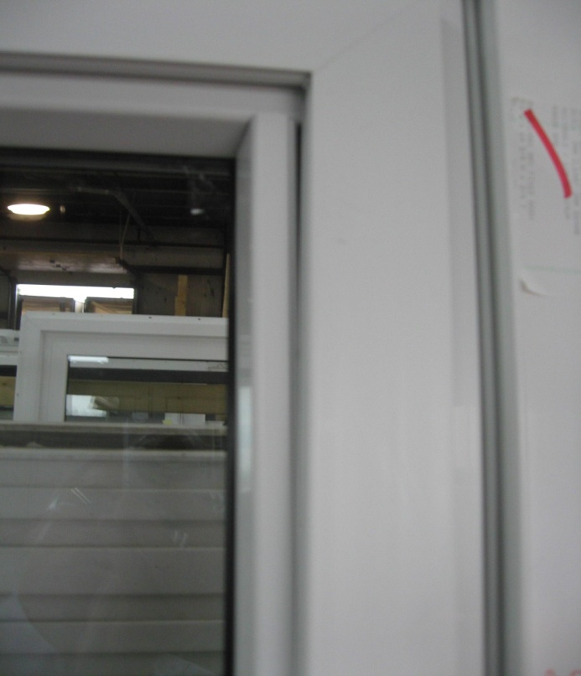
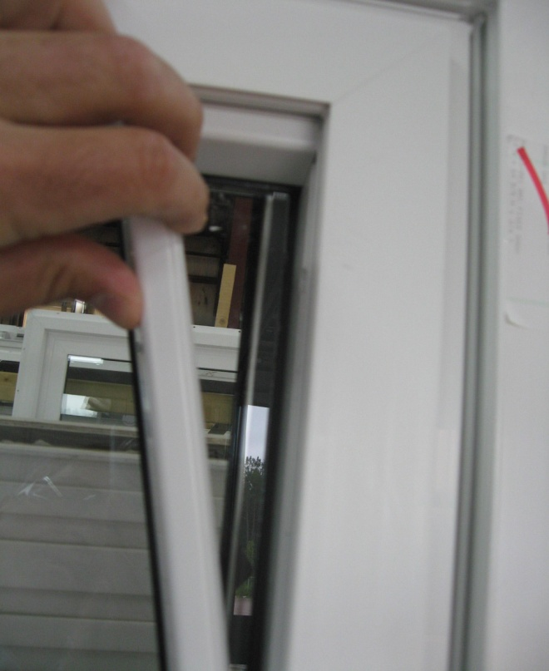
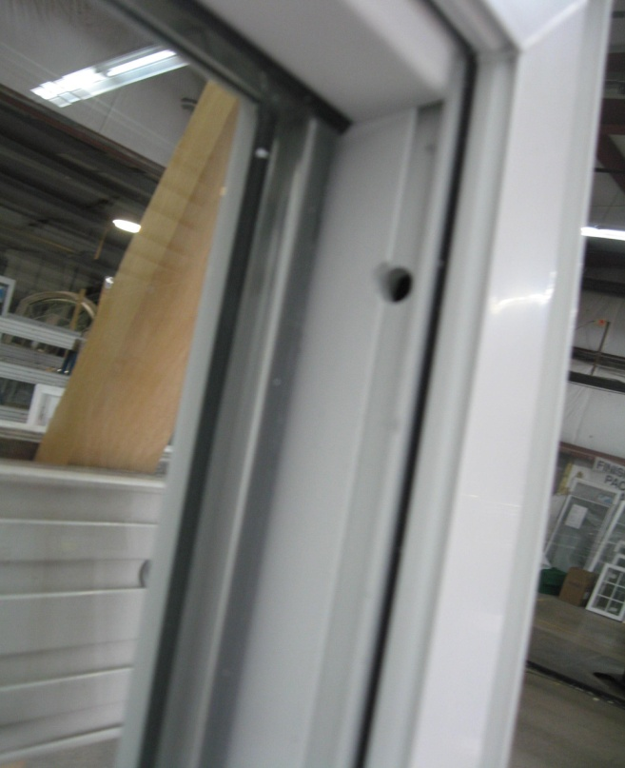
For a fixed Supreme Casement window,
Remove the glazing bead stop and
Screw through pre-drilled holes in the glazing track with screws provided.
Re-install glazing bead stops using plastic mallet.

Slide 23
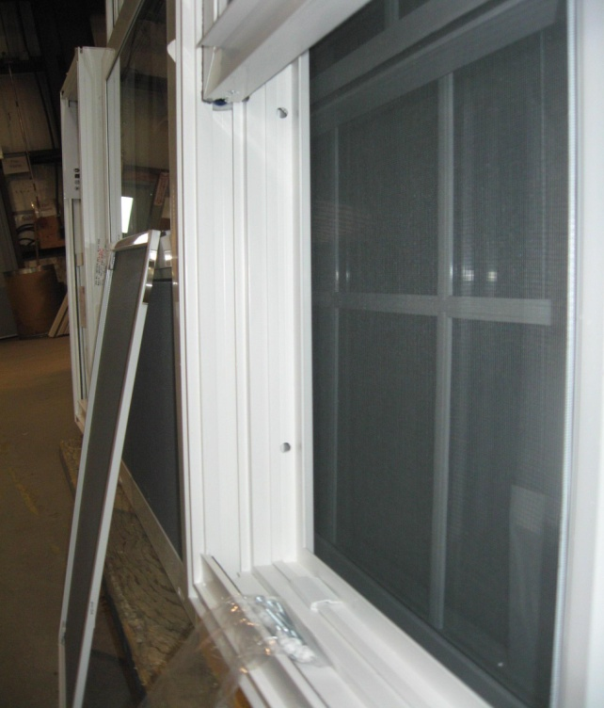
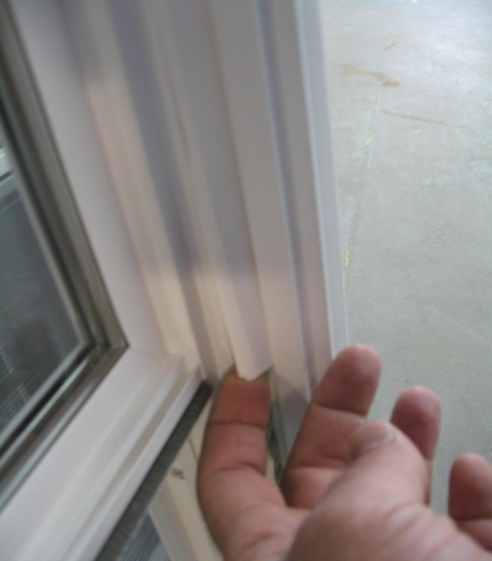
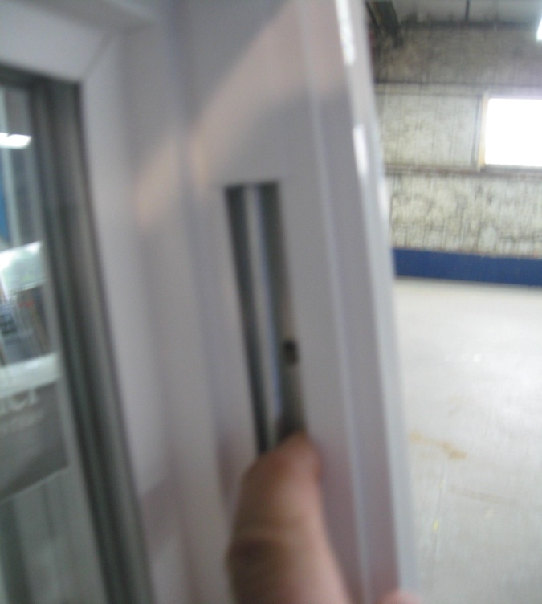
For Single Hung, Double Hung and Glider windows;
Screw through pre-drilled holes in the window jambs.
The bottom holes will be visible in the screen track.
To access the top hole on a hung window, remove the balance cover.
Note: cover the open screw holes with the vinyl screw hole caps provided. Use a dab of caulking prior to inserting the cap to prevent air leakage.

Slide 24
General Care:
Use extra care when installing below 5° C/45°F avoiding impact to frame and sash.
Operating hardware and drainage cavities should be kept clean of obstructions (dust, drywall dust, etc.) and be lubricated annually.

Slide 25
Questions?

