Slide 1
EVOLUTION OF VINYL WINDOW EFFICIENCY
Passive House and Net Zero Progress

Slide 2
Learning Objectives
Understand the Evolution of the uPVC Vinyl Window
Explore Sustainable Window Solutions
Discover Highly Efficient Vinyl Windows to Present Day Design Demands

Slide 3
Index
Evolution of the uPVC Vinyl Window
Sustainable Window Solutions
Performance Testing
Passive House – PHIUS
Net Zero
Noise Abatement through window choice
Vinyl Window Adaptation to Present Day Design Demands
Case Studies

Slide 4
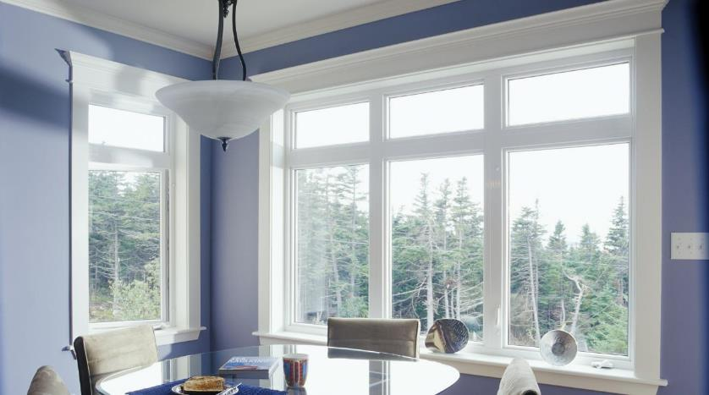
Evolution of the uPVC Window

Slide 5
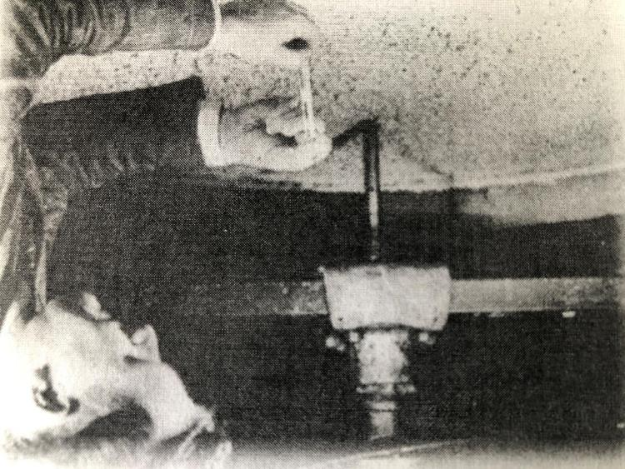
The Origins of uPVC
Searching for a synthetic alternative to rubber, Dr. Waldo Semon of B.F.Goodrich® formulated the first PVC polymer in 1926

Slide 6
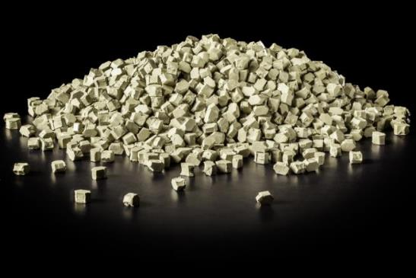
In Germany, manufacturers were looking for alternative synthetic materials due to the scarcity of raw materials following the war.
Manufacturers began introducing a vinyl window in the US in the mid 50’s but their designs were small and bulky.
Raw synthetic PVC pellets

Slide 7
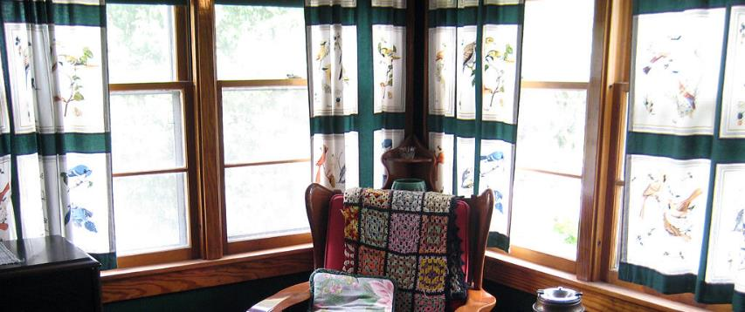
The B.F.Goodrich® company decided to launch vinyl windows in the late 50’s.
They emulated the popular wood and aluminum designs.

Slide 8
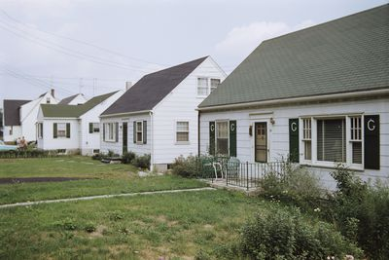
The designs were sleek, better sight lines and more aesthetically pleasing but did not catch on immediately.
Vinyl was still viewed as a plastic in North America and therefore less appealing.
It was not until the early 80’s that vinyl windows really took off
The advent of a global oil embargo put more emphasis on energy efficiency in homes.
The price of aluminum also skyrocketed.
Old Vinyl WIndows

Slide 9
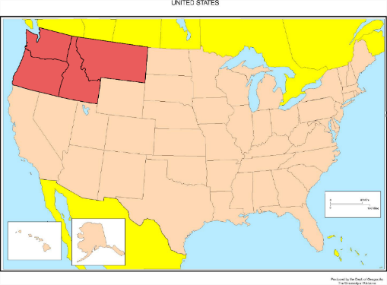
The US Northwest was one area to kickstart the movement
A power planning council for Oregon, Washington, Idaho and Montana were looking for alternatives to adding new power generation capacity
The council developed new energy conservation standards, including energy efficiency requirements for windows

Slide 10
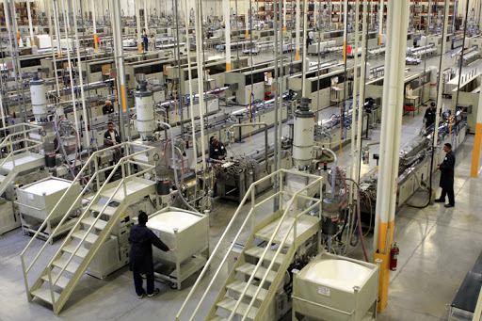
Advances in the vinyl composition and manufacturing process have made a window that is:
Virtually maintenance free
Uniform and consistent product

Slide 11
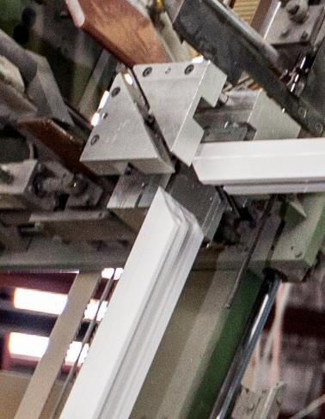
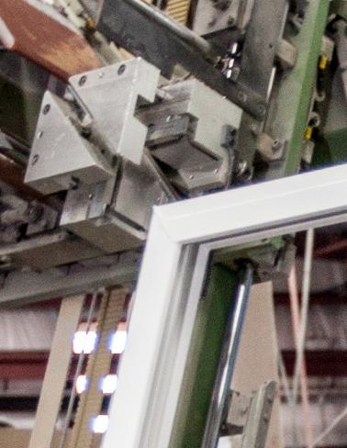
The introduction of welded corners improved the structural integrity compared to the standard mechanically-fastened joints.

Slide 12
It has also resulted in the creation of a long lasting product where companies are offering up to 30 years to lifetime warranties.

Slide 13
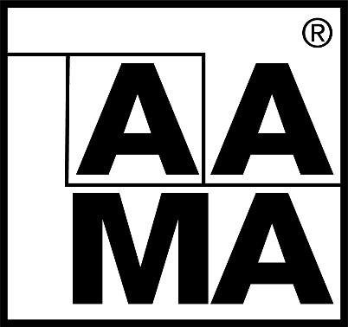
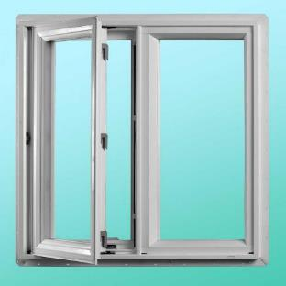
AAMA (American Architectural Manufacturers Association) launched the window-certification program in 1985.
It has been embraced by most North American vinyl window manufacturers and endorsed by the International Residential Code which now requires vinyl windows to be certified.

Slide 14
In 2020 AAMA and IGMA (International Glass Manufacturing Alliance) merged into one organization; the FGIA (Fenestration & Glazing Industry Alliance).

Slide 15
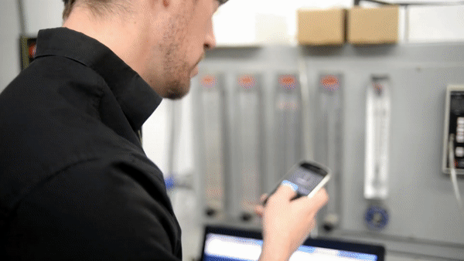
To obtain AAMA certification a vinyl window must pass the following criteria:
Impact resistance, dimensional stability, heat resistance, weight tolerance and colorfastness.
Must also survive outdoor weathering tests for up to 2 years

Slide 16
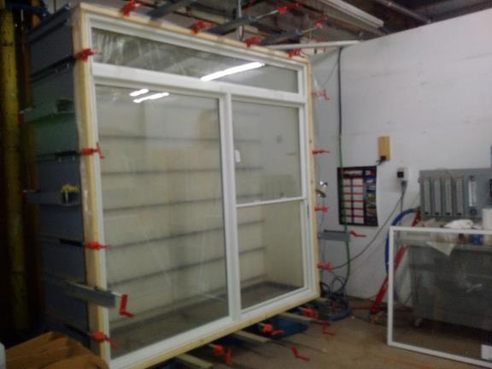
Assembled windows are also tested for structural performance under wind loading, air leakage, water penetration and forced entry

Slide 17
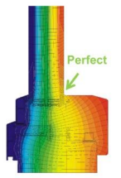
The evolution of the materials and process also allowed for the creation of more energy efficient windows.
Much lower conductivity compared to aluminum.

Slide 18
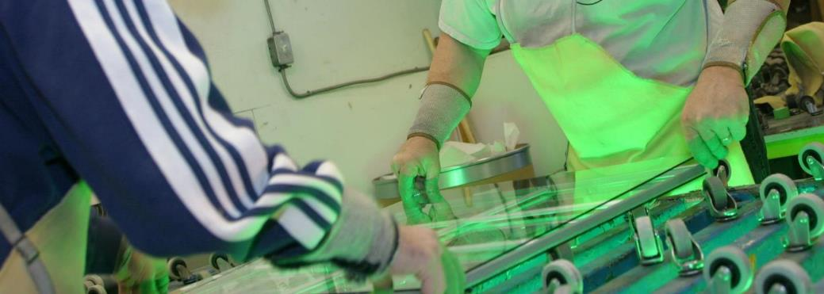
Evolution of the sealed glazing units vs a single pane unit was a significant improvement for energy efficiency.

Slide 19
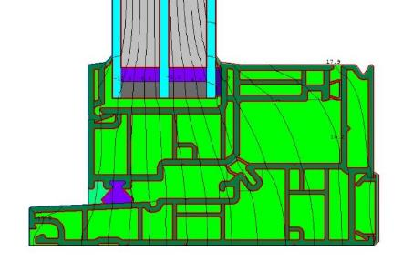
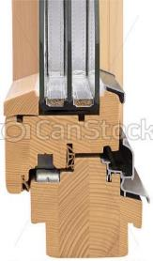
Chambered frame and sash extrusions adding strategic insulated compartments.
Air acts as an insulator and is beneficial for thermal properties
Vinyl Window Cross Section
Wood Window Cross Section

Slide 20
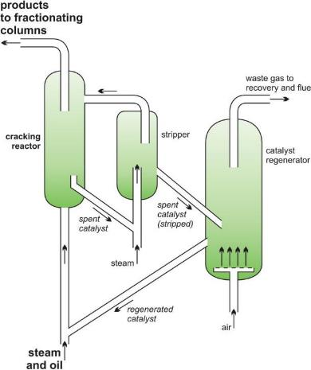
Sustainable Window Solutions
What is uPVC?
“u” means “unplasticized” – plasticizers made windows unstable.
PVC (polyvinyl chloride) is a plastic material produced by combining salt and oil derivatives.
essentialchemicalindustry.org

Slide 21
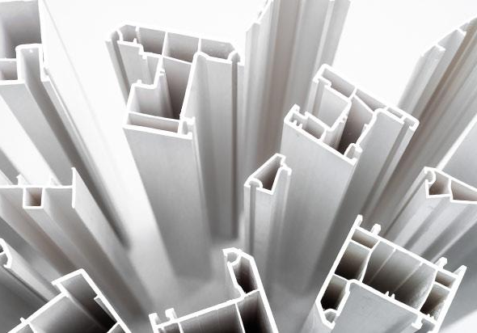
Green Credentials of PVC
PVC is made of plentiful natural resources (salt and ethylene) → Low stress on environment and energy sources

Slide 22
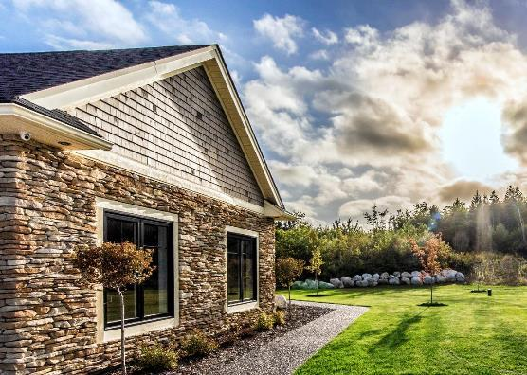
Green Credentials of PVC
Un-plasticized (uPVC) → minimal gas emissions → environmentally safe (Alliance for Sustainable Building Products, uPVC Windows through the life cycle.)
uPVC is recyclable

Slide 23
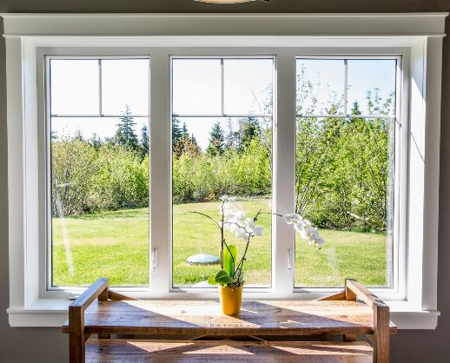
Green Credentials of PVC
uPVC is difficult to ignite and is self extinguishing
Proven resistance to UV degradation → maintains structural integrity → extended service life → less waste → low stress on environment

Slide 24
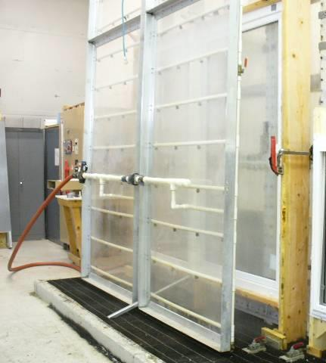
Performance Testing
uPVC windows have certified ratings available up to CW-PG100 for operating windows
The ability to use different mullion reinforcements → scale performance
Note: new NAFS (North American Fenestration Standard) use the all encompassing PG – performance grade vs the DP – design pressure

Slide 25
uPVC Windows are typically factory assembled and glazed with full time permanent trained employees → Better quality
Fusion welded corners instead of mechanical joints → Better weatherability
uPVC profile → Better at adapting to house movements over time
Many forward thinking manufacturers do have their own in-house testing equipment → Better reliability

Slide 26
Windows are efficient with respects to;
Air tightness
Limiting Radiant heat loss/gain
Limiting Convection heat loss/gain

Slide 27
Window are efficient by being;
Air tight
Inherent design
General order of most air tight to least:
Casement/Awning > Single Hung > Double Hung > Slider

Slide 28
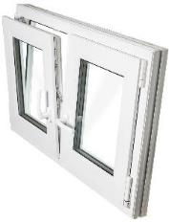
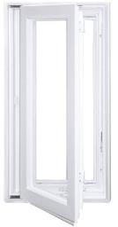
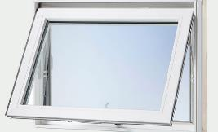
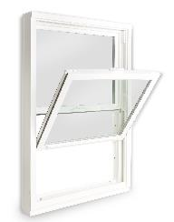
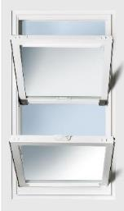
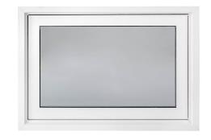
Available Configurations
3
1
2
Windows:
Casement
Awning
Tilt Turn
Fixed
Single Hung
Double Hung
5
6
4

Slide 29
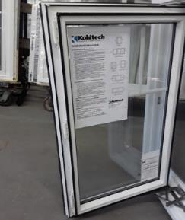
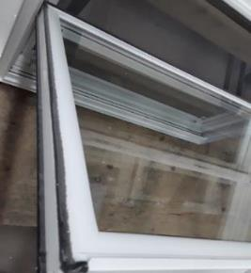
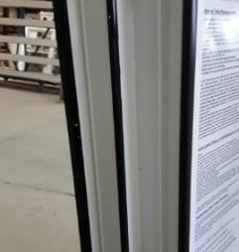
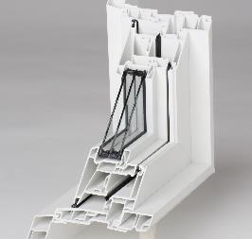
Weatherstripping provides a good seal medium:
Positive contact
Important to have engagement between surfaces
Weatherstrip can be:
Felt (better for slider surfaces)
bulb seal (good for compression contact)
Often window designs will incorporate 1, 2, or 3 perimeter points of contact using both felt and bulb seal

Slide 30
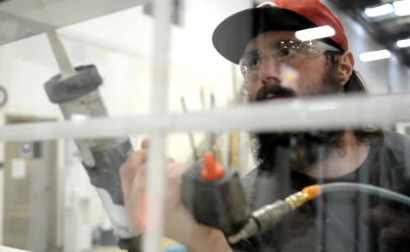
Glazing technique can impact air infiltration. 3 glazing techniques include:
Glazing tape; butyl back tape applied to glazing surface, must be sealed in cut corners
Sealant bead; applied wet, size of bead can vary
Compression seal; forcing the glazing stop in place compresses the glass to the frame material

Slide 31
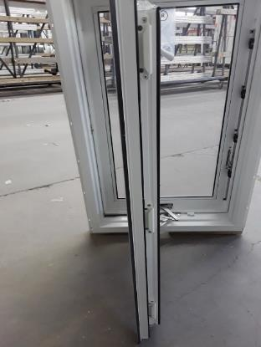
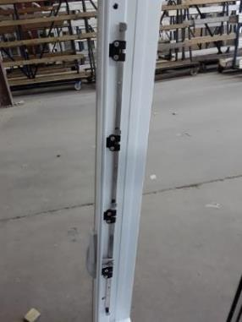
Locking mechanisms can also positively affect air tightness
Multiple locking points engages more of the perimeter of the sash
locking points are evenly spaced along locking edge and snubbers (anchor pins) spaced along hinge edge
Notes:
Anchor pins and snubbers should be adjustable to shift as building shifts over time.

Slide 32
Blower Door Test Used to measure building envelope air tightness.

Slide 33
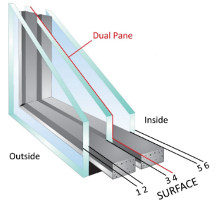
Limiting Radiant Heat Loss/Gain
Dual pane vs triple pane makes a difference as well as the thickness of the actual panes
Note: Switching from dual to triple glazing in a vinyl window keeps the same frame, it is simply done by using a different glazing bead, not a complete window change
- Assuming the window is designed to accommodate a deeper glazing package
Notes:
Condensation

Slide 34
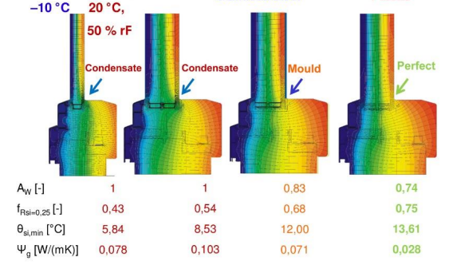
Radiant Heat loss leads to other issues
such as moisture. This can be reduced by:
Greater air space
Inert gas
LoE coating
Low Solar Gain coating
Triple glazing
Added Energy Efficiency options
Passive House Institute – Building Certification Guide

Slide 35
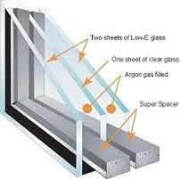
LoE (low emissivity coatings)
Low solar gain or high solar gain; number of coatings & surface placement
Not all coatings are alike
Glazing spacer material conductivity
Inert gas in glazing cavities
Air, Argon, Krypton
Frame material
Chambered vinyl (air) and fiberglass have higher R value than wood
Two Sheets Low-E Glass
One Sheet Clear Glass
Argon gas filled
Silicone Spacer

Slide 36
Growing trend towards triple glazing in commercial developments:
1 3/8” deep insulated glass units with 2 LoE surfaces and both cavities argon-filled can double the R value for the whole window.
Glass Option | Energy Rating | U-value (metric) | U-value (imperial) | R-Value Whole Window | Solar Heat Gain Coefficient
Clear | 18 | 2.3 | 0.41 | 2.44 | 0.51
Dual Pane – LoE x1 & Argon | 31 | 1.6 | 0.28 | 3.57 | 0.46
Triple Pane – LoE x2 & Argon x2 | 40 | 1.0 | 0.18 | 5.56 | 0.40

Slide 37
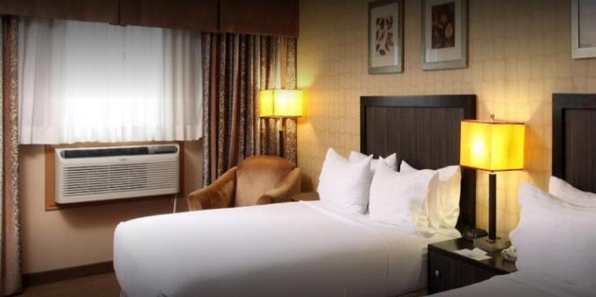
Upfront savings on HVAC systems can be greater than the cost of the triple glazing upgrade.
The annual energy savings and sound abatement are added benefits

Slide 38
Radiant Material Transmission Comparison
Material | K (Conductivity)
 | W/m.K | Btu/hr.ft.F
Pine | 0.14 | 0.081
Vinyl | 0.17 | 0.098
Fiberglass | 0.30 | 0.173
Glass (float) | 1.0 | 0.578
Stainless Steel | 17 | 9.8
Aluminum | 160 | 42.4
Notes:
Solid states shown – windows are chambered
In chambered windows – vinyl has better has conductivity than Fiberglass

Slide 39
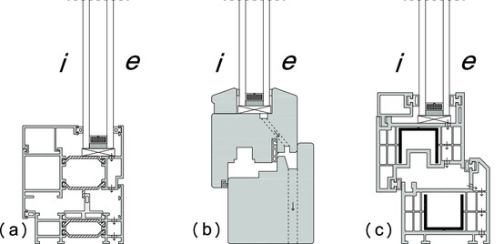
Window Type Comparison
Aluminum
Wood
cPVC
Fiberglass
Notes:
Solid states shown – windows are chambered
In chambered windows – vinyl has better has conductivity than Fiberglass

Slide 40
Limiting Convection Heat Loss/Gain
uPVC Vinyl Windows are efficient by preventing Convection heat transmission
Sheltering the window glass surface:
Pushing the glazing plane further into wall cavity
Insert window frame into window buck
Add deep exterior casing to window providing a positive seal to the window frame and casing flange to sheathing surface
Notes:
Convection – wind up against the glass causing heat loss/gain

Slide 41
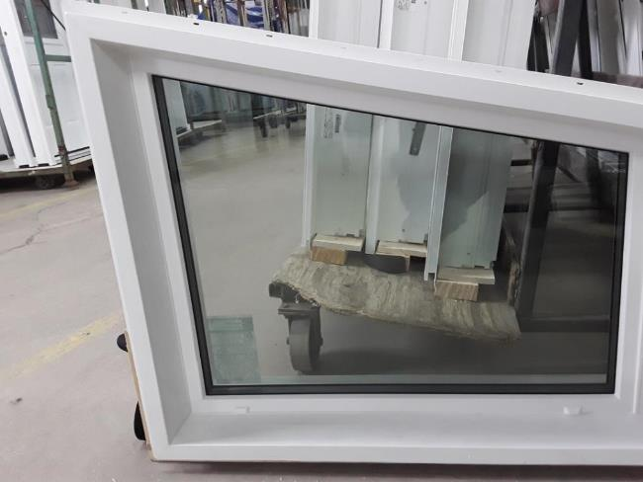
Deep exterior jamb sealed to window frame pushes window glazing plane further into wall cavity

Slide 42
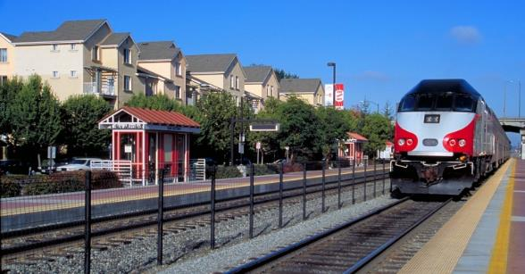
Sound Abatement
Air, rail, and highway traffic and associated noise is on the rise
It is important to match the performance of windows and doors with that of the wall since sound transmission finds the weakest path

Slide 43
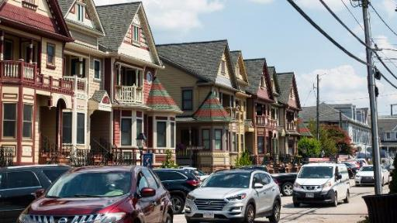
STC (Sound Transmission Class) ratings have been widely used to define requirements, but OITC (Outdoor Indoor Transmission Class) is being considered to replace it in the long term
High performance uPVC windows and doors can deliver excellent sound abatement
Notes:
Triple Glaze -Mid-to-High 30s STC Rating
Laminating and glass thickness has effects on STC rating

Slide 44
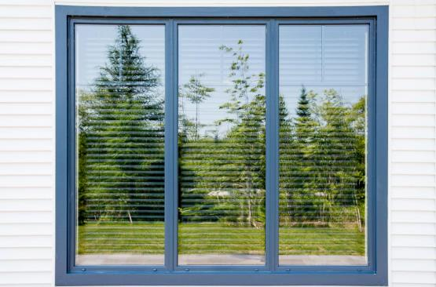
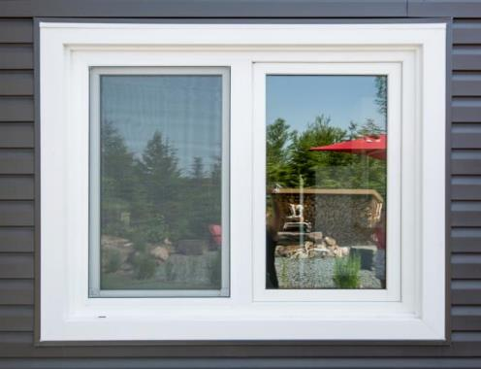
Adapting High Efficiency Windows to Designer Needs
Casing/Brickmould Options
Notes:
Integral J-Trim Cross Section – can be cut

Slide 45
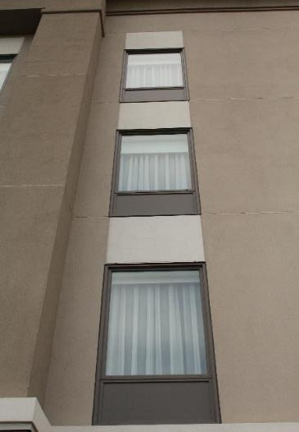
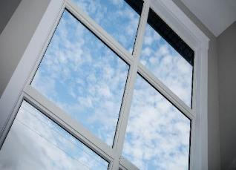
Glazing options
Satin deco, pin head, rain glass, spandrel
Tempered, laminate
Grilles, Simulated Divided Lite
PTAC Louvers

Slide 46
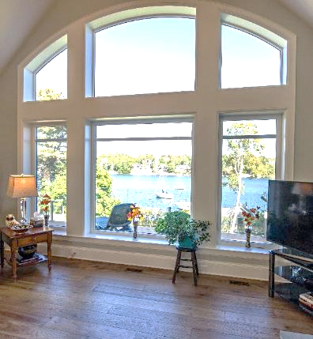
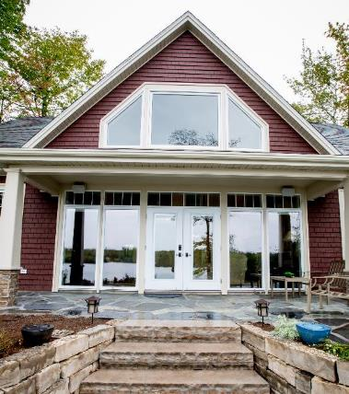
Shapes + Sizes
Interior Extensions

Slide 47
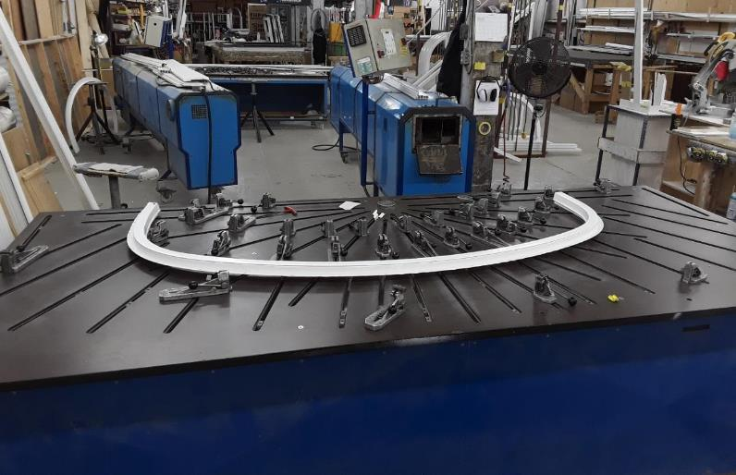
Modern uPVC Profile Bending Equipment

Slide 48
Color Options
Historically uPVC windows were available mainly in white or tan extrusions
The advent of waterborne polyurethane coating processes for uPVC windows have created a rapid growth in demand for color
ASTM Specification

Slide 49
The coating chemically bonds to the PVC providing superior adhesion and durability

Slide 50
Heat reflective properties allow a full range of standard colors including dark greens and blacks for all openings

Slide 51
Cladded windows do have varied results due to dissimilar material reacting differently to temperature swings as well as moisture build up behind the cladding.

Slide 52
Passive House (Passivhaus) - PHIUS
The term Passive House refers to a rigorous standard for energy efficiency in buildings.
The standard first originated in Germany in 1988 and has now spread across many countries worldwide.
Milestone attained in 2018; more than 1 million sq.ft of PHIUS certified and pre-certified projects across North America

Slide 53
Three rigorous building standards to be eligible for Passive House Certification, along with several recommendations:
Annual heating and cooling demand of not more than:
4,755 BTU/sq.ft per year in heating or cooling energy
OR
Be designed with a maximum peak heat load 0.929 W/sq.ft.
Sample PHIUS Window Label

Slide 54
The total primary energy (source energy for electricity, etc.) consumption (primary energy for heating, hot water and electricity):
Must not be more than 38,040 BTU/sq.ft per year.
Example : average US home, based on same size, consumes 43,600 BTU/sq.ft.yr

Slide 55
EIA. 2015 Residential Energy Consumption Survey

Slide 56
The building must not:
Leak more air than 0.6 times the house volume per hour (n50* ≤ 0.6/hour) as tested by a blower door
OR
Alternatively, when looking at the surface area of the enclosure, the leakage rate must be less than 0.05 cubic feet per minute.
n50: air leakage unit at 50 pascals
PHIUS Guidebook: https://www.phius.org/PHIUS+2018/PHIUS+%20Certification%20Guidebook%20v2.0_final.pdf

Slide 57
Caution: Ensure products that help contribute to Passive House certification also meet local, state and national building codes.

Slide 58
Passive House Installation Consideration
Installation important considerations
Ensure the glass plane is in line with the major insulating plane of the wall assembly
Anchoring around the centroid of the window.
Proper flashing and air sealing is a must.

Slide 59
Net Zero
A Net Zero home produces its own energy locally and should aim to produce at least as much energy as it consumes.
Likely needs to incorporate renewable energy source like solar power.
Some areas offer energy buyback programs.

Slide 60
The four essential components when considering Net Zero structure, in order:
Passive Solar Design, orientation of structure to take advantage of the sun
Energy efficient exterior building envelope
3. Efficient electrical, heating, and ventilation systems
Smart, efficient design
4. Electrical generation design
Alternate energy source

Slide 61
Building Envelope
After orienting your structure, the efficiency of the building is the next most critical step
With a Net Zero home, the building envelope must be highly efficient.
Areas such as doors, windows, the attic, the foundation, and the exterior walls, must be properly sealed with a high R-value and low air leakage through cracks & gaps. This ensures the home uses every unit of energy to its maximum potential.
Most wall assemblies are thicker than standard construction. Careful considerations need to be made to balance cost and efficiency.

Slide 62
Case Studies
Creekview
Parris Terrace
Halifax Project
Loewen window project

Slide 63
Creekview Apartments
Location: Canandaigua, NY
12 multi-family residences
PHIUS Certified
Casement Windows
U=0.15
Air Tightness
0.047 cfm50/ft²
HERS = 49
Architect: Glasow Architecture
Consultant: Sustainable Comfort
Builder: DiMarco Constructors

Slide 64
Parris Terrace
Kaplan Thompson Architects
Repurposing Portland ME industrial area
Use of “Passive House Technologies”
Overall energy use 50% of typical apartment building
uPVC Casement and fixed windows
Dual glazed
Black painted exterior, non-painted white interior

Slide 65
Halifax Saltstone Project
Passive House and Net-Zero Certified
Triple-Glazed Casement/Fixed Windows
Windows painted black both exterior & interior
Window glazing tuned per cardinal direction
R-Value doubled Code
Air Tightness of 0.41ACH @ 50 Pascals

Slide 66
Vermont Colonial
Haynes & Garthwaite Architects
uPVC Casement windows, simulated Double Hung
Total R value = 5.55

Slide 67
This concludes the formal part of the AIA presentation. Questions?

